Slide 1
Data Breach Occurrence
Yangsu Kim
Chief Counsel,
Illinois Department of Transportation

Slide 2
Webinar Housekeeping Items
This webinar is being recorded.
If you have questions, please type them into the Q&A feature at the bottom of the screen.
There will be time at the end for questions from phone callers. If you’re calling in and wish to ask a question at that time, please raise your hand by pressing *3.
Questions will be answered at the end of the webinar.

Slide 3
The Breach Occurrence
WHAT …
happened – an IDOT employee inadvertently placed a file in InsideIDOT without the proper access permissions
was exposed: your SSN and, depending on your date of hire, your employee identification number
WHO was affected by the breach?
All current and former IDOT employees
WHEN was the breach discovered?
April 14;
Data had been visible from April 6, 2022 through April 14, 2022
WHERE was the file located?
Internal IDOT website called InsideIDOT
HOW could someone see my information?
InsideIDOT has a search box, similar to an internal Google search box, and if a user entered an employee’s full name, the search results may have included your first and last names, your SSN, and potentially your EID.

Slide 4
What did IDOT do after the breach?
Removed file upon discovery
Limited access to authorized staff
Analysis of cause and risk
Notices: General Assembly, Attorney General, Credit Reporting Agencies, and Potentially Affected Individuals

Slide 5
PROTECTING YOUR IDENTITY
Get Your Credit Report
Confirm the information is correct
Are your prior addresses correct?
Is your name correct, including any past names, such as maiden names?
Is your Social Security Number correct?
Are there any credit accounts that don’t look familiar?
Are the balances for your accounts correct?
Contact the credit bureaus if any information is incorrect
Equifax | Experian | TransUnion
888-378-4329 | 888-397-3742 | 833-395-6938
www.equifax.com | www.experian.com | www.transunion.com

Slide 6
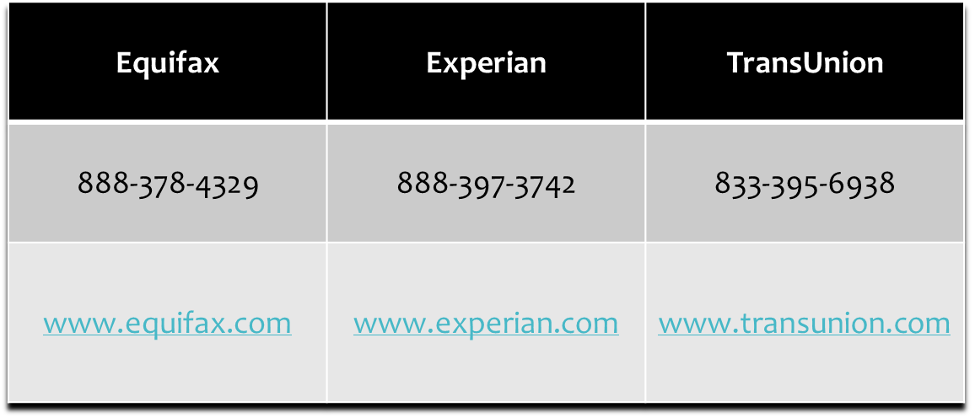
PROTECTING YOUR IDENTITY
Credit monitoring – each bureau is required to provide you with a free credit report yearly.
Stagger your requests for every four months to get a complete year of monitoring for yourself.
Many credit card and banks offer credit monitoring as part of their suite of services for consumers.

Slide 7
PROTECTING YOUR IDENTITY
Put a FRAUD ALERT on your credit – sends a lender a notification that you have a fraud alert on your credit and requires the lender to take certain steps to confirm your identity.
Temporary – 1 year
Active-duty – 1 year and renewable to match duration of deployment
Extended – 7 years
You only need to contact one bureau; that one will contact the other two bureaus.

Slide 8
PROTECTING YOUR IDENTITY
Put a CREDIT FREEZE on your credit – new lenders cannot see your credit report so new accounts in your name can’t be open until the freeze is lifted.
Lifting the freeze requires you to use a special password-protected account or PIN.
You will need to contact each bureau to put a freeze on your credit
Credit freezes are governed by federal law. Each bureau also offers commercial products that act similarly to a credit freeze.

Slide 9
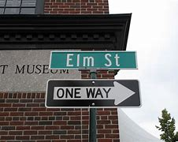
PROTECTING YOUR IDENTITY: Digital Hygiene
Change your password on a regular basis
Do not use a password you will forget
Do not use a sports team name or pop culture references
yankees
superman
Do not use passwords with information that can be gleaned from your credit report
birthdates
maiden name
prior street names
Choose a password that is difficult for someone to guess. The most common passwords include:
123456
123456789
qwerty (first 6 top letters on a keyboard)
password

Slide 10
PROTECTING YOUR IDENTITY: Digital Hygiene
Social Media
Use a different name, if possible
Do not post photos of you or your loved ones
Do not post personal information about yourself; maiden name, location, alma maters
Two-Factor Authentication
Use a different cell phone number or email method that is separate from your primary number or email
Verify Authenticity of Emails Asking for Personal Information
Do not ask the sender if the email is legitimate

Slide 11
Questions?
Yangsu Kim – Chief Counsel, IDOT
yangsu.kim2@illinois.gov

