Slide 1




Find Your Opportunity.
Work.Illinois.Gov

Slide 2

Find Your Next Opportunity.
Work.Illinois.Gov

Slide 3


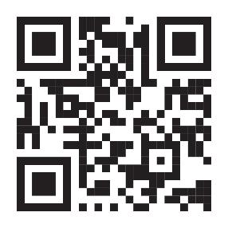
Why Work for State Government?
Desire to contribute and have purposeful, meaningful work
People: work with engaged and passionate individuals
Training opportunities to advance your skills
Enjoy work/life balance, great vacation and benefits
Career growth potential while maintaining stability
Career opportunities close to home
Find Your Opportunity.
Work.Illinois.Gov

Slide 4






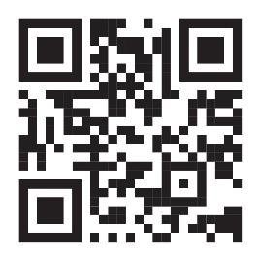
Hot Jobs
Nurses
Healthcare Workers
Information Tech Careers
Corrections Officers
Social Service Caseworkers
Accounting/Finance
Find Your Opportunity.
Work.Illinois.Gov

Slide 5
State of Illinois Employee Perks
Work.Illinois.Gov

Slide 6





Putting All the Pieces Together
Health Related
Benefits
Work Life Integration
Financial Wellness
Professional Development

Slide 7


Health Related
Health Insurance
Dental Coverage
Vision Coverage
Behavioral Health Services
Employee Assistance Program (EAP)
  24/7 free and confidential emotional and crisis support
Personal Support Program (PSP)
Medical Care Assistance Program (MCAP)
Dependent Care Assistance Program (DCAP)
Health Savings Account (HSA)
Flu Shots
BeWell Wellness Program
Disease Management
Smoking Cessation Program
Weight-Loss Benefit Program
Total Retiree Advantage Illinois (TRAIL)
Find Your Opportunity.
Work.Illinois.Gov

Slide 8


Work Life Integration
37.5 hour work week
Overtime and Earned Equivalent Time
Paid vacation, holidays (13-14 holidays per year, 25 paid days off first year of employment)
Hybrid in-person/remote work schedule potential
Flexible work schedules
My Benefits Plus
Accident Insurance
Critical Illness Insurance
Hospitality Indemnity Insurance
Legal Services
Identify Theft Protection
Pet Health Insurance
Auto and Home Insurance
Purchasing Power
Salary Finance
Rollover vacation and sick time
Sick leave bank
Adoption Benefit Program
Paid Parental Leave
Various Leave Types: Disability, FRL, FMLA, General, Educational, Military, VESSA
Find Your Opportunity.
Work.Illinois.Gov

Slide 9

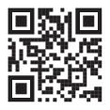
Financial Wellness
Life Insurance
Deferred Compensation Plan
  Tax-deferred contribution
  Roth IRA
Commuter Savings Program (CSP)
Discounts
Education loan forgiveness and reimbursement
State Employee Forgiveness Loan
Retirement with monthly Pension Income
Survivor benefits
Bilingual skills pay
Illinois 529 College Savings
Find Your Opportunity.
Work.Illinois.Gov

Slide 10


Professional Development
Upward mobility program
Paid education and training
CMS University
Veteran’s outreach
Programs for workers with disabilities (DWTP, SD, AE)
Career Progression
Find Your Opportunity.
Work.Illinois.Gov

Slide 11
Health Related Benefits
Work.Illinois.Gov

Slide 12


Health Benefits
Benefits are a very important part of the compensation package as a State of Illinois employee.
Benefits are available to eligible employees and their qualified dependents.
Health Insurance
  State Health Plan Coverage - State Employee Benefits (illinois.gov)
  Health Plan Programs - Health Plan Programs (illinois.gov)
Find Your Opportunity.
Work.Illinois.Gov

Slide 13
Health Plan Administrators
HMO-Health Maintenance Organization
Aetna HMO
OAP-Open Access Plan
Aetna OAP
Blue Cross Blue Shield OAP
HealthLink OAP
BlueAdvantage HMO
BCBS HMO Illinois
Health Alliance HMO
PPO-Preferred Provider Organization
Consumer Driven Health Plan (CDHP) - Aetna PPO
Quality Care Health Plan (QCHP) - Aetna PPO

Slide 14
Co-payments
Physician Office Visit $30
Outpatient Surgery $300
Coinsurance & Deductibles
OAP
Tier II Plan $300 Year Deductible/Enrollee
Coinsurance & Deductibles
Plan Year Deductibles
Specialist & Home Health Care Visit $35
ER Services $275
Inpatient Hospitalizations $425
Same as HMO
Physician & Specialist 90%
ER Services $275/visit
Inpatient Hospitalizations Services 90% after $475 copay
Outpatient Surgery 90% after $300 copay
Tier III Plan $400 Year Deductible/enrollee
Physician & Specialist 60%
ER Services $275
Inpatient Hospitalizations Services 60% after $550 copay
Outpatient Surgery Services 60% after $300 copay
In-Network
Physician & Specialist visits 85%
ER Services $450
Inpatient Hospitalizations Services 85% after $200
Out-of-Network
Salary based
Individual/Family
Outpatient Surgery 85%
Physician & Specialist 60%
ER Services $450
Inpatient Hospitalizations Services 60% after $800
Outpatient Surgery 60%
Plan year Out of Pocket Max:
$3,000 Individual
$6,000 Family
HMO
Tier I
PPO
All plans include prescription drug coverage.

Slide 15
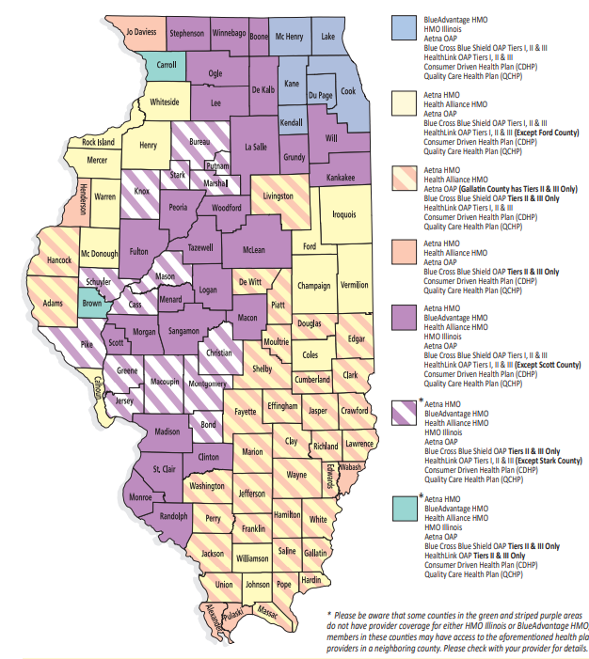
Plan Administrators available by residential county
Plan Administrators

Slide 16
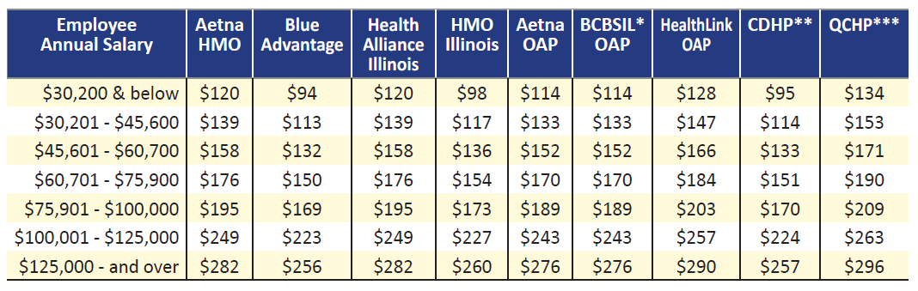
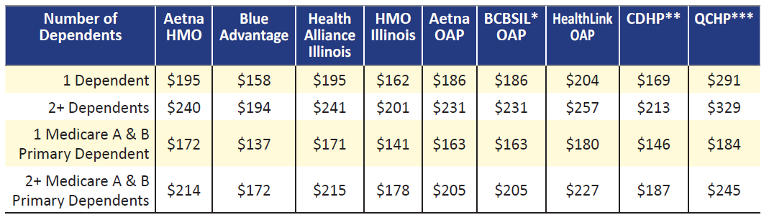
Monthly Contributions
  Member Rates are based on March 1st Annual Salary
  Dependent Rates based on:
  Number of Dependents
  Plan Enrollment
  Medicare Primacy

Slide 17


Health – Vision Coverage
State Vision Plan - State Employee Benefits (illinois.gov)
Cost of vision coverage is included in monthly Health Plan Contribution. Eligible for those enrolled in any State Health Plan.
Administered by EyeMed.
Eye exams covered every 12 months.
Replacement lenses benefit once every plan year, from the last date used.
Standard frames available once every 24 months, from the last date used.
Find Your Opportunity.
Work.Illinois.Gov

Slide 18
Health – Dental Coverage
Dental Plan - State Employee Benefits (illinois.gov)
Quality Care Dental Plan (QCDP) offers a comprehensive range of benefits
Administered by Delta Dental of Illinois.
Cost of dental coverage based on Member Only or Member Plus Dependent(s).
Member and dependents have the same benefits regardless of plan selected.
Employees may opt-out out of health coverage and elect Dental Only Coverage.
Find Your Opportunity.
Work.Illinois.Gov

Slide 19



Health – Behavioral Health
Employee Assistance Program (EAP)
5 Sessions, per occurrence, every plan year
ComPysch Guidance Resources is for all non-AFSCME Council 31 members and their covered dependents.
Free, confidential 24/7 assistance.
Comprehensive approach to the delivery of information, tools, resources and expert advice helps people navigate the broad spectrum of life issues.
Personal Support Program (PSP) administered for AFSCME employees
Free services statewide through a network of professional counselors who are licensed and specially trained to provide confidential assistance on a wide variety of personal difficulties or problems.
Behavioral Health Services - State Employee Benefits (illinois.gov)
Find Your Opportunity.
Work.Illinois.Gov

Slide 20

Health – Spending Accounts
Flexible Spending Account
Medical Care Assistance Program (MCAP)
Dependent Care Assistance Program (DCAP)
Flexible Spending Accounts (FSA) Program - State Employee Benefits (illinois.gov)
Administered by Optum Financial Connect Your Care.
Health Savings Account (HSA)
Health Savings Account (HSA) - State Employee Benefits (illinois.gov)
Administered by Pay Flex.
*Due to Federal guidelines, employees cannot be enrolled in both HSA and MCAP Flexible Spending Accounts
Find Your Opportunity.
Work.Illinois.Gov

Slide 21

Medical Care Assistance Program (MCAP)
The Medical Care Assistance Program is a pre-taxed deduction that provides funds to pay for eligible medical expenses for enrollees and dependents such as co-payments, co-insurance, deductibles and prescriptions.
Funds are available for use in July and are paid back to the program throughout the fiscal year through the payroll deductions.
Max contribution amount is $2,850 annually.
Unused rollover capped at $570.
Find Your Opportunity.
Work.Illinois.Gov

Slide 22

Dependent Care Assistance Program (DCAP)
Dependent Care Assistance Program is a pre-taxed deduction that provides funds for daycare expenses for children ages 12 and under, or to care for physically or mentally disabled dependents while the member is at work.
Funds are available on a monthly basis after the payroll deductions are done.
Max contribution amount is $5,000 annually.
All unused funds will be forfeited.
DCAP does not pay for medical expenses.
Find Your Opportunity.
Work.Illinois.Gov

Slide 23
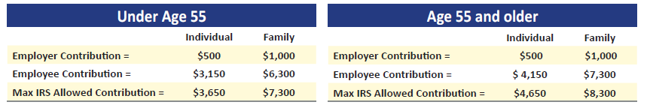
Health Savings Account (HSA)
Available only to those enrolled in the Consumer Driven Health Plan (CDHP).
Pre-taxed deduction that provides funds to pay for eligible medical expenses for member and dependents such as co-payments, co-insurance, deductibles and prescriptions.
Option to enroll in the HSA with:
The employer contribution AND the employee contribution.
Find Your Opportunity.
Work.Illinois.Gov

Slide 24


Health – Flu Shots/Disease Management
Flu Shots
Flu Shot Info - Fall 2022 - State Employee Benefits (illinois.gov)
Disease Management
Available through health plans as part of member’s enrollment.
Programs target and assist those identified as having certain risk factors for chronic conditions, like diabetes and cardiac health.
If member is identified as having risk factors and meet appropriate criteria, may be contacted by health plan administrator to participate in one of these highly confidential programs.
Find Your Opportunity.
Work.Illinois.Gov

Slide 25


Comprehensive Wellness Program
Be Well Illinois
Features educational resources, webinars, motivational messages and engaging events.
Provides awareness articles, financial wellness resources, health plans programs and resources, fitness articles, and kids corner.
Be Well Illinois focuses on:
Physical
Mental
Financial
Social wellbeing
Initiatives:
Fall into Fitness 5/10K Challenge
Coast to Coast
Feel Like a Million
Biometric Home Screenings
First Responder Mental Health Trainings
Active Minds-Stop the Silence Suicide Prevention Campaign
Visit the Be Well Illinois website to access the latest wellness information.
Follow on Facebook to join special challenges and to engage with a community of peers looking to strive to live healthier.
Website
Facebook

Slide 26


Health – Smoking Cessation Program
Smoking Cessation Program
Smoking Cessation Program - State Employee Benefits (illinois.gov)
Quit smoking with the help of the State’s Smoking Cessation Program.
Eligible members are entitled to receive an approved rebate amount, upon the completion of the program.
Many managed care plans offer smoking cessation programs separate from the department’s Smoking Cessation Program.
Employees who utilize a smoking cessation program through their managed care plan are not eligible for a Smoking Cessation Program benefit through the Department.
Find Your Opportunity.
Work.Illinois.Gov

Slide 27

Health – Weight Loss Benefit Program
Weight-Loss Benefit Program
Weight-Loss Benefit - State Employee Benefits (illinois.gov)
Members who utilize weight-­loss programs may be eligible for up to an approved rebate amount, once every three plan years.
Find Your Opportunity.
Work.Illinois.Gov

Slide 28

Health – TRAIL
Total Retiree Advantage Illinois (TRAIL)
TRAIL MAPD
The State of Illinois offers retirees, annuitants, and survivors (of the State Employees Group Insurance Program (SEGIP), The Teachers' Retirement Insurance Program (TRIP), and the College Insurance Program (CIP)) a healthcare program entitled Total Retiree Advantage Illinois (TRAIL).
This program provides Medicare-eligible members and their covered dependents comprehensive medical and prescription drug coverage through TRAIL Medicare Advantage Prescription Drug (commonly referred to as "MAPD") plans.
Find Your Opportunity.
Work.Illinois.Gov

Slide 29
Financial Wellness
Work.Illinois.Gov

Slide 30


Financial Wellness
Life Insurance
Deferred Compensation Plan
Commuter Savings Program (CSP)
Discounts
Education loan forgiveness and reimbursement
Retirement and Pension
Survivor benefits
Bilingual skills pay
Illinois 529 College Savings
Find Your Opportunity.
Work.Illinois.Gov

Slide 31

Life Insurance
  Free Basic Life Coverage, equal to your annual salary.
  Employee Optional Life Coverage, up to 8 times your Basic Life amount, with a monthly contribution. Rates vary based on age.
  Accidental Death & Dismemberment Coverage, equal to Basic Life or combined Basic and Optional Life, is available with a monthly contribution. Rates will vary.
  Spouse and guaranteed Child Life, lump sum amount of $10,000 per dependent, with a monthly contribution.
  New hires enrolling in up to 4 times Optional Life, are not required to submit a Statement of Health form for approval.
  Administered by MetLife.
Find Your Opportunity.
Work.Illinois.Gov

Slide 32


Deferred Compensation Plan
  Supplemental retirement program for State employees.
  Pre-tax or Roth basis through salary deferrals.
  The combined pre-tax and Roth contributions cannot exceed the limit, set by the IRS, of $20,500. Employees over the age of 50 are allowed to defer up to $27,000.
  New employees, who are a member of the State Employees’ Retirement System (SERS), the General Assembly Retirement System (GARS), or the Judges Retirement System (JRS), will be automatically enrolled in the Plan with a 3% pre-tax deferral, unless you opt-out within thirty days of hire date.
  If you are not a member of SERS, GRS, or JRS, you will not be automatically enrolled in the Plan; however, you may enroll at any time.
  Register at www.myillinoisdcplan.com or call (833) 969-4532.
  Administered by Empower Retirement.
Find Your Opportunity.
Work.Illinois.Gov

Slide 33


Commuter Savings Program (CSP)
  Commuter Savings Program (CSP) - State Employee Benefits (illinois.gov)
  Available for non-University employees.
  Pre-tax deductions to pay out-of-pocket, work-related commuting and/or parking expenses.
  Max contribution is $280 monthly for bus or train transit passes or vanpooling. The transit media selected is conveniently mailed directly to the participants’ homes before the beginning of the month.
  Max contribution is $280 monthly for work-related parking expenses. The parking provider may be paid directly, or the participant may be reimbursed by submitting a claim form and proof of services to the CSP Plan Administrator.
  Administered by Edenred Commuter Benefits
Find Your Opportunity.
Work.Illinois.Gov

Slide 34
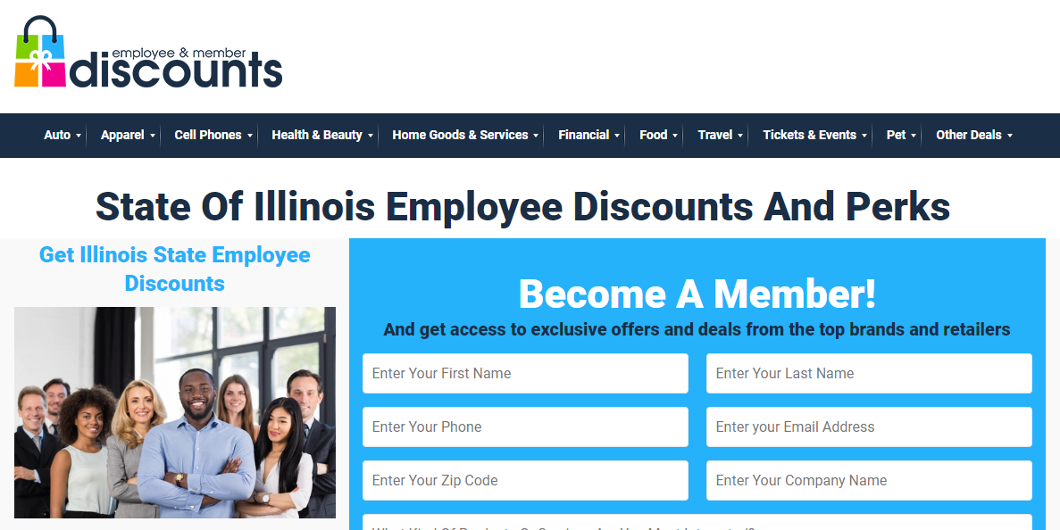

Employee Discounts
  Illinois State Employees, retirees, their families, and friends are eligible for employee discounts, special pricing, and perks on products and services they use every day.
  Employee Discounts, Perks, & Benefits For Illinois State Employees (employeeandmemberdiscounts.com)
Find Your Opportunity.
Work.Illinois.Gov

Slide 35


Education loan forgiveness
  Veterans’ Home Nurse Loan Repayment Program. Veterans' Home Medical Providers' Loan Repayment Program (isac.org)
  Nurse Educator Loan Repayment Program. Nurse Educator Loan Repayment Program (isac.org)
  Public Service Loan Forgiveness Program. Public Service Loan Forgiveness - The White House
Find Your Opportunity.
Work.Illinois.Gov

Slide 36

Retirement and Pension
Retirement and Pension
Retirement and Pension
  SRS of Illinois
Survivor benefits
  Retiree, Annuitant and Survivor Life Coverage - State Employee Benefits (illinois.gov)
  Pre-retirement workshops are offered throughout the state for all state employees and their spouses.
Find Your Opportunity.
Work.Illinois.Gov

Slide 37


Bilingual Skills Pay
Bilingual pay is guided by the AFSCME collective bargaining agreement (CBA), providing employees utilizing bilingual skills to serve the public, additional compensation (see 20 ILCS 415/8a.2)
Find Your Opportunity.
Work.Illinois.Gov

Slide 38

Financial Wellness
Illinois 529 College Savings
Illinois 529 College Savings
  Michael W. Frerichs - Illinois State Treasurer: College Savings (illinoistreasurer.gov)
Find Your Opportunity.
Work.Illinois.Gov

Slide 39
Work Life Integration
Work.Illinois.Gov

Slide 40

Work Life Integration
37.5 hour work week
Overtime and Earned Equivalent Time
Paid vacation, holidays (13-14 holidays per year, 25 paid days off first year of employment)
Paid time off for:
  Skill tests for promotions
  Blood, blood platelet, bone marrow, organ donations
  Court attendance
  Vote
Rollover vacation and sick time
Sick leave bank
Flexible work schedules
Leaves
  Parental Leave (Paid 10 work weeks)
  Disability
  Family Responsibility Leave (FRL)
  Family and Medical Leave Act (FMLA)
  General Leave
  Educational Leave
  Military Leave
  Victims’ Economic Security and Safety Act (VESSA)
Find Your Opportunity.
Work.Illinois.Gov

Slide 41

MyBenefits Plus
My Benefits Plus
Accident Insurance
Critical Illness Insurance
Hospitality Indemnity Insurance
Legal Services
Identify Theft Protection
Pet Health Insurance
Auto and Home Insurance
Purchasing Power
Salary Finance
Find Your Opportunity.
Work.Illinois.Gov

Slide 42

MyBenefits Plus
Open Enrollment
(New Hire Only)
Accident Insurance
Critical Illness Insurance
Hospital Indemnity Insurance
Legal Services
Evergreen Enrollments (Anytime Elections)
Identity Theft Protection
Pet Health Insurance
Auto and Home Insurance
Purchasing Power*
Salary Finance*
Find Your Opportunity.
Work.Illinois.Gov

Slide 43


Accident Insurance
There are things you and your family do daily that may lead to an accident or out-of-pocket expenses.
Lump Sum Benefits
Immediate Coverage/No Waiting Periods
On & Off the Job Coverage
Covered Hospital Stays
Guaranteed Issue
Annual Health Screening Benefit
Available During Open Enrollment
Find Your Opportunity.
Work.Illinois.Gov

Slide 44
Critical Illness Insurance
Gain the Power to make treatment decisions, without putting your finances as risk.
Simplified Underwriting
Choice Plans Available
Dependent Coverage Available
Use Benefits for Any Expenses
Cash Benefits Distributed
Covered Hospital Stays
Available During Open Enrollment
Find Your Opportunity.
Work.Illinois.Gov

Slide 45
Hospital Indemnity Insurance
Achieve peace of mind knowing you have additional coverage to help ease your financial responsibility while you recover.
Annual Health Screening Benefit
Plans Level Options
Dependent Coverage Available
Use Benefits for Any Expenses
Lump Sum Distributions
Portable Plans
Available During Open Enrollment
Find Your Opportunity.
Work.Illinois.Gov

Slide 46

Legal Services
Protect yourself and your family. Find the extra guidance when you need it.
Expert attorneys in all fields
Family Law Coverage
National Network of Attorneys
Financial & Consumer Coverage
Real Estate Transaction Coverage
Auto & Traffic Coverage
Available During Open Enrollment
Find Your Opportunity.
Work.Illinois.Gov

Slide 47
Identity Theft Protection
Millions of consumers are victims of identity theft each year. Don’t wait to get protected.
Credit Alerts
Digital Wallet
Credit reporting
Identity Remediation
Social Media Reputation Monitoring
ID Theft Insurance Policy
Available Anytime
Find Your Opportunity.
Work.Illinois.Gov

Slide 48

Pet Insurance
Protect your pet and your wallet with exceptional savings on veterinary bills.
Visit Any Vet, Anywhere
Injuries like Cuts & Broken Bones Covered
24/7 Vet Helpline
Surgeries and Hospitalizations Covered
X-Rays, MRIs and CT Scans Covered
Choice Plans Available
Available Anytime
Find Your Opportunity.
Work.Illinois.Gov

Slide 49

Auto & Home Insurance
Three of the nation’s top providers offering plans that fit your lifestyle and your wallet.
Multi-policy discounts
Special Employee Savings
24/7/365 Claim reporting
Portable Plans
Coverage Can Begin the Next Day
Switch Carriers Anytime
Available Anytime
Find Your Opportunity.
Work.Illinois.Gov

Slide 50

Purchasing Power
Shop thousands of brand-name products, pay over time, right from your paycheck.*
No Credit Check
Appliances, Computers, Furniture, more
Pay Using Payroll Deduction
No Down Payment
Upfront Product Delivery
Available Anytime
*Must be active full-time employee for a minimum of 12 months, at least 18 years of age, earn at least $16,000. Must provide a valid bank account or credit card.
Find Your Opportunity.
Work.Illinois.Gov

Slide 51

Salary Finance
Loans at affordable rates with higher acceptance than traditional lenders.*
Budgeting Tools
Rebuild Savings
Pay down Expensive Debt
Checking and optional Savings Account
Referrals to Local Financial Resources
Available Anytime
*Must be active full-time employee for a minimum of 12 months, at least 18 years of age, earn at least $16,000.
Find Your Opportunity.
Work.Illinois.Gov

Slide 52

Adoption Benefit Program
  Adoption Benefit Program - State Employee Benefits (illinois.gov)
The Program pays for approved eligible expenses for reimbursement.
All adoption benefits are subject to Medicare and social security taxes.
If more than one child is adopted, benefits are available for each child.
The benefit is available to all active employees who are eligible for benefits under the State Employees Group Insurance Program.
The adoption must be final before expenses are eligible for reimbursement.
The request for reimbursement must be received within one year from the end of the plan year the adoption became final.
If both spouses are State employees, only one adoption benefit is available per child.
Find Your Opportunity.
Work.Illinois.Gov

Slide 53
Professional Development
Work.Illinois.Gov

Slide 54

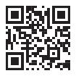
Professional Development
Upward mobility program
Paid education and training
CMS University
Veteran’s outreach
Programs for workers with disabilities
Career Progression
Find Your Opportunity.
Work.Illinois.Gov

Slide 55


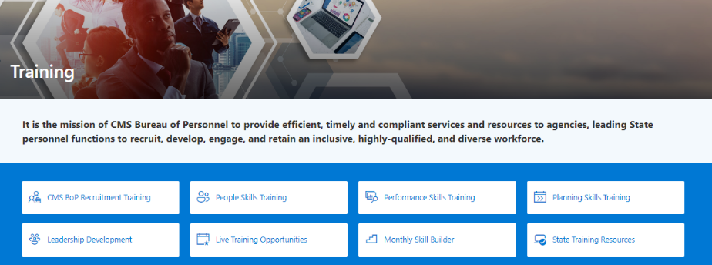

CMS University
  CMS University is the State of Illinois' internal, continuing and professional education portal
  Designed to showcase the innovative programs offered by state agencies to address the training needs of our staff
  Centralized location for all state employees
  CMS Leads Podcast Series
  CMS Conversations: Diversity Equity & Inclusion
Find Your Opportunity.
Work.Illinois.Gov

Slide 56


Upward Mobility Program
Upward Mobility Program - Upward Mobility Program (illinois.gov)
  Career mobility program providing paid education and training
  Designed to give current state employees an opportunity to advance to more challenging, higher paying positions.
  Joint venture between CMS and AFSCME.
  Employees receive individual counseling to inform them of the career opportunities available and to guide them in developing their career plans.
  Participants take proficiency exams and/or complete required education and training programs designed to provide the skills and knowledge needed for advancement.
  Employees can work toward advancement in the following major career paths: Data Processing, Office Services, Accounting, Human Services, Criminal Justice, and Nursing.
Find Your Opportunity.
Work.Illinois.Gov

Slide 57




Career Mobility
The State values allowing individuals movement in their career, whether to another position or occupation, or gaining different responsibilities within their current role.
The State invests in its employees, wants them to learn new skills, grow, and continue to contribute!
Benefits for employees:
Leverage many professional development programs
Maintain their job while completing education
Continue receiving benefits (insurance, annual bonuses, etc.) while exploring career advancement
Receive pay increases relative to new roles
Increase value within the organization
Find greater satisfaction in new, more rewarding roles
Add valuable skills and responsibilities to their resume
Find Your Opportunity.
Work.Illinois.Gov

Slide 58

Veterans Outreach Program
  We give our support to the men and women who have given theirs.
  Under State law, qualified veterans are entitled to preference points in the hiring process.
  Personalized career counseling for veterans.
  All veterans are required to submit a certified copy of their most recent DD214/215 as proof of military service.
Find Your Opportunity.
Work.Illinois.Gov

Slide 59

Programs for workers with disabilities
The Disabled Worker Trainee Program (DWTP) provides an opportunity to individuals with disabilities and no work experience to gain state employment through an established trainee program
The Successful Disability Opportunities Program aims to increase the number of qualified employees with disabilities working in the State.
The State provides an opportunity for employees to seek alternative employment after a work related or non-work related disability essentially precludes that employee from performing his or her currently assigned duties.
Find Your Opportunity.
Work.Illinois.Gov

Slide 60
Work.Illinois.Gov

