Slide 1

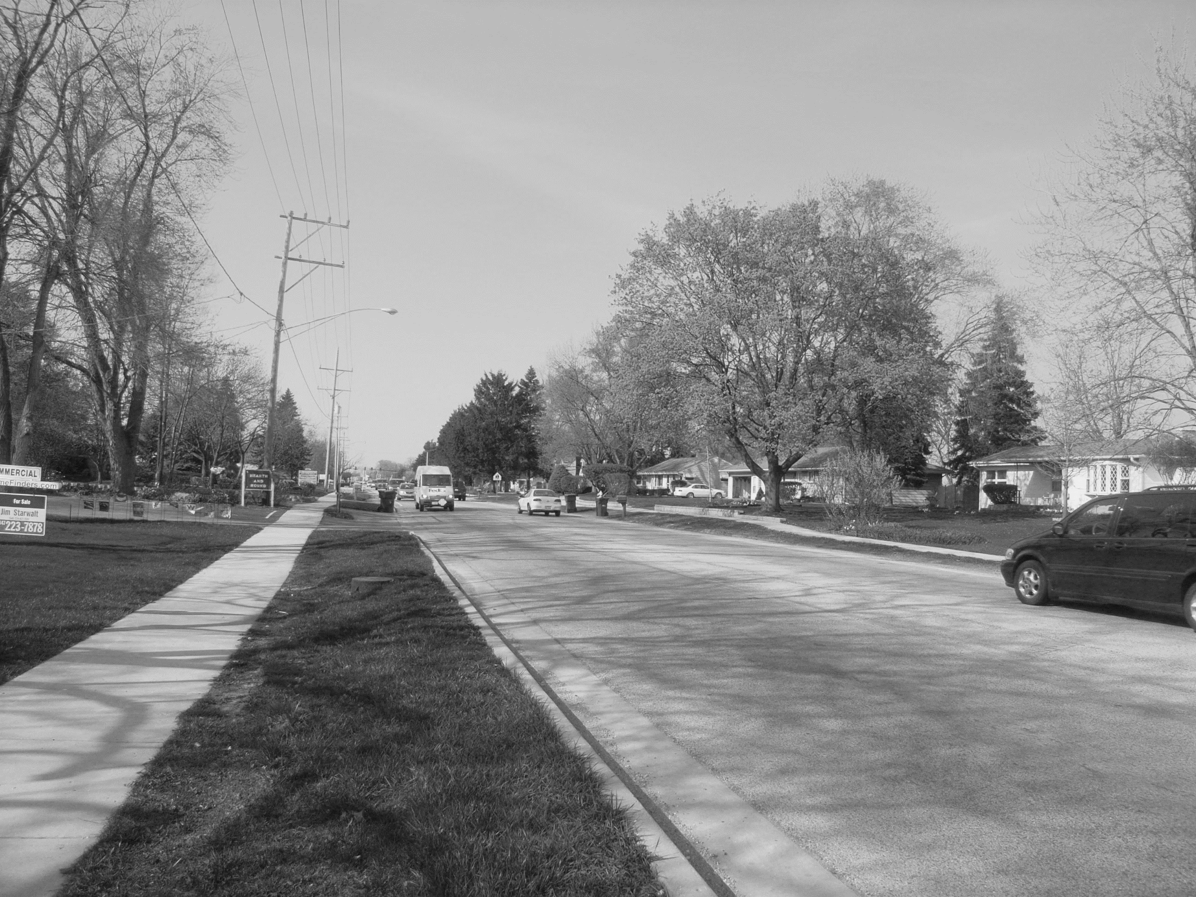


Welcome!
Public Meeting #2
May 24, 2016
www.idot.illinois.gov/projects/il83-137-study
Notes:
The Illinois Department of Transportation, or IDOT, welcomes you to the second Public Meeting for the Illinois 83 and Illinois 137 Preliminary Engineering and Environmental study.

Slide 2

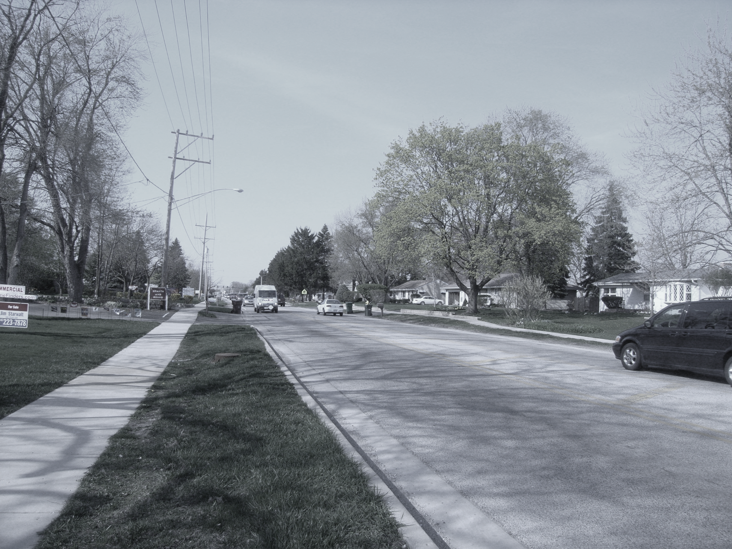

Meeting Purpose
Project Overview
Purpose and Need
Input on Preliminary Alternatives
Next Steps
www.idot.illinois.gov/projects/il83-137-study
Notes:
The Purpose for tonight’s meeting is to provide a brief overview of the project, to present the purpose and need for the project , to solicit input on the range of alternatives that have been developed, and to provide information regarding the next steps in completing this study.

Slide 3
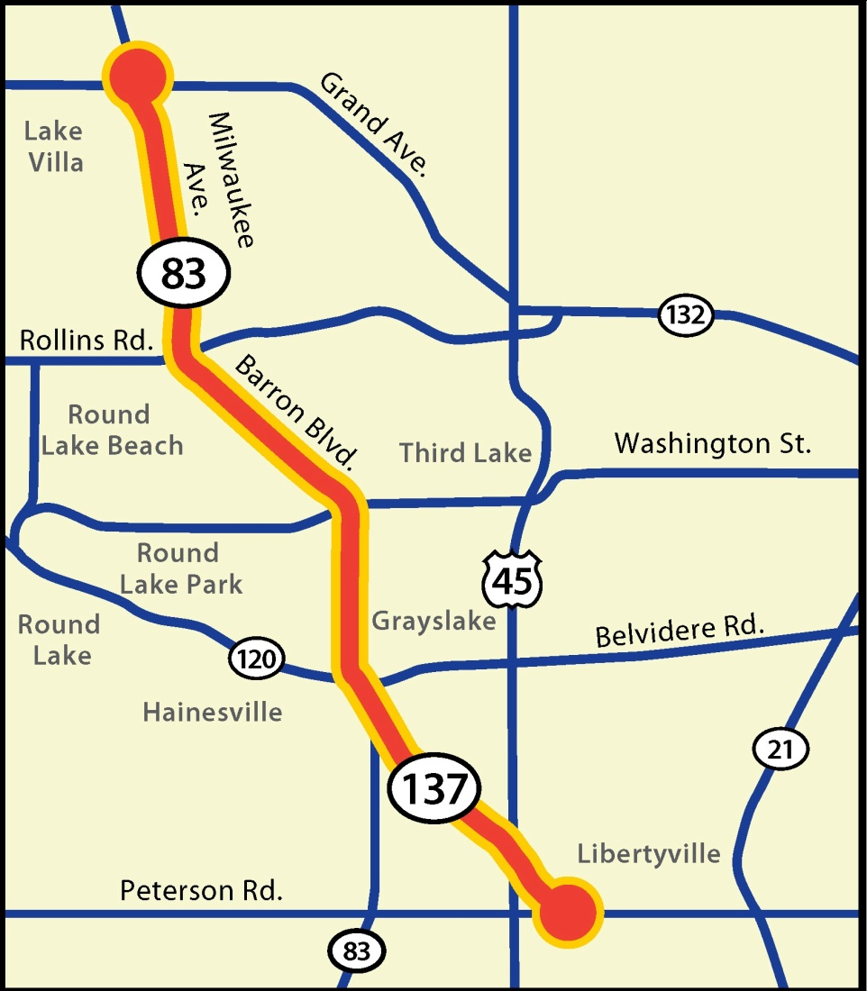
Project Overview
Study Limits:
IL 83 – from IL 132 to IL 120
IL 137 – from IL 120 to East of US 45
Approximately 11 miles in length
Extends through Lake Villa, Round Lake Beach, Grayslake, Libertyville
www.idot.illinois.gov/projects/il83-137-study
Notes:
The Illinois 83 and Illinois 137 project extends through lake County, on IL 83 from IL 132 to IL 120 and along IL 137 from IL 120 to east of US 45. This project is approximately 11 miles in length and travels through the villages of Lake Villa, Round Lake Beach, Grayslake, and Libertyville.
The reason for this Study is to review the existing roadway for needs and concerns and determine methods for improving the conditions for travel within the corridor.
Improvements that are made will tie into other improvements completed and planned in corridor, including improvements recently completed at Rollins Road and those planned at the intersection of Illinois 83 and Illinois 120.

Slide 4
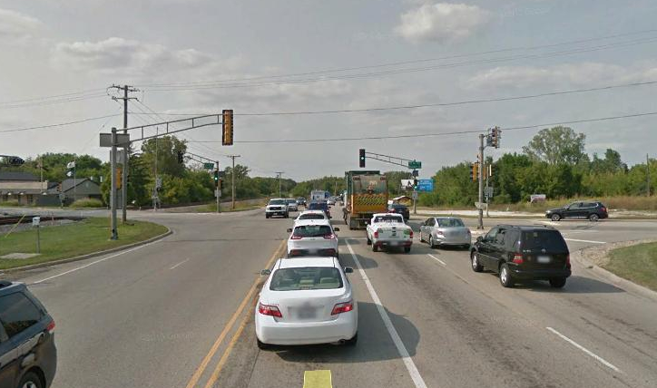
IDOT Project Phases
PHASE I
PHASE II
PHASE III
Preliminary Engineering & Environmental Studies
3 to 5 years
Design (Funded)
Land Acquisition (Not Funded)
1.5 to 2 years
Construction
(Not Funded)
2 to 3 years
WE ARE HERE
www.idot.illinois.gov/projects/il83-137-study
Notes:
IDOT develops highway transportation improvement projects in 3 phases. The Illinois 83 and Illinois 137 study is currently in Phase I. During this phase, preliminary engineering and environmental studies are completed to develop an improvement of the roadway that addresses an established purpose and need for the project.
This Phase I study and the phase II design have been funded.
Funding for the remaining phases, including land acquisition and construction will be considered as part of future Transportation Programs.

Slide 5
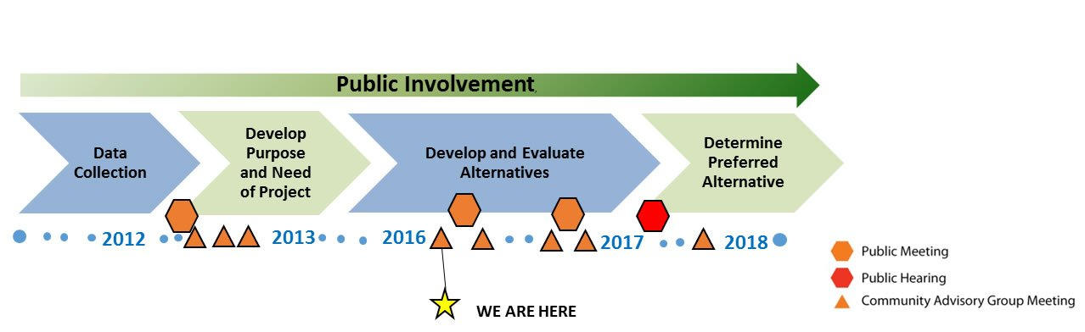
Phase I Timeline
Public Involvement
Data Collection
Develop Purpose and Need of Project
Develop and Evaluate Alternatives
Determine Preferred Alternative
2012
2013
2016
2017
2018
WE ARE HERE
www.idot.illinois.gov/projects/il83-137-study
Notes:
The Phase I study process involves 4 primary components. These include: data collection, developing the Purpose and Need for a project, developing and evaluating alternatives and determining a Preferred Alternative.
IDOT will consider all input from stakeholders throughout the Phase I process.

Slide 6
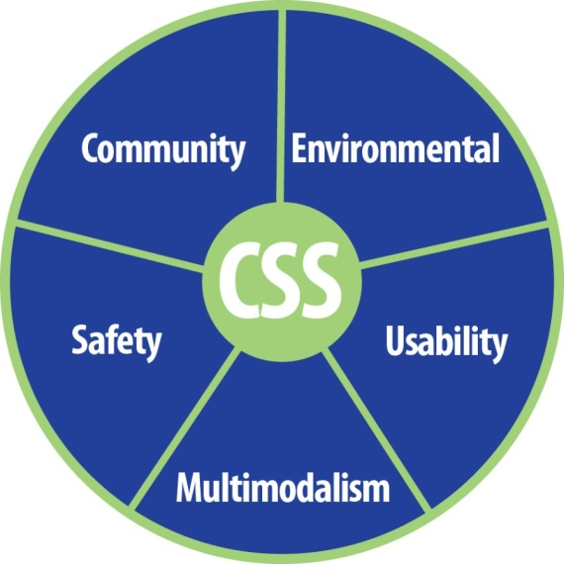
Context Sensitive Solutions
CSS Process
Collaborative process to involve stakeholders in decision making
Fits improvement into its surroundings, “its context”
Maintains safety and mobility
Addresses all modes of transportation
Preserves scenic, economic, historic and natural qualities
www.idot.illinois.gov/projects/il83-137-study
Notes:
IDOT utilizes Context Sensitive Solutions , or CSS, to engage and inform the community. CSS is a collaborative process to involve stakeholders in decision making.
This coordination helps to ensure that a planned improvement fit into its surrounding , also referred to as “its context”.
The CSS process considers need throughout the area of a project so improvements made for safety and mobility and other needs can also address all modes of transportation while preserving the scenic, economic, historic and natural qualities of the area.
This process allows the project team and stakeholders to share information so all can better understand key issues and concerns within the area and so alternatives that are developed better fit the needs of the community.

Slide 7
Outreach Tools
IDOT
&
Project Team
Public Meetings & Hearing
Media
Outreach
Project Website
Newsletters
Agency Meetings
Community Advisory Group
Small Group Presentations
www.idot.illinois.gov/projects/il83-137-study
Notes:
Through the CSS process, IDOT and the Project Team engages area stakeholders through a number of tools. These include Public Meetings, Community Advisory Group Meetings, media outreach, the project website, Village or Local Agency Meetings, Project Newsletters, and other small group presentations. This coordination helps to inform the community as well as provide the team with valuable input and concerns.

Slide 8
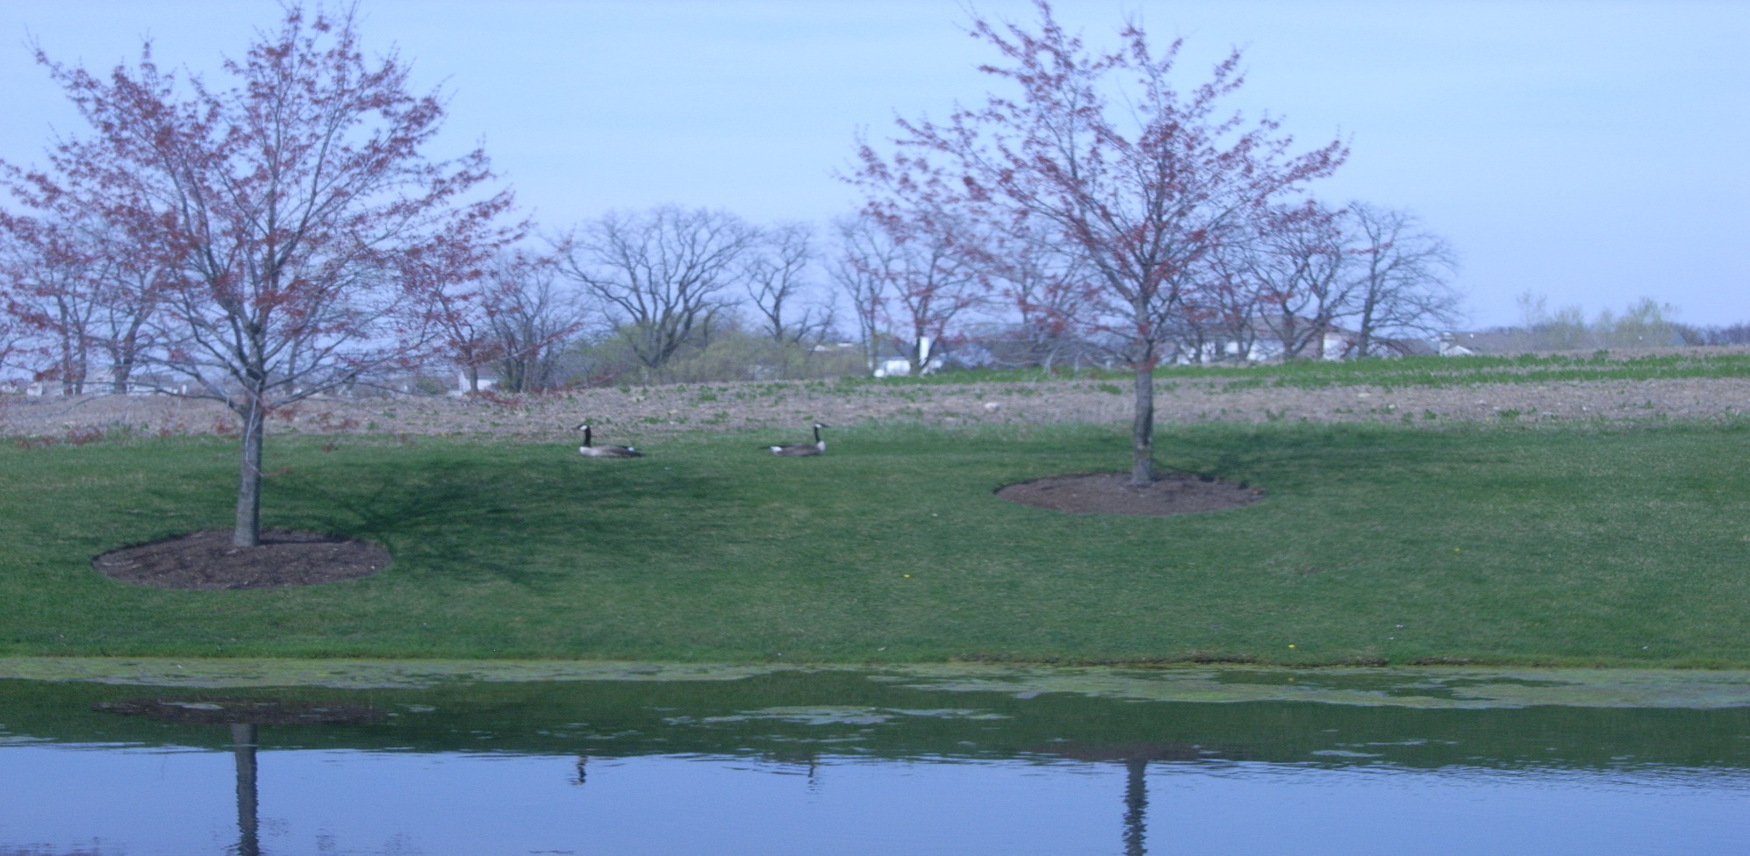

Environmental Considerations
This project is being developed in accordance with the National Environmental Policy Act (NEPA)
The purpose of the NEPA is to ensure that environmental factors are weighted equally when compared to other factors in the decision making process.
Not only is IDOT responsible for adhering to NEPA, but also to environmental specific regulations, such as, the Clean Water Act, Endangered Species Act, etc.
www.idot.illinois.gov/projects/il83-137-study
Notes:
This project is being developed in accordance with the National Environmental Policy Act (or NEPA). The environmental impacts of potential alternatives is a critical component to the overall alternative development process.
The purpose of NEPA is to ensure that environmental factors are weighted equally when compared to other factors in the decision making process. Not only is IDOT responsible for adhering to NEPA, but also to other environmental specific regulations, such as the Clean Water Act, and the Endangered Species Act.

Slide 9
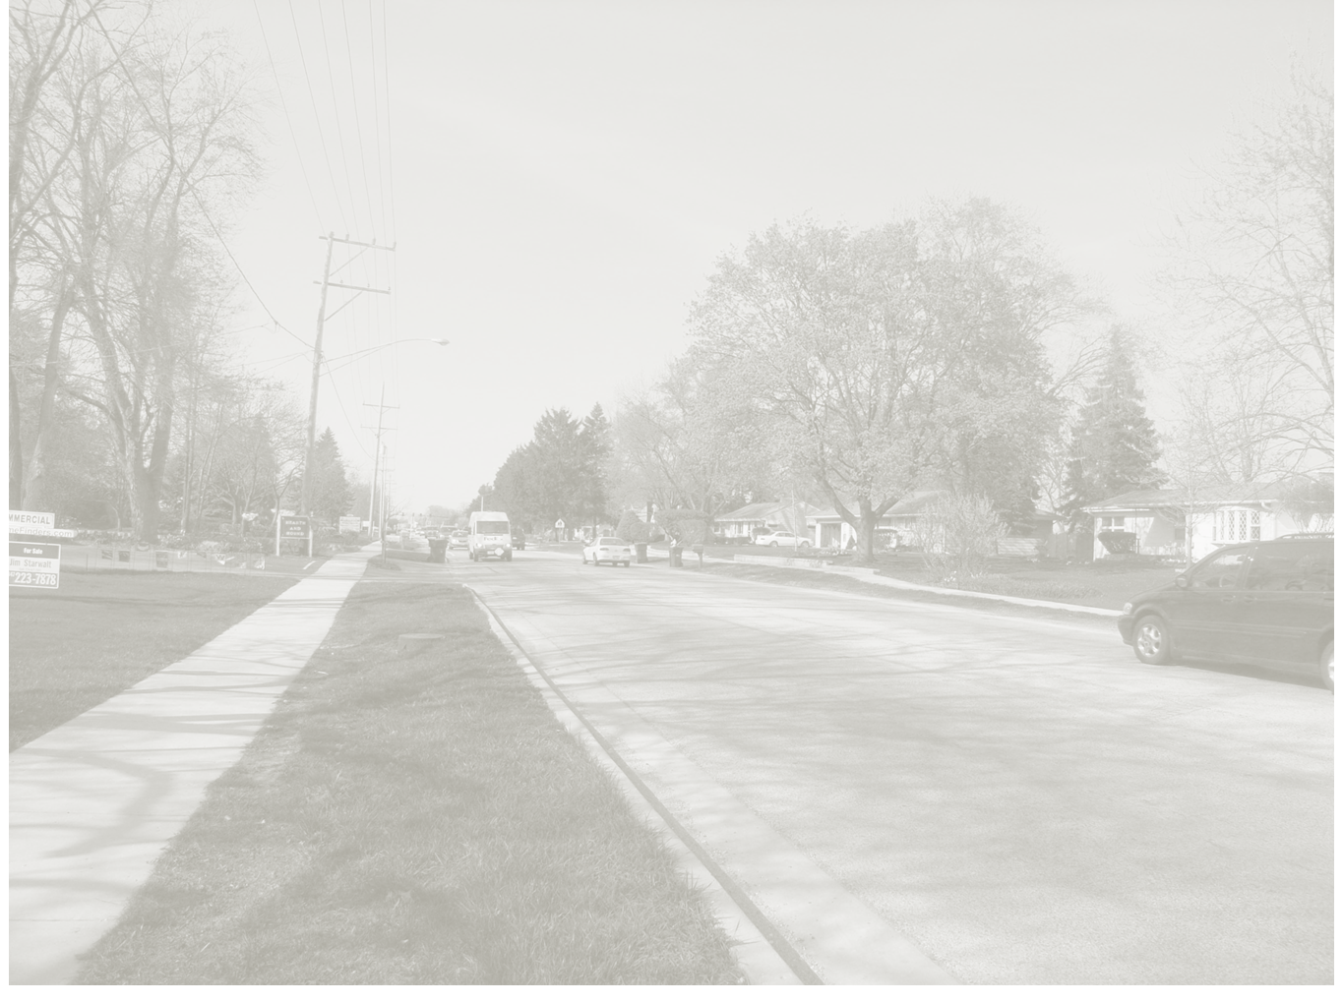



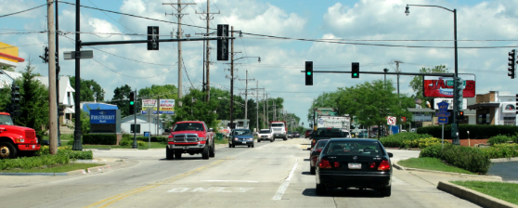
Purpose and Need
  Purpose & Need
  Improve safety
  Improve mobility
  Improve multimodal opportunities
www.idot.illinois.gov/projects/il83-137-study
Notes:
Through the collaborative effort with the community a Problem Statement was developed for this project. The Problem Statement provided the community context basis for the improvement. The Project Purpose and Need was developed from the problem statement as well as from a technical analysis of the roadway and additional stakeholder input.
The purpose of this project is to improve safety, Improve mobility, and Improve multimodal opportunities.

Slide 10
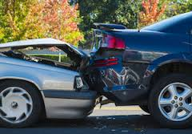
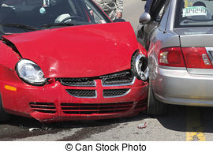
Safety Considerations
Crash History (2009-2011)
Total Crashes = 706
      54% Rear End
  Crash Analysis Concluded
High rate of rear end crashes indicates heavy stop and go traffic
Improve capacity to reduce potential for accidents
  19% Turning
Notes:
With safety identified as a key concern for the corridor, crash history along the corridor was utilized to identify high crash locations and to determine patterns related to safety concerns. There were 706 Crashes identified through the corridor in the 3 year period (2009 to 2011) studied.
A Crash Analysis conducted along this corridor found 54% of these crashes were rear-end collisions and 19% were turning crashes . These rates were identified as inordinately high and indicative of heavy traffic conditions. Given the anticipated growth along the corridor, Illinois 83 and Illinois 137 will likely experience more crashes as a result of increasing traffic. Therefore, in order to reduce the potential for these crashes along IL 83/IL 137, the traffic capacity of the roadway must be improved.

Slide 11
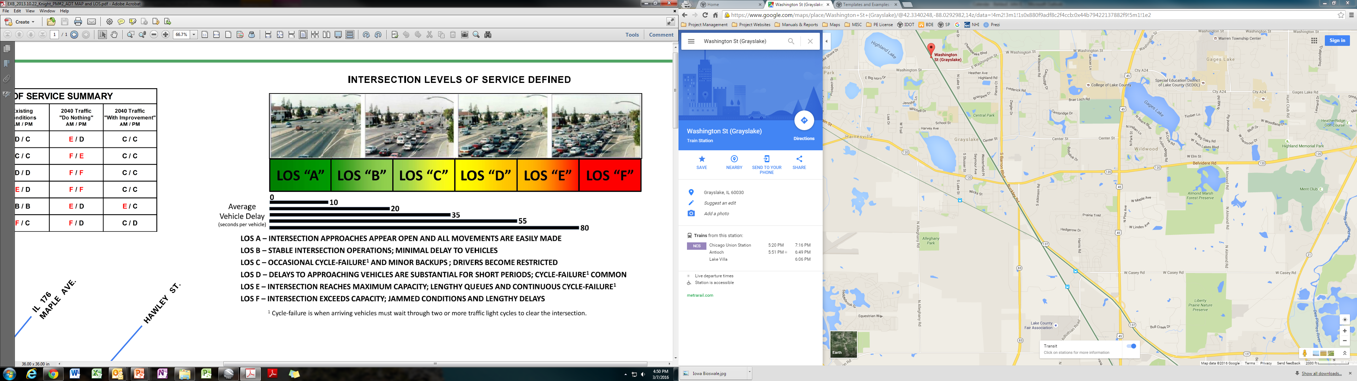
Mobility Considerations
Operational Level of Service (LOS)
www.idot.illinois.gov/projects/il83-137-study
Notes:
To determine the mobility within the corridor, the existing traffic volumes are measured and future volumes projected. The existing needs can then be determined and alternatives developed to provide the capacity as to meet the required design criteria.
Traffic capacity and the associated traffic congestions are defined in terms of level of service , or LOS.
The level of service is expressed by a scale ranging from “A” to “F.”
“A” represents the best traffic condition with no backups or obstacles to traffic flow and “F” represents a total breakdown in traffic operations accompanied by extensive delays and traffic volumes that approach capacity.
The design criteria requires that the projected 2040 traffic capacity along the corridor have a Minimum Level of Service of D and a Target LOS of C or higher.

Slide 12
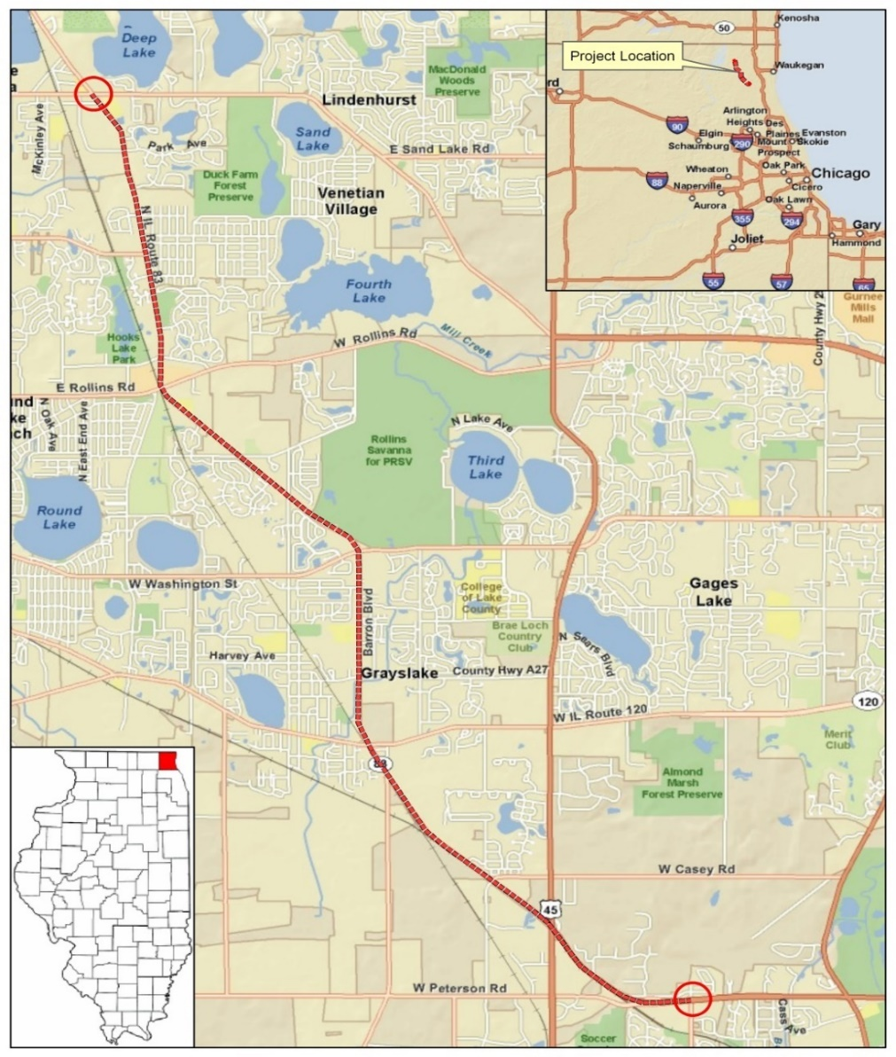
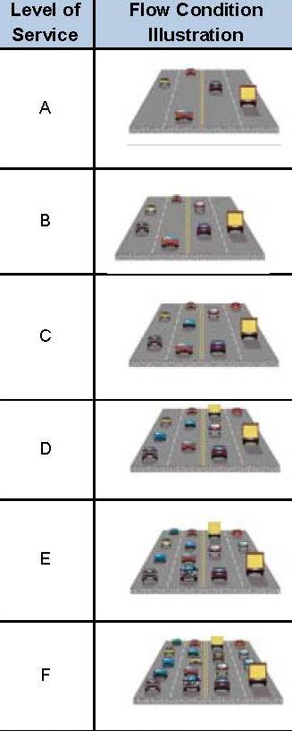
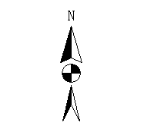

Mobility
Considerations
Year 2040 No-Build LOS
21,000
  IL 132
13,600
A
B
22,200
31,000
Level of Service (LOS)
C
  Rollins Rd.
Average Daily Traffic (ADT)
Existing ADT = 13,000 to 22,000
Year 2040 No-Build ADT = 14,000 to 31,000
27,000
D
21,000
E
  Washington St.
18,000
F
29,000
Project No-Build (Year 2040) LOS
Lack of capacity
Without an improvement the traffic congestion within the corridor will be below acceptable levels
  IL 120
Legend:
  US 45
14,000
XXXX Existing ADT
  IL 83
XXXX Year 2040 No-Build ADT
14,200
  IL 83
17,000
  Peterson Rd.
16,300
  IL 137
Notes:
The existing traffic volumes along the corridor range from 13,000 to approximately 22,000 vehicles per day. With no-improvement to the corridor, the traffic volume is projected to increase to 14,000 to 31,000 vehicles per day by year 2040.
With this volume of traffic, the projected Level of Service for the corridor will be below the acceptable level in most areas. The only areas where acceptable levels were found is where 4 or 5 lane improvements have been completed or are planned to be completed.

Slide 13

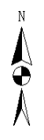
Multi-Modal
Considerations
  IL 132
  Rollins Rd.
Residential areas
Commercial development
Parks
Schools
Bicycle Paths
Metra Stations
  Washington St.
  US 45
  IL 120
LEGEND:
Parks
Schools
Bicycle Paths
Metra Stations
  IL 83
  Peterson Rd
Notes:
Multi-modal opportunities was identified as another need along this corridor. Because of the residential and commercial land use found along the corridor, as well as the frequency of parks, schools, bicycle paths and Metra stations within the area, the inclusion of bicycle and pedestrian facilities along the corridor provides residents and travelers an alternative means of travel and access.

Slide 14
Alternative Development Process
Range of Alternatives
Preferred Alternative
Initial Alternatives
Alternatives Carried Forward
Stakeholder Input Received & Considered Throughout the Process
WE ARE HERE
www.idot.illinois.gov/projects/il83-137-study
Notes:
The Alternative Development Process is a multi-step process of developing, improving, screening, and eliminating alternatives until a preferred alternative is selected. Throughout this process IDOT utilizes the CSS to keep the community engaged in the project, which helps to ensure the preferred alternative fits the needs of the community.
The process begins by screening initial alternatives to make sure they meet the Purpose and Need of the project and they do not have fatal flaws.
Following this screening the Range of Alternatives carried forward are evaluated in greater detail. This is the point in the process we are at now.
The alternatives and their associated impacts will then be further refined, and subsequently screened until a preferred alternative is selected.

Slide 15

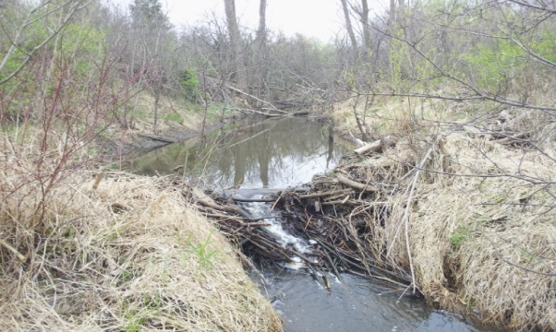
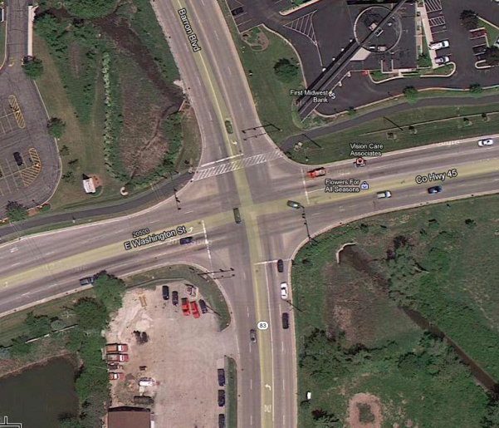
Alternative Development Process
Environmental Considerations
Design Considerations
www.idot.illinois.gov/projects/il83-137-study
Notes:
The consideration of both Environmental Resources and Engineering design elements found within the corridor is an integral part of Developing a Range of Alternatives that provide viable options for improving the roadway corridor.

Slide 16
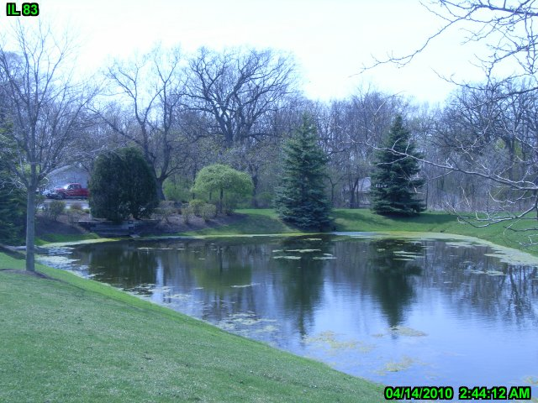
Environmental Considerations
Wetlands
Protected species and habitat
Floodplains
4(f) Resources
Historic Sites
Parks, recreation areas and refuges
Community & Social Resources
Property Impacts
www.idot.illinois.gov/projects/il83-137-study
Notes:
Environmental surveys were collected throughout the project area so that critical areas can be identified and the impacts of potential alternatives can be measured. This allows us to identify alternatives that best serves the purpose and need of the project while taking into consideration the environmental impacts.
Environmental features include: wetlands, protected species and habitat, floodplains, 4(f) resources such as historic sites and parks, community and social resources and property impacts.

Slide 17

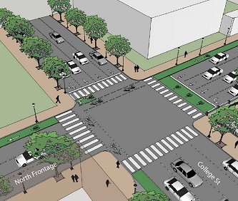

Design Considerations
Intersections
Traffic Signals
Roundabouts
Additional Channelization (Turn Lanes)
www.idot.illinois.gov/projects/il83-137-study
Notes:
Proposed alternatives also require considerable engineering design considerations.
At intersections, the considerations included looking at signal warrants, alternative design concepts such as roundabouts and geometric improvements to provide additional turn lanes where needed for future traffic demand.

Slide 18
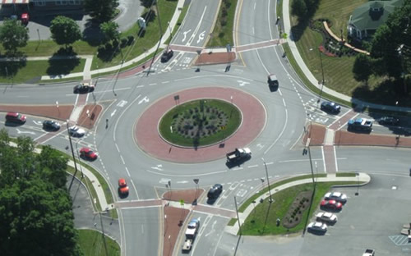
Design Considerations
Roundabouts
Roundabouts provide opportunities to improve safety and operational efficiency due to:
Fewer conflict points for vehicles
Lower crash severity
Low-speed (approx. 20 mph)
www.idot.illinois.gov/projects/il83-137-study
Notes:
Roundabouts are examined as an alternative in projects considering construction of new or improved intersections.
Modern roundabouts are a type of intersection characterized by a generally circular shape where all entering traffic yields to traffic circulation counterclockwise around a central island. They are designed with geometric features that create a low-speed environment and have been demonstrated to provide a number of safety and operational benefits when compared to other types of intersections.

Slide 19
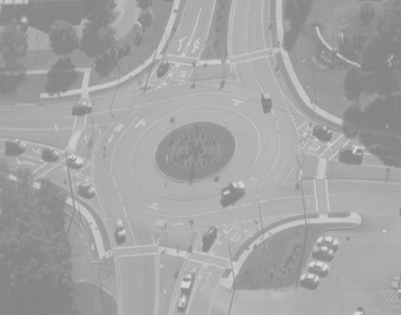
Design Considerations
Roundabouts
Characteristic Pros and Cons
PROS:
Fewer conflict points
Fewer crashes
Less severe crashes
CONS:
Driver familiarity
No signal to stop traffic for pedestrians
Lighting is required
www.idot.illinois.gov/projects/il83-137-study
Notes:
There are advantages to utilizing the roundabout deign:
Due to the physical shape, this design reduces the number of crossing conflict points thus reducing accident rates and severity.
A federal study has found overall reductions of 35 % in total crashes & 76 % in injury crashes.
Due to the near elimination of head-on impacts, severe, incapacitating injuries and fatalities are less likely
Some potential disadvantages include:
drivers unfamiliar with the use of roundabouts
No signal to stop traffic for pedestrians
And lighting is required at roundabout locations

Slide 20
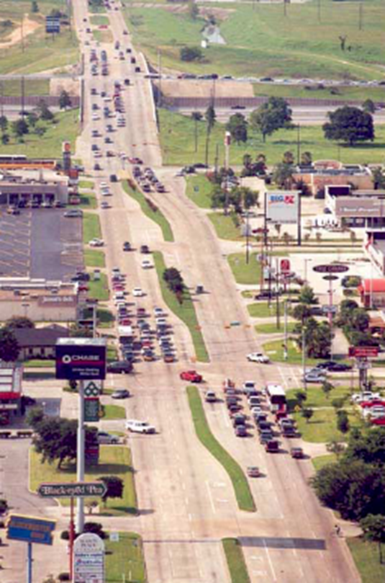
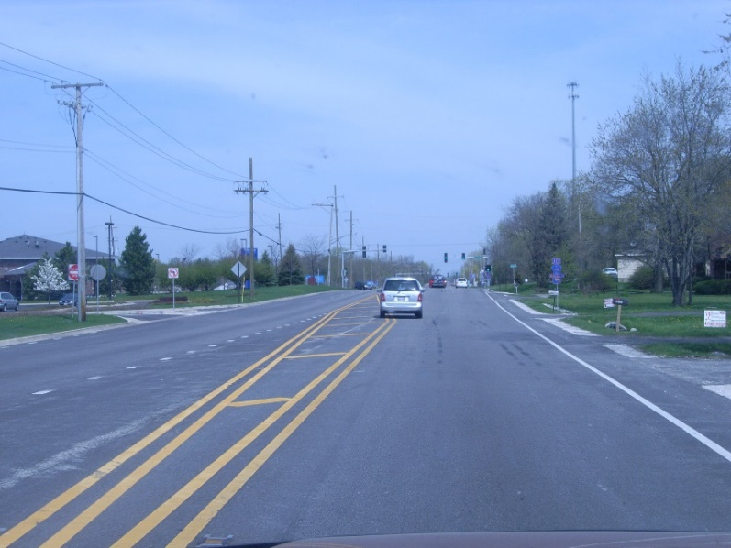

Design Considerations
Access Management
Purpose
To balance safety and mobility with access
Effect
Reduce conflict points
Free-up through traffic
Raised Curb Median
Raised medians separate traffic and direct motorists where to access properties.
Turn lanes are used to queue separate movements and to “free up” through traffic
Raised medians provide opportunities for improving aesthetics
www.idot.illinois.gov/projects/il83-137-study
Source FHWA – Access Management Principals
Notes:
The effectiveness of the alternatives depend on many factors but is evaluated by how well they address the Purpose and need.
Two of the primary factors identified in our P&N are Safety and Mobility.
Access management is defined as the control of the location, spacing, design, and operation of driveways, median openings, interchanges, and street connections to a roadway. The purpose of access management is to help balance safety and mobility. By doing so, the number of conflict points are reduced and through traffic is freed-up.
Driveways are inevitable and necessary, but an increase in their frequency within a corridor also increases the likelihood for accidents to occur. Raised medians are a key tool used for access management. Raised medians separate traffic and direct motorists where to access properties. Turn lanes are used to queue separate movements and to “free up” through traffic. Additionally, raised medians provide opportunities for improving aesthetics.

Slide 21


Intersection Studies
  IL 132
  IL 83
  Rollins Rd.
Roundabout Analysis
20 Locations Considered
Two Locations Carried Forward:
  Washington St.
Frederick Rd
Library Ln
  IL 120
  US 45
  IL 83
  Peterson Rd.
www.idot.illinois.gov/projects/il83-137-study
Notes:
Intersection studies were completed throughout the corridor. Because of the safety and capacity benefits that a roundabout could provide if it is placed in a suitable location, 20 intersection locations within the corridor were reviewed to determine if a multilane roundabout may be suitable.
Traffic analysis at these locations identified concerns related to traffic and locations were eliminated due to traffic volumes and traffic patterns. Following this analysis two potentially suitable locations were identified and carried forward. These are the intersections at Illinois 83 and Frederick Rd and at Illinois 83 and Library Lane.

Slide 22
Initial Alternative Analysis
2-Lane Alternative
1-lane in each direction with a center turn lane
4-Lane Alternatives
2-lanes in each direction
  Raised curb median
  Flush median with a center turn lane
  Depressed (grass) median – rural section only
www.idot.illinois.gov/projects/il83-137-study
Notes:
The lane configuration was also studied throughout the corridor by developing initial build alternatives.
The initial alternatives developed throughout the corridor included:
A 2-lane alternative (which is an alternative with one through lane in each direction and a center turn lane)
And 3 basic types of 4-lane alternatives (all of which have 2 through lanes in each direction). These include an alternative with a raised curb median, an alternative with a center turn lane and an alternative with a depressed (grass) median, which is used in rural areas with higher speeds.

Slide 23


Purpose and Need Screening
Capacity of 2-Lane Alternatives
  IL 132
A
B
  Rollins Rd.
Alternative Dismissed
C
  Washington St.
D
  IL 120
E
  US 45
  IL 83
F
  Peterson Rd.
  IL 137
www.idot.illinois.gov/projects/il83-137-study
Notes:
To determine the feasibility of a 2-lane alternative, it was modeled to determine its capacity. This alternative was considered in areas that were not already widened to 4 or more lanes. As previously stated, the design criteria requires a projected 2040 traffic capacity level of D or Higher. The 2-lane roadway models produced a level of service of E, where they were used within the corridor.
Since this alternative did not meet the required capacity, the alternative was dismissed from further consideration.

Slide 24
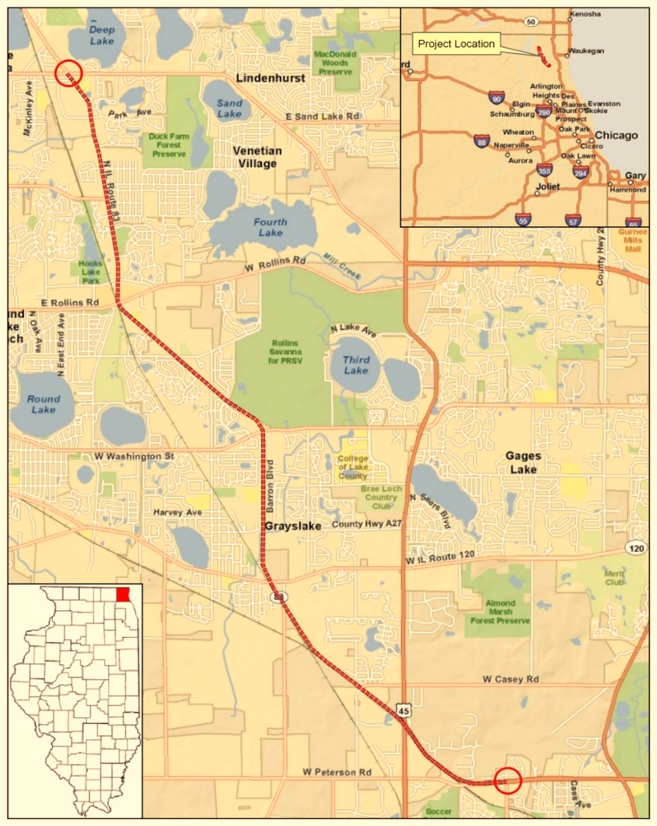

Purpose and Need Screening
Capacity with 4-Lane Alternatives
  IL 132
A
B
  Rollins Rd.
C
  Washington St.
D
  IL 120
E
  US 45
  IL 83
F
  Peterson Rd.
  IL 137
www.idot.illinois.gov/projects/il83-137-study
Notes:
To determine the feasibility of 4-lane alternatives, they were also analyzed to determine capacity. As previously stated, the design criteria requires a projected 2040 traffic capacity level of D or Higher.
Using Highway Capacity Software and projected traffic volumes provided by Chicago Metropolitan Agency for Planning, the Projected LOS in these areas with a 4 lane improvement was found to be between a B and a D.
Since the 4-lane alternatives provide suitable mobility, 4-lane design alternatives will be used for the Range of Alternatives throughout the corridor.

Slide 25

Corridor Characteristics
  IL 132
  IL 132
North Section – IL 132 to Washington St.
  Suburban
  Moderate development
  Rollins Rd.
Central Section – Washington St. to IL 120
  Urban
  Highly developed
  Washington St.
  IL 120
South Section – IL 120 to East of US 45
  US 45
  Rural
  Low development
  IL 83
www.idot.illinois.gov/projects/il83-137-study
  Peterson Rd.
Notes:
The characteristics of the corridor area is another important element in identifying the elements used in the Range of Alternatives.
The land use varies significantly along the Illinois 83 and Illinois 137 corridor area. To develop alternatives that more closely align with the land use in the various areas, the corridor was first divided into 3 sections for evaluation due to distinctly different characteristics. These are referred to as the project’s north, central and south sections.
The North section extends from IL 132 to Washington St and is suburban in nature with moderate level of development
The Central section extends from Washington St. to IL 120 is a more highly developed or urban section
and a South section extending from IL 120 to east of US45 has higher operating speeds and is more rural.
By dividing the corridor up in this way we could better focus on the alternatives in those areas that will better serve the community.

Slide 26
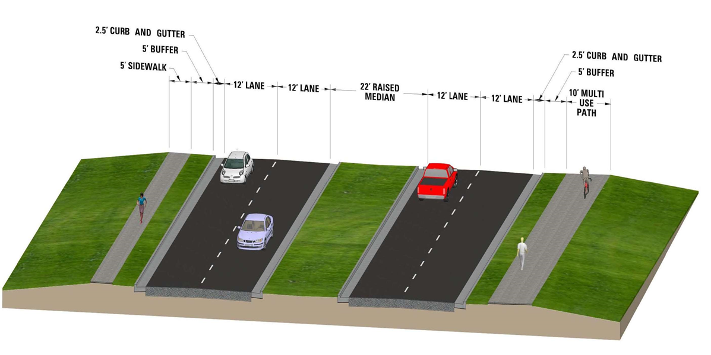
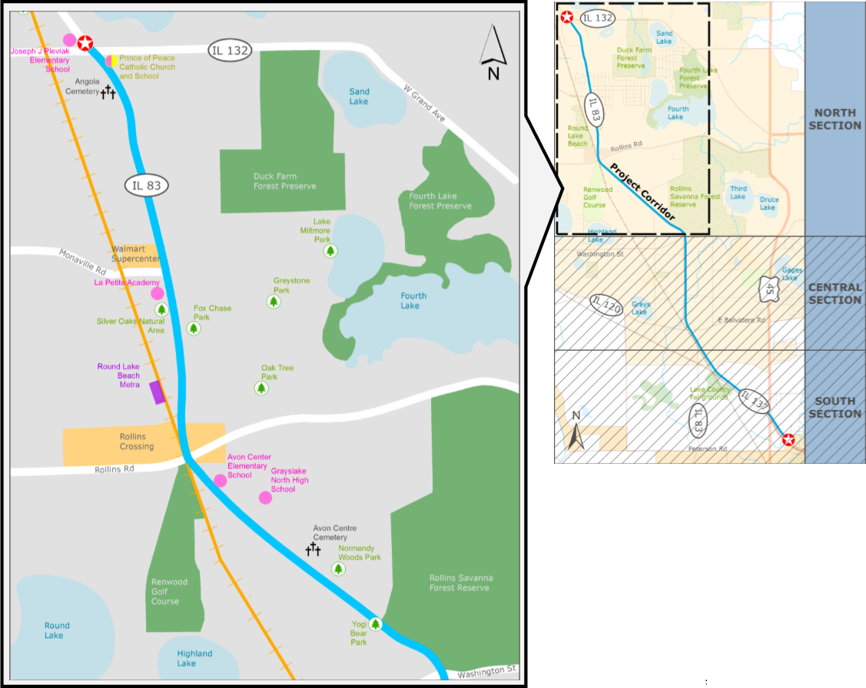
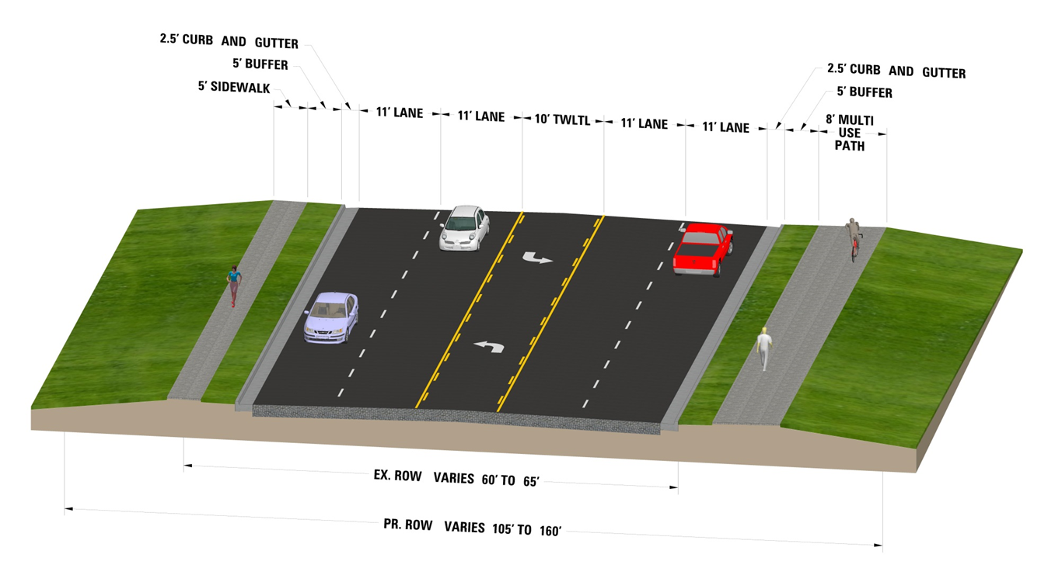

Range of Alternatives
North Section – IL132 to Washington St.
  IL 132
4-Lanes w/ Raised Curb Median
  NORTH CENTRAL SOUTH
4-Lanes w/ Flush Center Turn Lane
(from IL 132 to Park Ave)
  Rollins Rd.
Notes:
In the North Section, we have two alternatives.
The first alternative is a 4-lane cross-section with a 22 foot barrier median, outside curb and gutter, a sidewalk on the west side of the roadway and a multi-use path along the east side of the roadway. This alternative would extend throughout the north section.
In the northern portion of the North section there are numerous commercial and residential close to the roadway and frequent access points. An alternative design in this area is a 4-lane section with a flush center turn lane. This alternative narrows the footprint and would provide more access but safety impacts related to two way left turn lanes will need to be reviewed. This alternative would also include a multi-use path along the east side of the roadway throughout the section and a sidewalk on the west side of the roadway through most of the section.

Slide 27
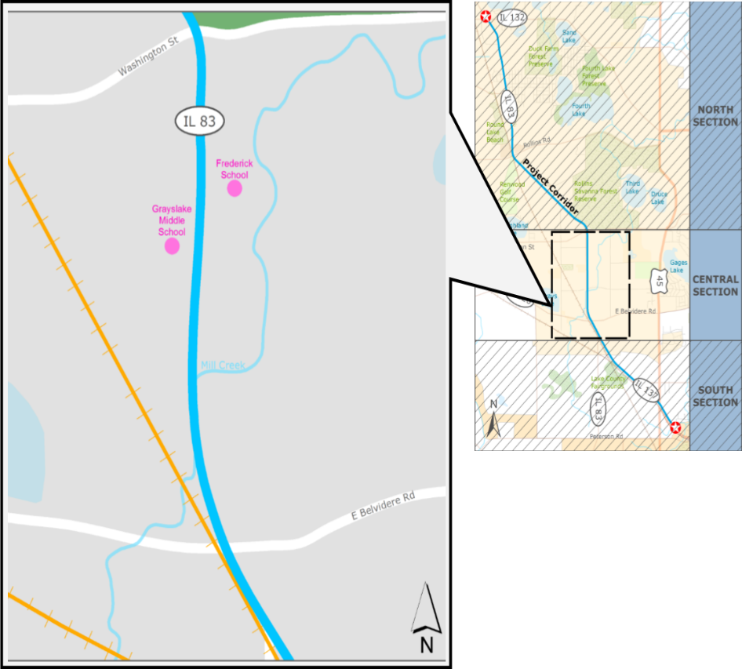
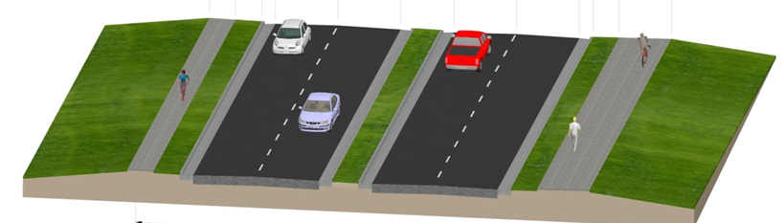
Range of Alternatives
Central Section – Washington St. to Center St.
4-Lanes w/ Raised Curb Median
  Washington St.
  NORTH CENTRAL SOUTH
4-Lanes w/ Flush Center Turn Lane
  Center St.
4-Lanes w/ Narrow Raised Curb Median
and Roundabouts
  IL 120
Notes:
In the Central Section three alternatives were developed.
The first alternative replicates the 4-lane cross-section in the north section, with a 22 foot barrier median and outside curb and gutter.
The second alternative is a 4-lane roadway with a paved two-way left turn lane median and outside curb and gutter.
The third alternative is a 4-lane roadway with a narrower 8 foot barrier median and outside curb and gutter. This alternative includes roundabout improvements at two of the intersections within the section. All three alternatives primarily follow the existing centerline alignment and include a multi-use path along the east side of the roadway and a sidewalk on the west side of the roadway throughout the length of the section.

Slide 28
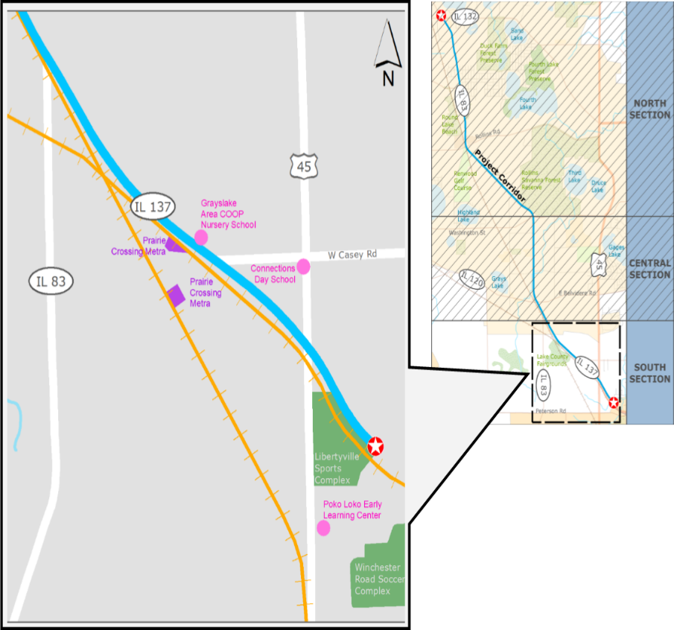
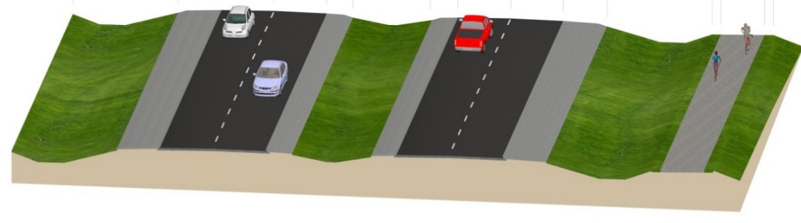
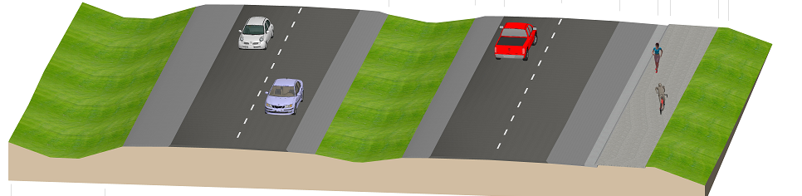
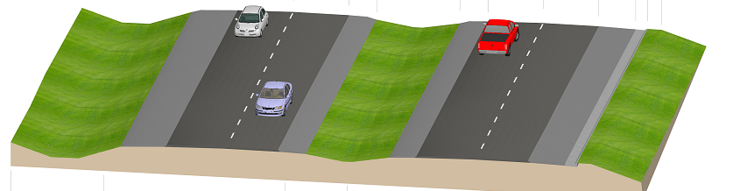
Range of Alternatives
South Section – IL83 to East of US45
4-Lanes w/ Depressed Grass Median
  US 45
  NORTH CENTRAL SOUTH
  Casey Rd
Additional Alternatives in Areas of Development
Notes:
In the South Section an alternative was first developed that provides a 4-lane roadway with a standard 50 foot wide depressed median, outside paved shoulders and ditches and a multi-use path along the east side of the roadway.
This section lies immediately adjacent to a railroad and constraints on right-of way were recognized immediately, so to reduce the right-of-way impacts an alternative was developed with a narrower 30 foot depressed median. This alternative reduced impacts significantly, allowing the 50’ alternative to be eliminated from further consideration. This alternative is the primary design used throughout the South Section.
In the areas of residential development, the 30’ median alternative was refined to provide alternatives that further reduced impacts. These include an alternative that places the multi-use path along the edge of the shoulder , and an alternative with no path along the roadway.
An overhead view of the all of the alternatives in each section is provided for view today in the proceeding exhibit room.

Slide 29

Next Steps
Further refine alternatives using feedback
Alternatives to be Carried Forward
Public Meeting #3 Tentatively Winter 2016
www.idot.illinois.gov/projects/il83-137-study
Notes:
With the range of alternatives identified, the next steps in completing the study are: to use feedback from the community to help refine the alternatives, to screen the alternatives to determine the Alternatives to be Carried Forward, and to provide these refinements to the community in a Public meeting (tentatively scheduled for later this year).

Slide 30
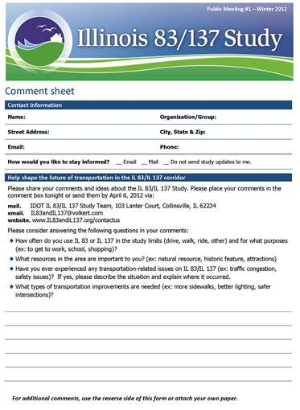
We Need Your Input
Complete a comment form here today
Forms can also be found online at:
www.idot.illinois.gov/projects/il83-137-study
E-mail project team at: IL83andIL137@volkert.com
Comments received by June 7th will be included in public meeting record
www.idot.illinois.gov/projects/il83-137-study
Notes:
We hope this information has been helpful in understanding the Illinois 83 and Illinois 137 study and where we are in the process.
Your input is very valuable to the project study so please review the alternatives in the next room and share your thoughts and comments by completing a comment form which are available here or on our project website. Or by sending comments by email to the project team the website and email addresses are provided on your comment sheets.
Comments received by June 7th will be included in the public meeting record.

Slide 31
Thank you!
Please Proceed to View Exhibits and meet with our Project Team
(this presentation will start again in a few minutes)
www.idot.illinois.gov/projects/il83-137-study
Notes:
Thank you for taking the time to attend tonight’s meeting.
Please proceed to the next room where the project exhibits are displayed, team members will be available to answer your questions and comment sheets can be submitted.

