Slide 1
IDOT Active Transportation Plan
Joint Meeting for the Steering Committee & Stakeholder Advisory Group
11.30.2023
Notes:
IDOT welcomes

Slide 2





Core Project Team
Notes:
Jennifer

Slide 3
Today’s Agenda
1. Project Schedule
2. Existing Conditions
3. VRU Safety Assessment
4. Public Engagement Update
5. Draft Recommendations Framework
6. TSG Stakeholder Feedback Round 1
7. Next Steps
Notes:
Jennifer
Ask participants to introduce themselves in the chat.

Slide 4
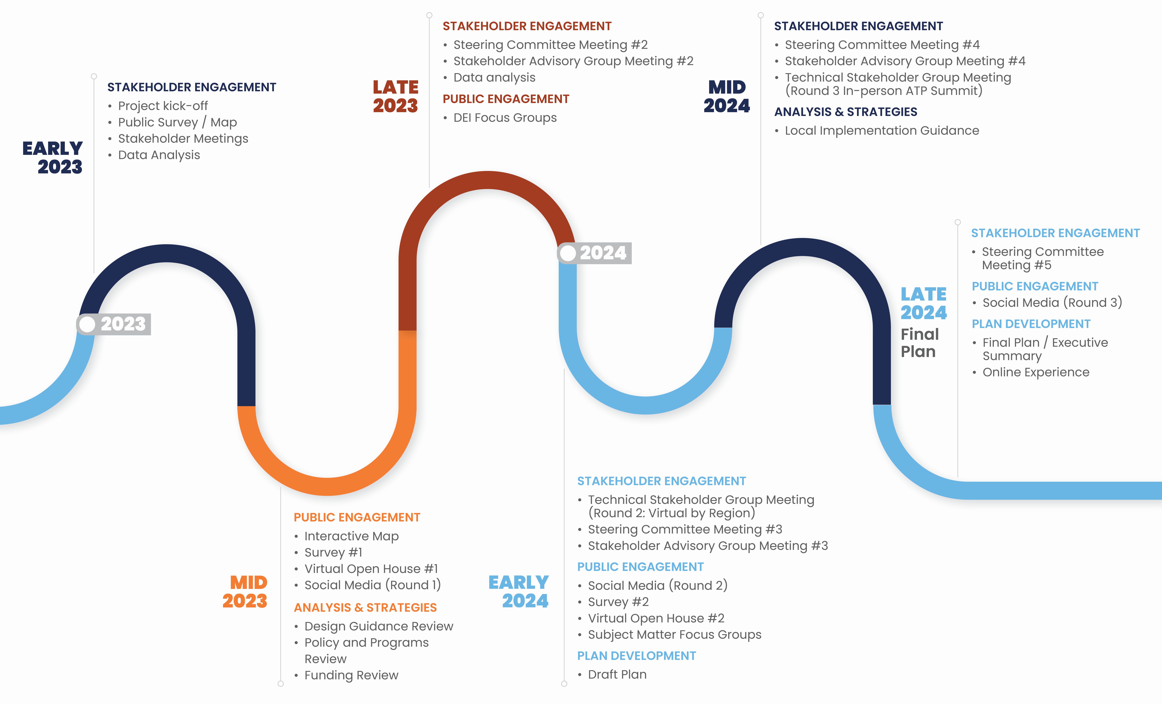
Schedule
Notes:
Jennifer

Slide 5

Existing Conditions
Cutsheets at the district- and state-level
Notes:
Sara K

Slide 6
Existing Conditions Analysis
Demand Analysis
Health Analysis
Equity Analysis
Level of Traffic Stress
Safety Analysis
(VRU Study)
Current State of Biking and Walking in Illinois
AT Design
Funding
Maintenance
New Mobility
Notes:
Sara K

Slide 7
Demand Analysis factors
Data Measure | Definition | Walk Score Weight | Bike Score Weight
Intersection Density | Smart Location Database (EPA, 2021) D3B | 10% | 0%
Bike Facility Density (quality adjusted) | Illinois DOT Bicycle Facility Inventory System Data 2023 | 0% | 15%
Proximity to Transit Stops | National Transit Map Stops (BTS, 2022) | 10% | 5%
Proximity to Entertainment | OpenStreetMap | 5% | 5%
Proximity to Grocery Stores | USDA SNAP Eligible Retailers | 5% | 5%
Proximity to Parks | OpenStreetMap | 10% | 10%
Proximity to Schools | Homeland Infrastructure Foundation-Level Data (HIFLD) | 10% | 10%
Employment Mix | Smart Location Database (EPA, 2021), D2B_E8MIXA | 5% | 5%
Employment + Housing Mix | Smart Location Database (EPA, 2021), D2A_EPHHM | 5% | 5%
Housing Unit Density | Smart Location Database (EPA, 2021), D1A | 5% | 5%
Job Density | Smart Location Database (EPA, 2021), D1C | 5% | 5%
Percent Zero Vehicle Households | Smart Location Database (EPA, 2021), Pct_AO0 | 15% | 15%
Walk/Bike Mode Commute Split | 2020 5-Year American Community Survey (ACS) | 5% | 5%
Short Trip Making | Replica Places | 10% | 10%
Notes:
Sara K

Slide 8
Equity Analysis factors
Data Measure | Definition | Source | Weight
Economic Opportunity | The percentage of people who grew up in a given census tract who, 30 years later, don’t live in a wealthy census tract | Opportunity Atlas | 10%
Access to a Vehicle | The percentage of households without access to a vehicle | ACS 5-year | 15%
Air Quality | The quantity of particulate matter (PM2.5) in the air | EJ Screen | 10%
Housing Cost Burden | The cost of rent and mortgage payments as a percent of income | ACS 5-year | 5%
Race | The percentage of the population that identifies as non-white and/or Hispanic/Latino | ACS 5-year | 20%
Income | The percentage of households making less than 200% of the Federal Poverty Level, which is a threshold set by the U.S. Census Bureau and updated annually. | ACS 5-year | 25%
Educational Attainment | The percentage of the population over 25 years of age with educational attainment at or less than a high school diploma or equivalent. | ACS 5-year | 10%
Youth & Seniors | The percentage of the population under the age of 18 and over the age of 65 | ACS 5-year | 5%
Notes:
Sara K

Slide 9
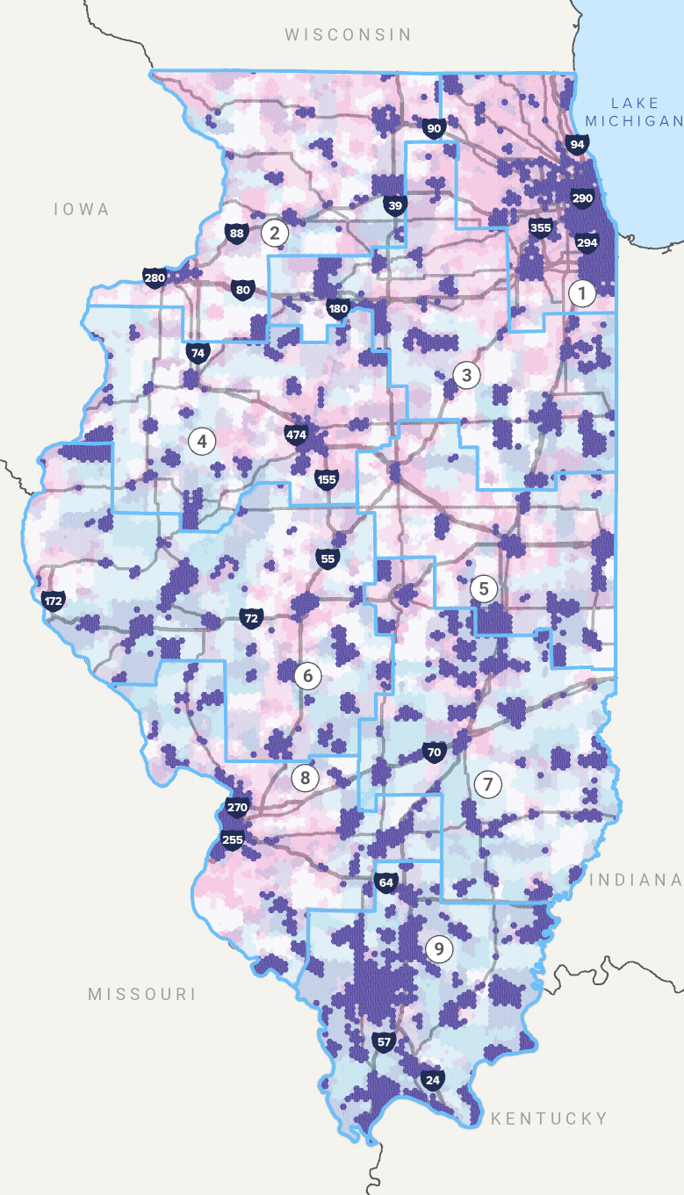
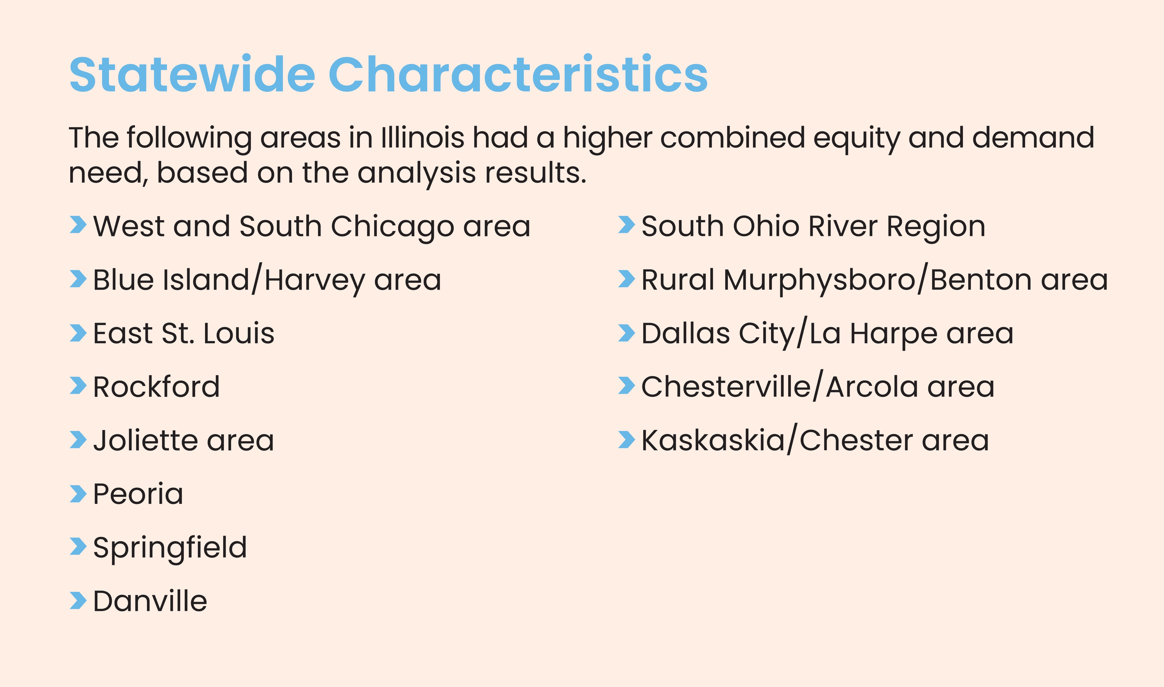
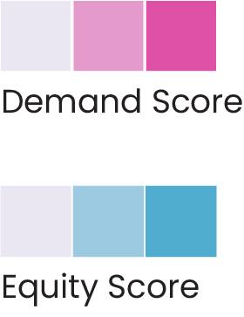
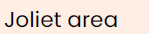
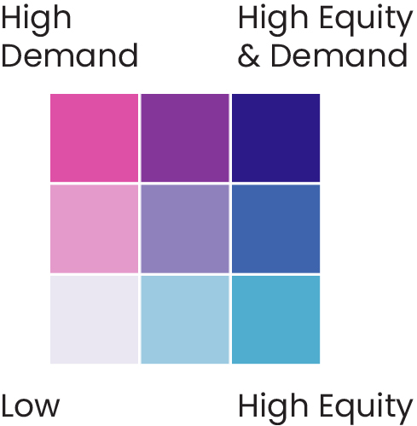
Equity and Demand Overlay
Notes:
Sara K
Use this slide in part to explain the Equity and Demand overlay matrix.

Slide 10
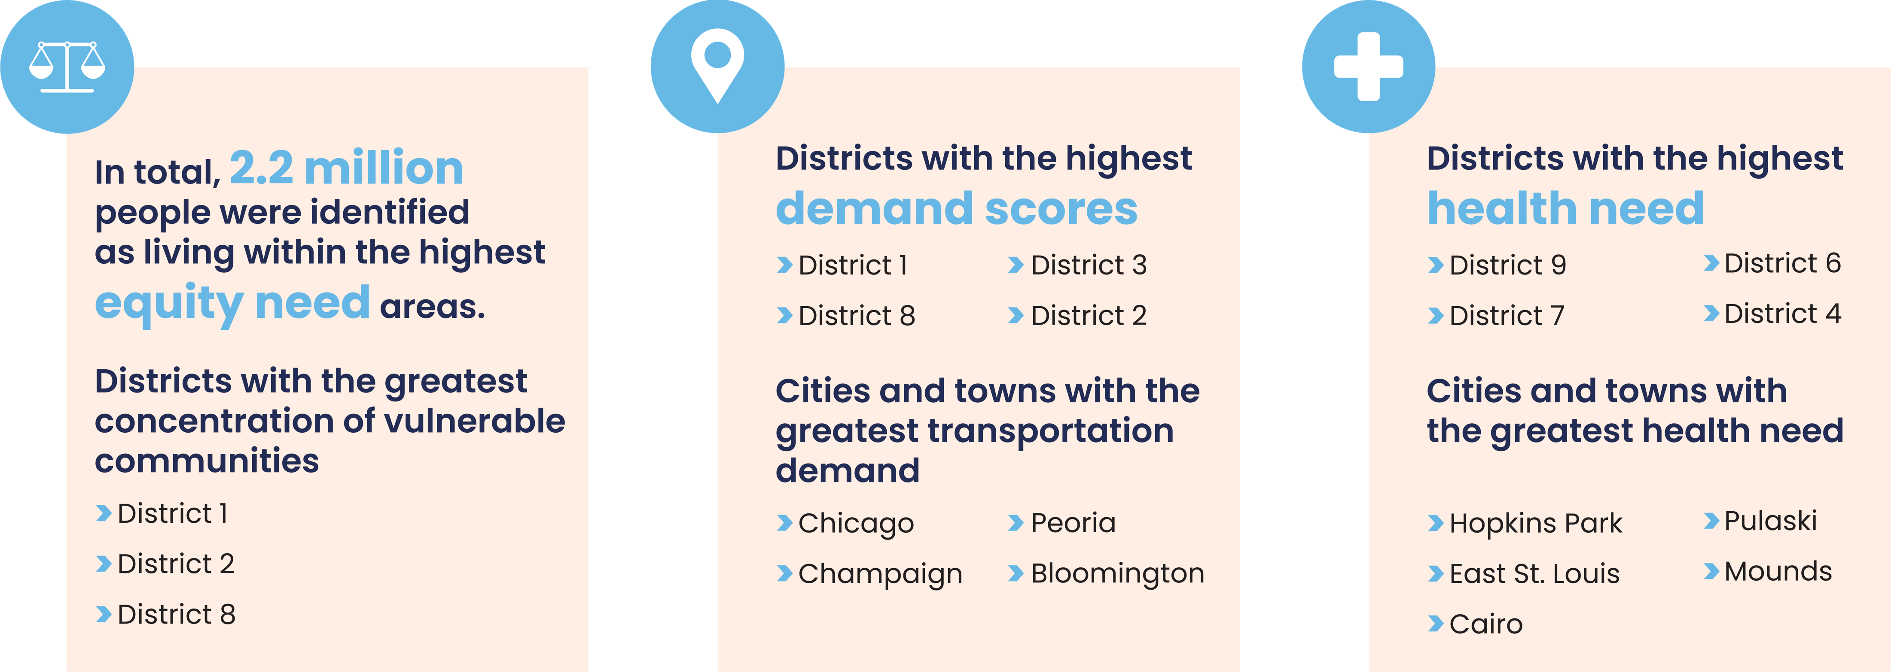
Statewide Results
Notes:
Sara K - IL total population (1/6th)
Talking points for health

Slide 11
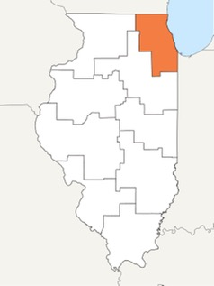
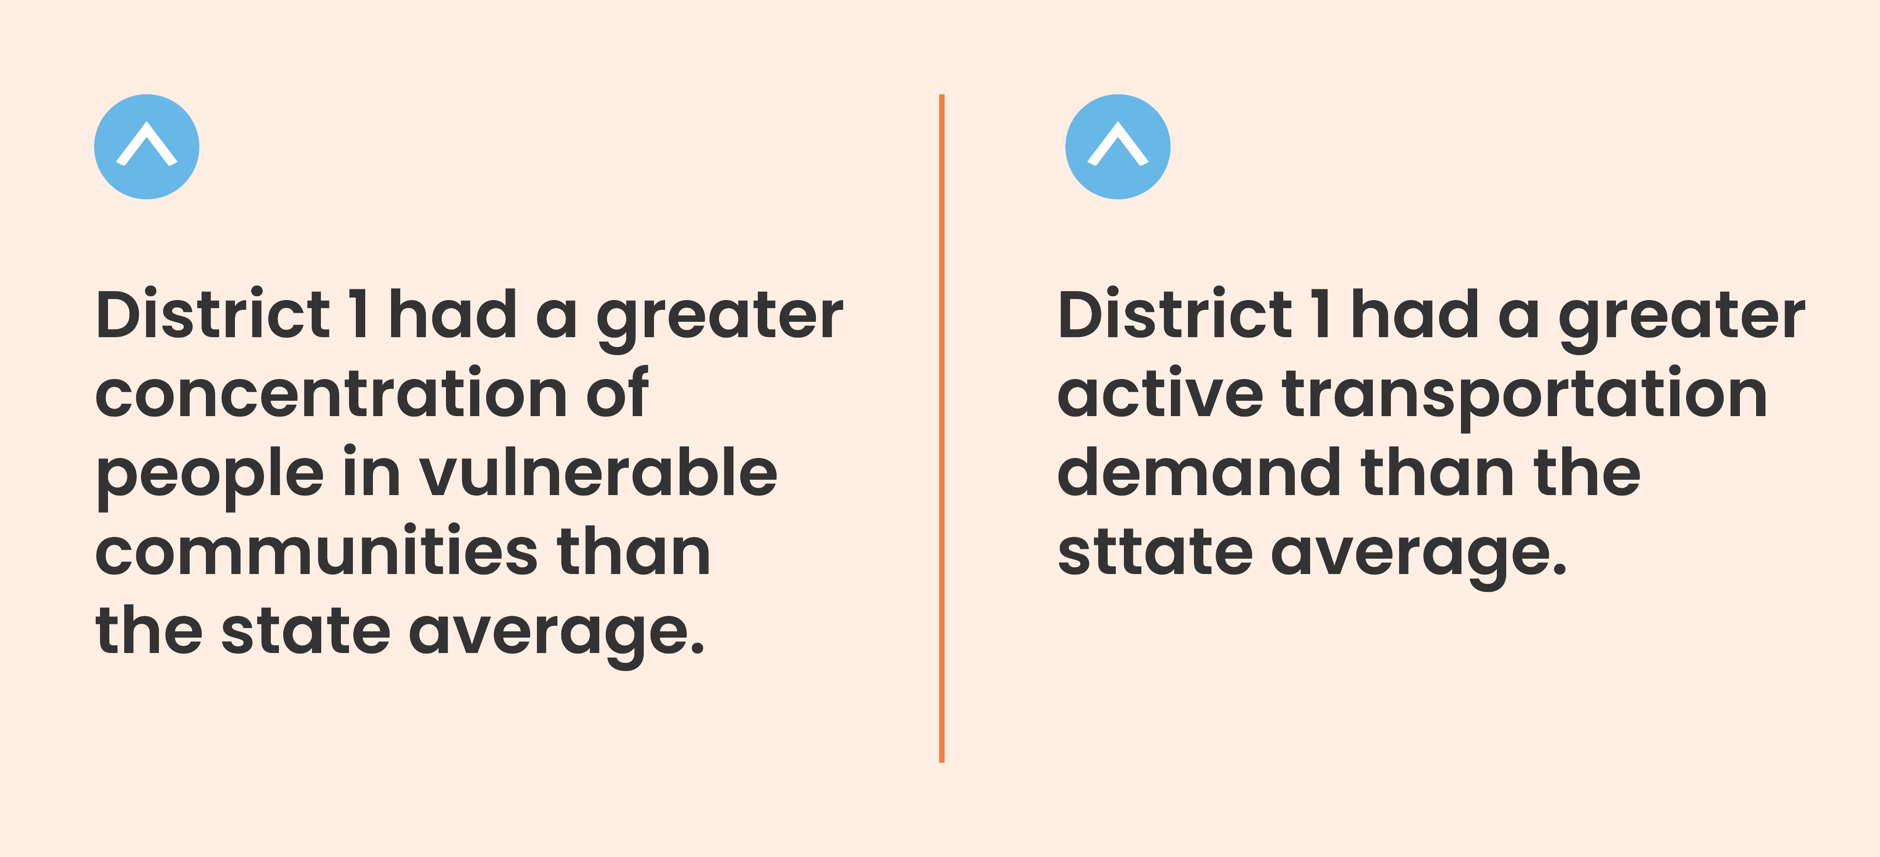

District 1
8,439,776 residents
$44,707
median income
709
miles of bikeways
Notes:
Sara K
*Make a note of where the bikeways data origins. (Feedback from Mike)

Slide 12
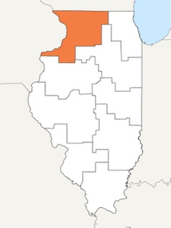
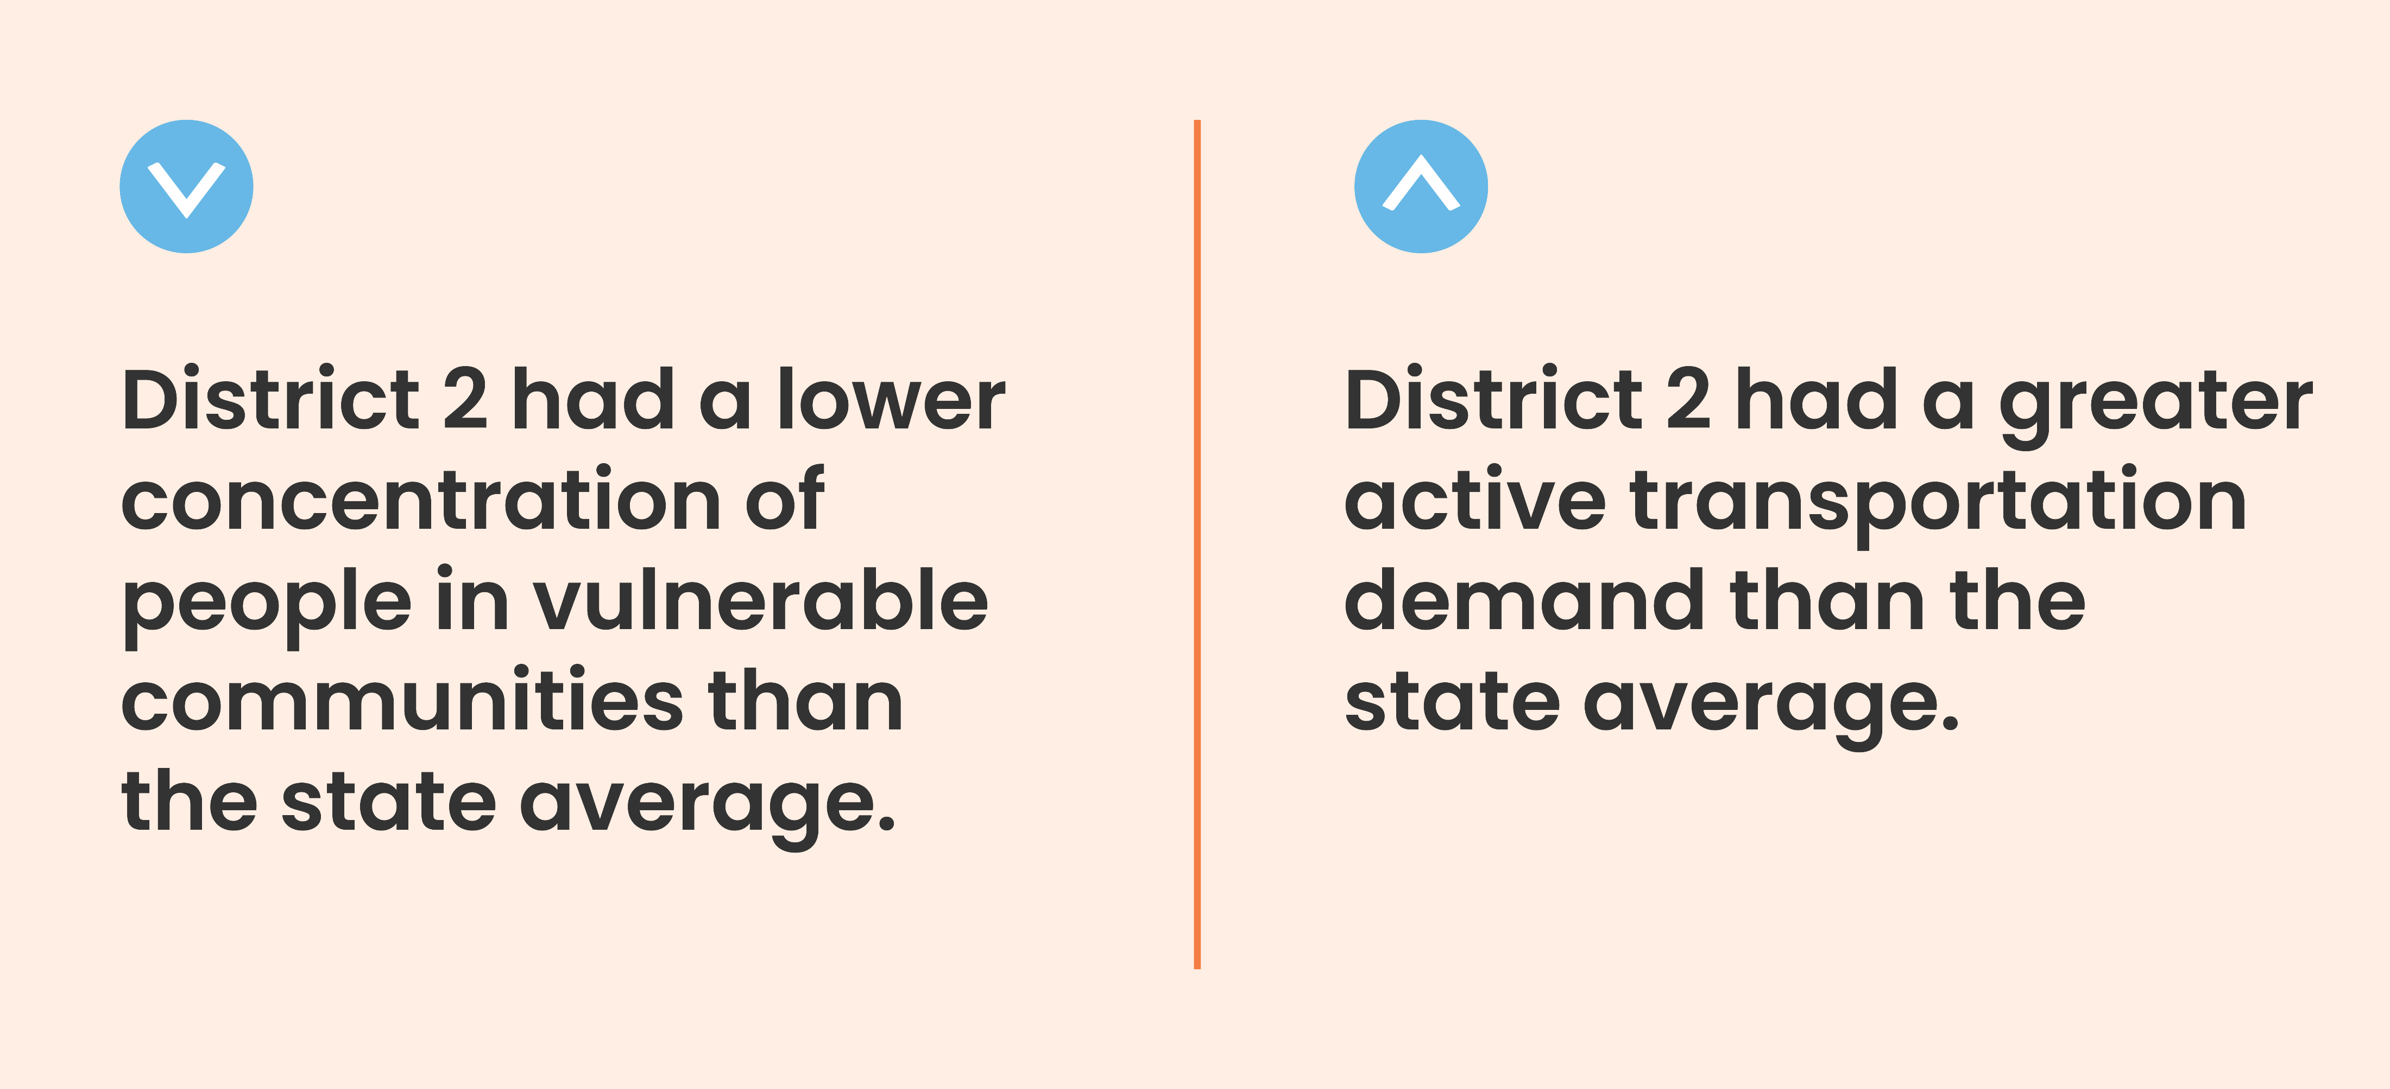
District 2
757,659 residents
$32,186
median income
186
miles of bikeways
Notes:
Sara K – Rockford, Freeport, Rochelle, Quad cities (Rock Island) places along the Rock River

Slide 13
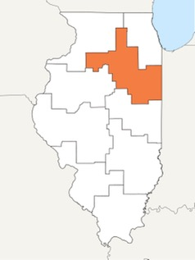

District 3
612,324 residents
$33,865
median income
150
miles of bikeways
Notes:
Sara K – Communities along I-80 and IL River Valley

Slide 14
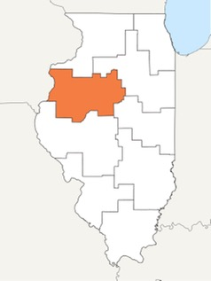
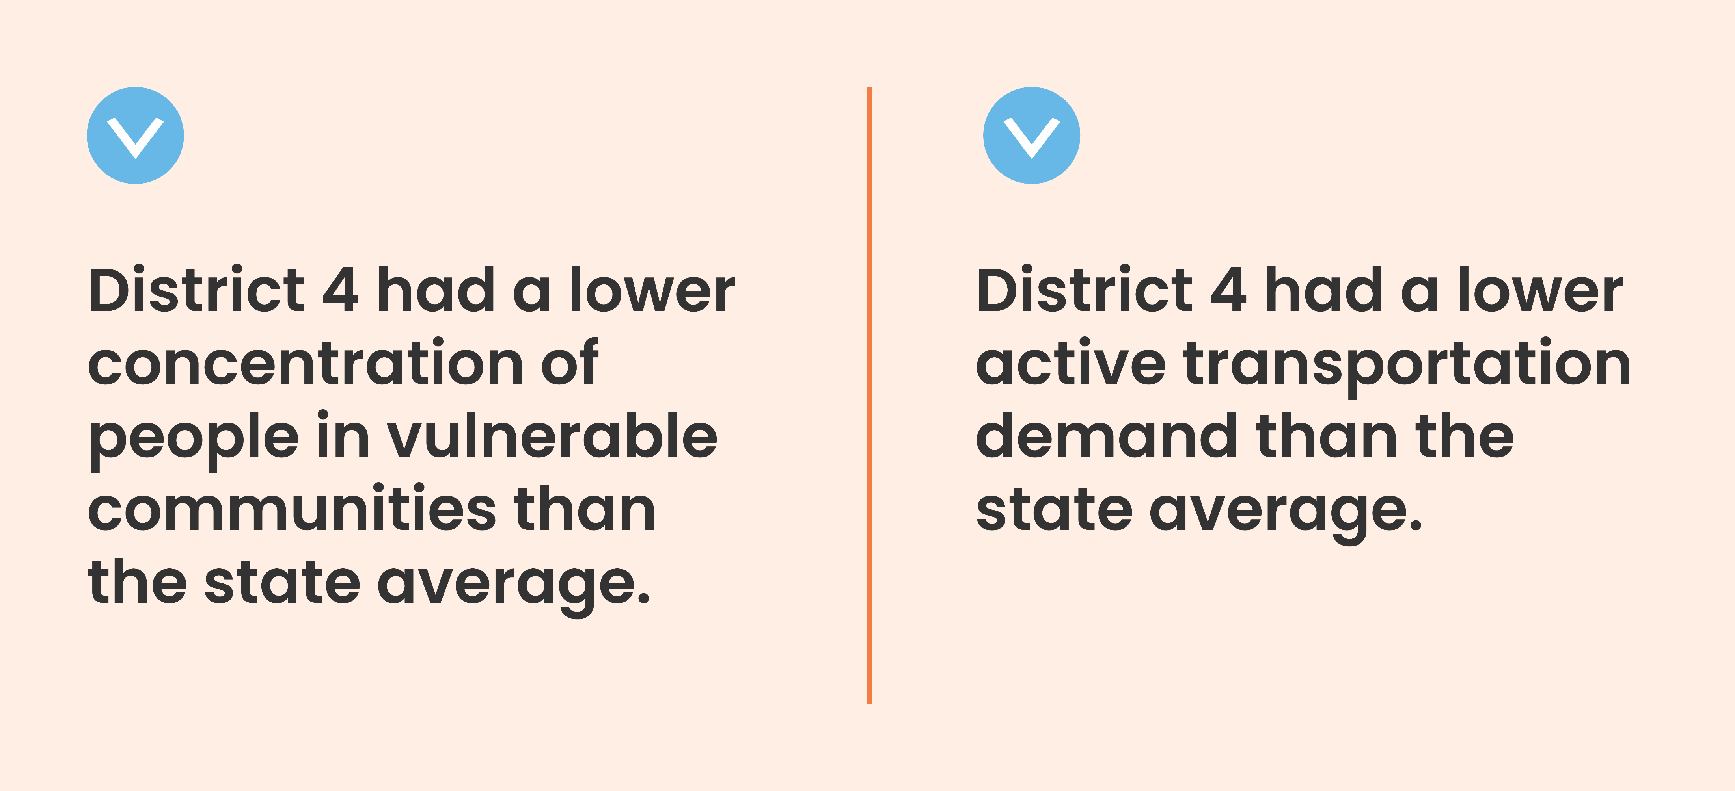
District 4
526,951 residents
$31,304
median income
68
miles of bikeways
Notes:
Sara K

Slide 15
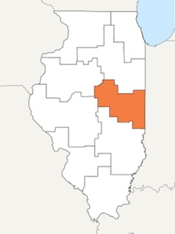

District 5
522,014 residents
$33,068
median income
110
miles of bikeways
Notes:
Sara K
- Champaign Urbana and communities along Us 36

Slide 16
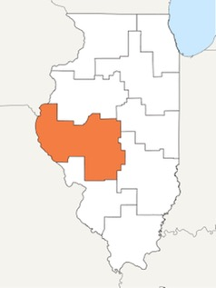

District 6
521,241 residents
$31,841
median income
348
miles of bikeways
Notes:
Sara K – Springfield and communities along IL River

Slide 17
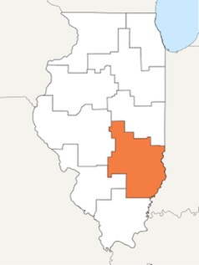

District 7
376,572 residents
$30,682
median income
7
miles of bikeways
Notes:
Sara K – Decatur, Communities along I-70 and US-50

Slide 18
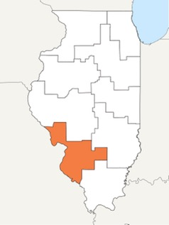

District 8
733,790 residents
$33,327
median income
720
miles of bikeways
Notes:
Sara K – East St Louis

Slide 19
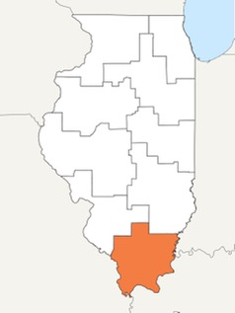

District 9
331,486 residents
$27,387
median income
315
miles of bikeways
Notes:
Sara K – Carbondale, communities west of I-57, communities along the Ohio River

Slide 20

VRU Safety Assessment 2023
Notes:
Juan
We are not doing a separate safety analysis; we are working off this. We will use this to inform strats and action items.

Slide 21
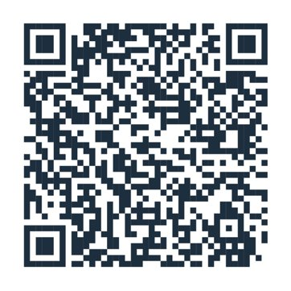

VRU Background
New federal requirement under IIJA
VRU definition
VRU Safety Assessment definition
A vulnerable road user may include:​
People walking, biking, or rolling
Includes a highway worker on foot in a work zone, given they are considered a pedestrian
Does not include a motorcyclist​
Notes:
Juan

Slide 22
VRU Safety Assessment 2023
Overview of Vulnerable Road User Safety Performance
Summary of Quantitative Analysis
Summary of Consultation
Program of Projects or Strategies
Program Implementation
Notes:
Juan

Slide 23
VRU Quantitative Analysis
VRU centric analysis from observed safety data
Consideration of perceived levels of safety
Account for underreported crashes and equity considerations
Develop a comprehensive methodology to blend it all together
Notes:
Juan

Slide 24
VRU Data Sources
Traditional
Crash data
Inventory data
  Roadway segments
  Intersections
  VRU facilities
Land use data
Justice40 data
Non-Traditional
NHTSA VIN-decoder
Hospital records
Composite equity score
Perceived safety data
Stakeholder strategy selection input
Notes:
Juan

Slide 25
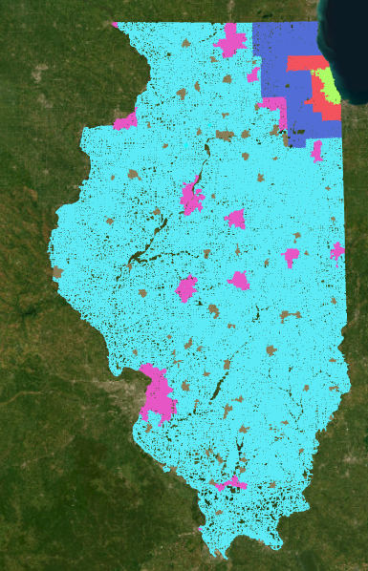
VRU Area Classes
To account for population density, we divided the state into 6 area classes:
  Chicago
  Cook County
  Collar Counties
  Urbanized Areas
  Small Urban Areas
  Rural Areas
Notes:
Juan

Slide 26
VRU High Injury Network
297 miles of high-tier Locations:
  105 mi in Chicago
  69 mi in Cook County
  79.5 mi in Collar Counties
  38.5 mi in Urbanized Areas
  4.5 mi in Urban Areas
  0.5 mi in Rural Areas
52% of high-tier locations are in disadvantaged areas as defined by Justice40 data
75% of high-tier locations are identified by observed safety and 25% are identified based on perceived safety
Notes:
Juan

Slide 27
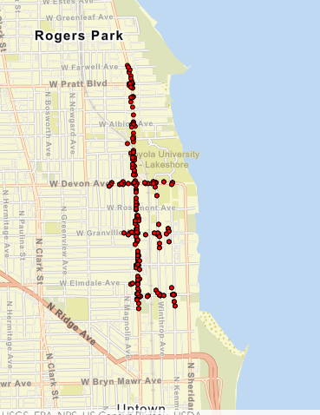
VRU Clusters
Top 3 Pedestrian Cluster Locations in Chicago
Locations Description | Total Crashes | Adjusted Crashes per Year | Justice 40
Pulaski, Adams to Arthington | 241 | 21.63 | Disadvantaged
Broadway, Farewell to Thorndale | 278 | 19.05 | Disadvantaged
Illinois to Chicago, Wells to Orleans | 292 | 16.64 | Not Disadvantaged
Notes:
Juan

Slide 28
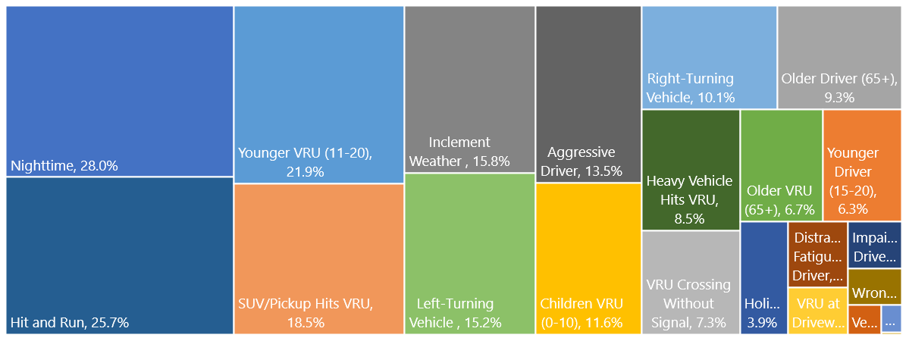
Common Factors in VRU Crashes
Notes:
Juan

Slide 29
VRU : Systemic Safety Analysis
Area Class | VRU Crashes by Mode, Location, and Area Class |  |  |  |  |  | Total
 | Bicycle |  |  | Pedestrian
 | Along Corridor | Signalized Intersection | Unsignalized Intersection | Along Corridor | Signalized Intersection | Unsignalized Intersection
Chicago | 3.2% | 8.0% | 6.6% | 7.1% | 17.3% | 11.4% | 53.6%
Cook County | 1.2% | 2.7% | 3.7% | 2.3% | 3.6% | 4.1% | 17.6%
Collar Counties | 1.2% | 1.7% | 2.7% | 1.9% | 1.7% | 2.5% | 11.7%
Urbanized | 0.9% | 1.4% | 2.5% | 1.7% | 1.7% | 2.7% | 10.8%
Urban | 0.3% | 0.3% | 1.1% | 0.5% | 0.3% | 0.9% | 3.3%
Rural | 0.7% | 0.0% | 0.3% | 1.5% | 0.0% | 0.4% | 3.0%
Total | 7.5% | 14.2% | 16.9% | 15.0% | 24.5% | 22.0%
Notes:
Juan

Slide 30
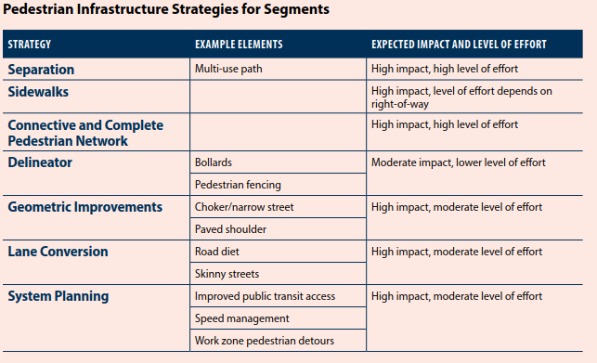
VRU : Program of Projects or Strategies
Strategies and Countermeasures
  Infrastructure strategies for intersections and segments
  Safe System Approach strategies
  National research resources
Application
  Systemic analysis
  Stakeholder input
​
Notes:
Juan

Slide 31
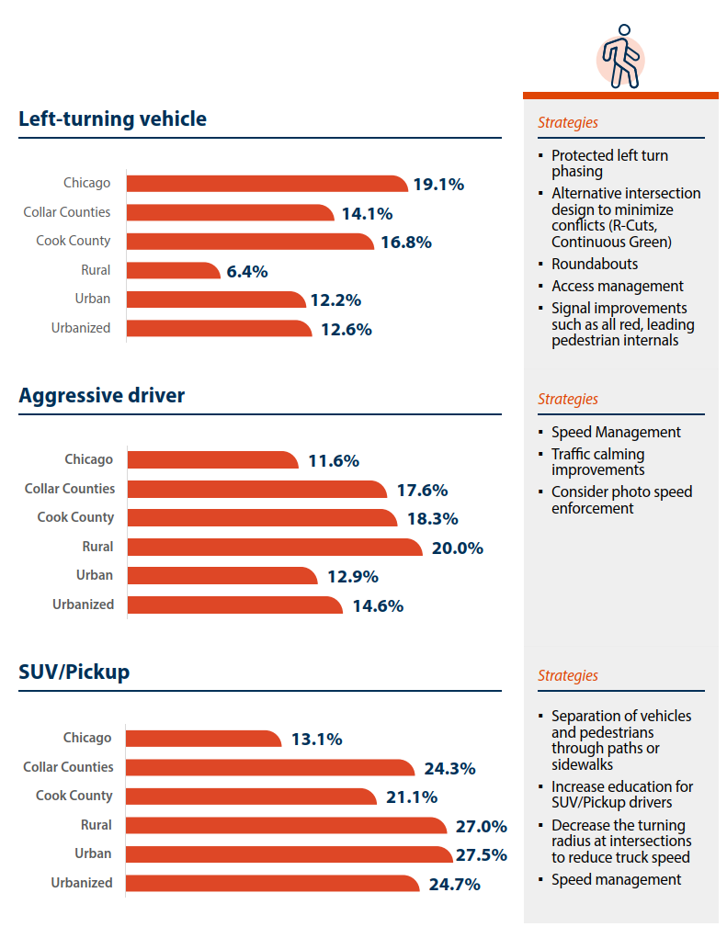
Common Factors and Strategies for Pedestrians
Notes:
Juan

Slide 32
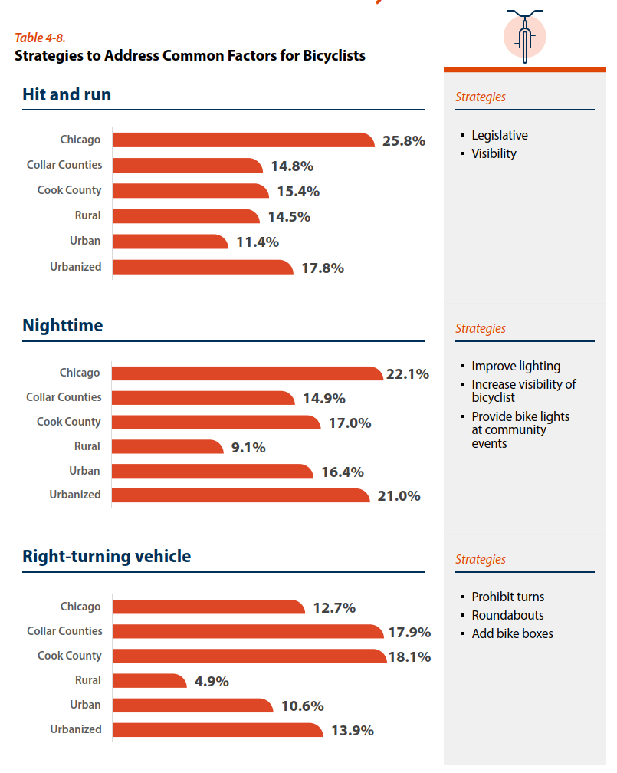
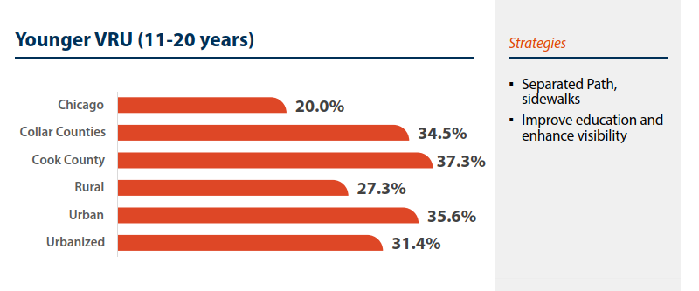
Common Factors and Strategies for Bicyclists
Notes:
Juan

Slide 33
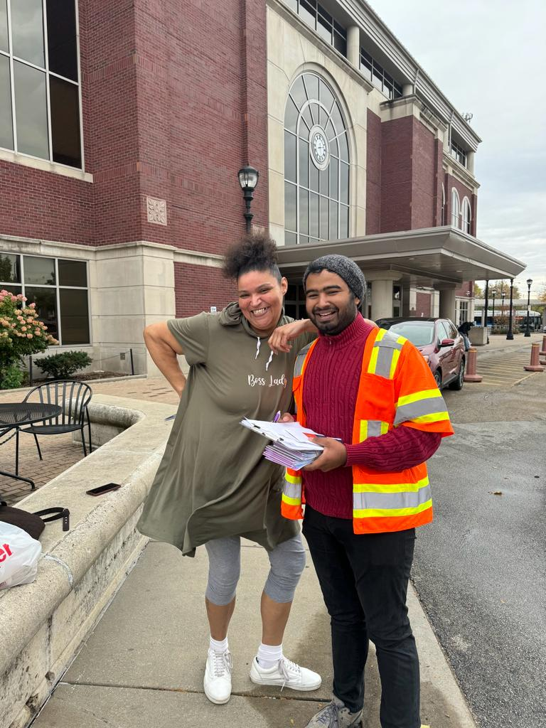
Public Engagement
High-level trends emerging from interactive map & survey
Notes:
Kristina

Slide 34
Pop-up Events
14 Events with
340 Intercept Surveys and
2,833 Project Postcards
Distributed
Online Public Survey
2,442 Surveys Completed
Virtual Open House
123 Visitors
Technical Stakeholder Meetings
Meeting #1: Spring 2023
Meeting #2: Early 2024
Meeting #3: Fall 2024
Targeted Focus Groups (DEI)
Subject Matter Focus Groups
Interactive Map
4,133 Comments
Notes:
Kristina

Slide 35
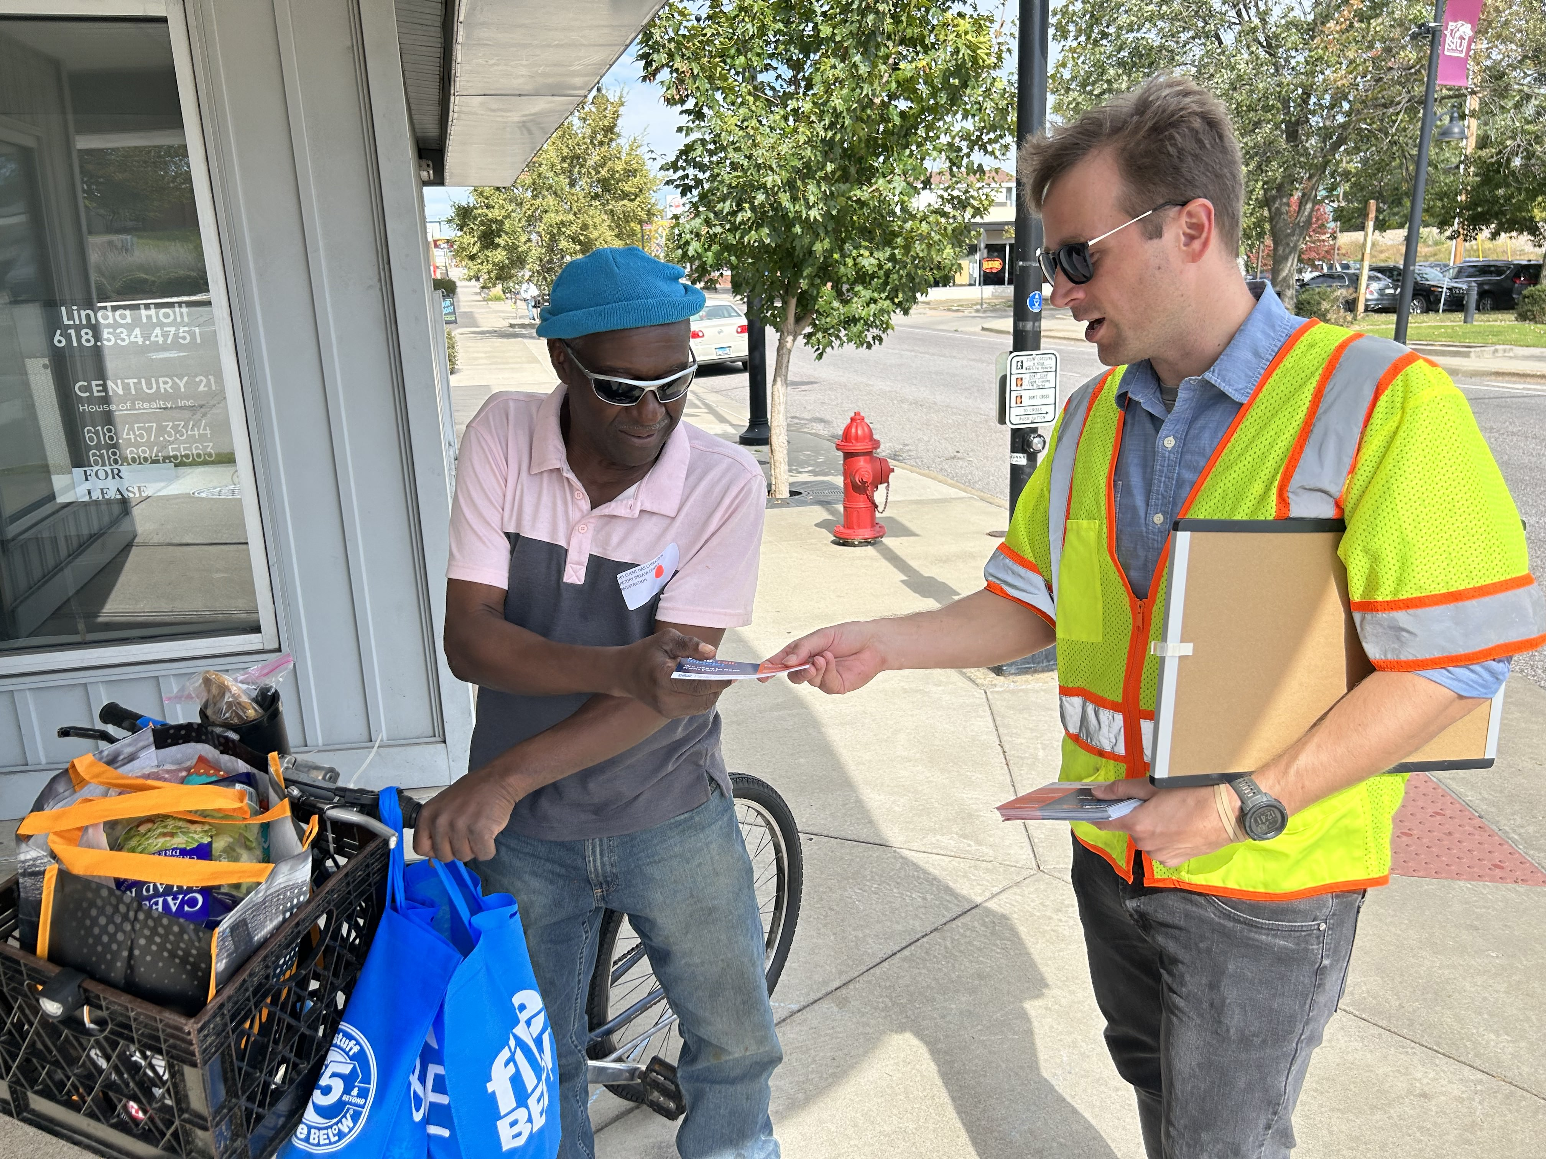
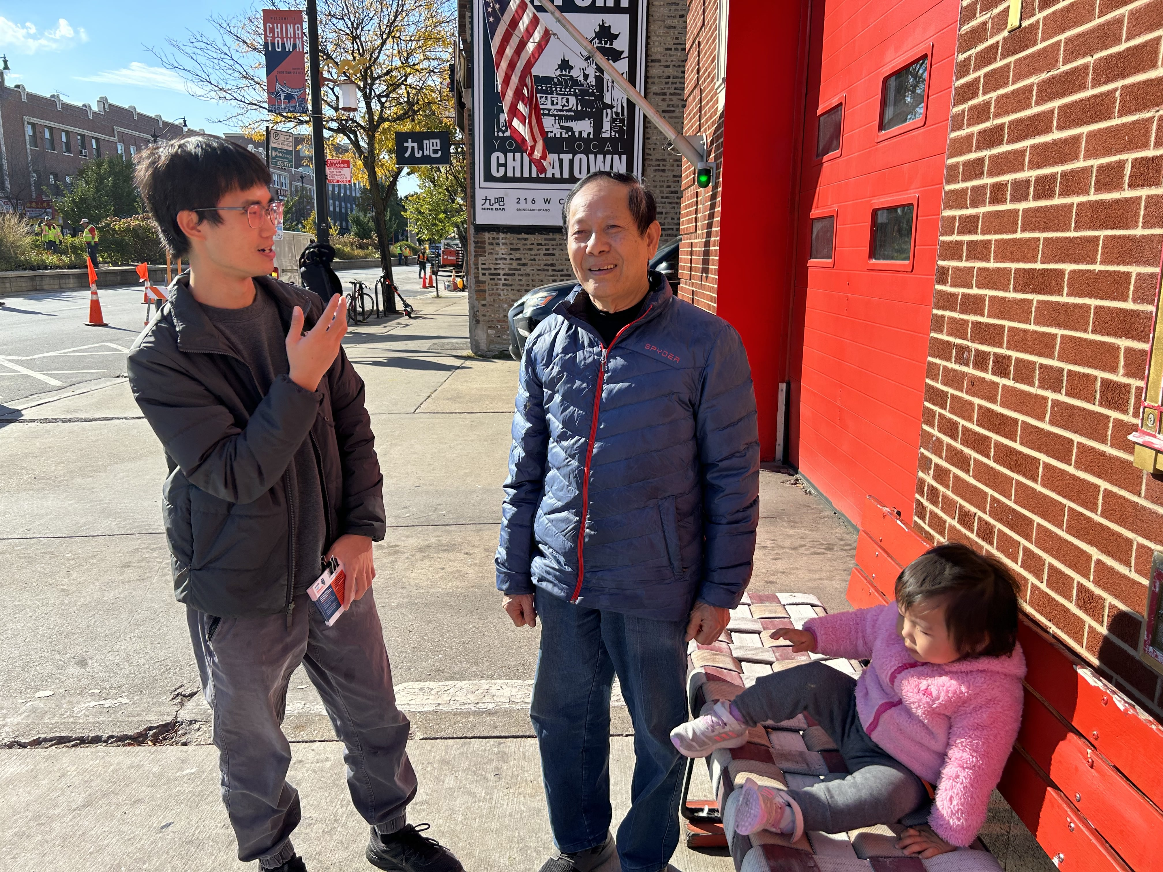
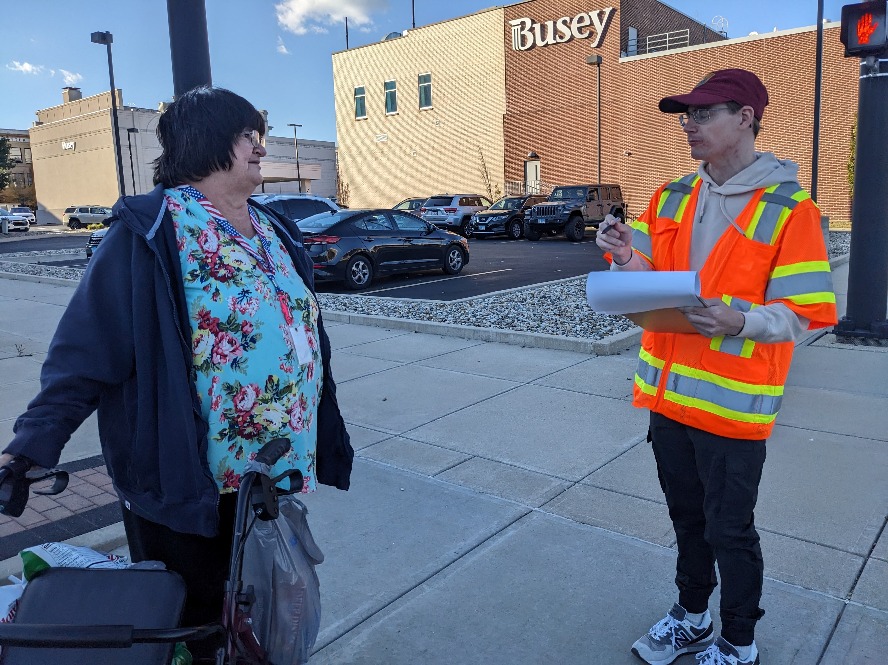
Targeted Outreach
District | City | Location | Date | Surveys collected | Postcards distributed
1 | Chicago | Chinatown Public Library & Business District | 10/23 | 34 | 65
2 | Moline | Center Station | 10/26 | 10 | 115
3 | Kankakee | Kankakee Public Library | 10/23 | 6 | 60
4 | Peoria | Transit Center | 10/25 | 12 | 50
5 | Champaign | Illinois Terminal | 10/25 | 11 | 62
6 | Springfield | Downtown SMTD Transfer Center | 10/20 | 5 | 68
7 | Decatur | Downtown Transportation Center | 10/20 | 10 | 40
8 | East St Louis, Granite City | JJK Station MetroLink Station, Downtown Granite City | 10/19 | 4 | 73
9 | Carbondale | Downtown Carbondale | 10/18 | 5 | 46
Totals |  |  | Total | 97 | 533
Notes:
Kristina

Slide 36
Additional Targeted Outreach
District | City | Location | Date | Attendees | Postcards/Survey Link distributed
 |  | Illinois Statewide Metropolitan Planning Organization Meeting | 6/6 | 43 attendees (14 of 16 MPOs)
 |  | SUMC Booth at Conference | 5/3 | ~150 booth visitors | 150
2 | East Moline | Quad Cities Marathon Club | 10/26 |  | 100
2 | Moline | Quad Cities Bicycle Club | 10/26 |  | 2,000
6 | Quincy | Quincy Transit Public Meeting | 10/26 | 50 | 50
Totals |  |  | Total | 243 | 2,300

Slide 37
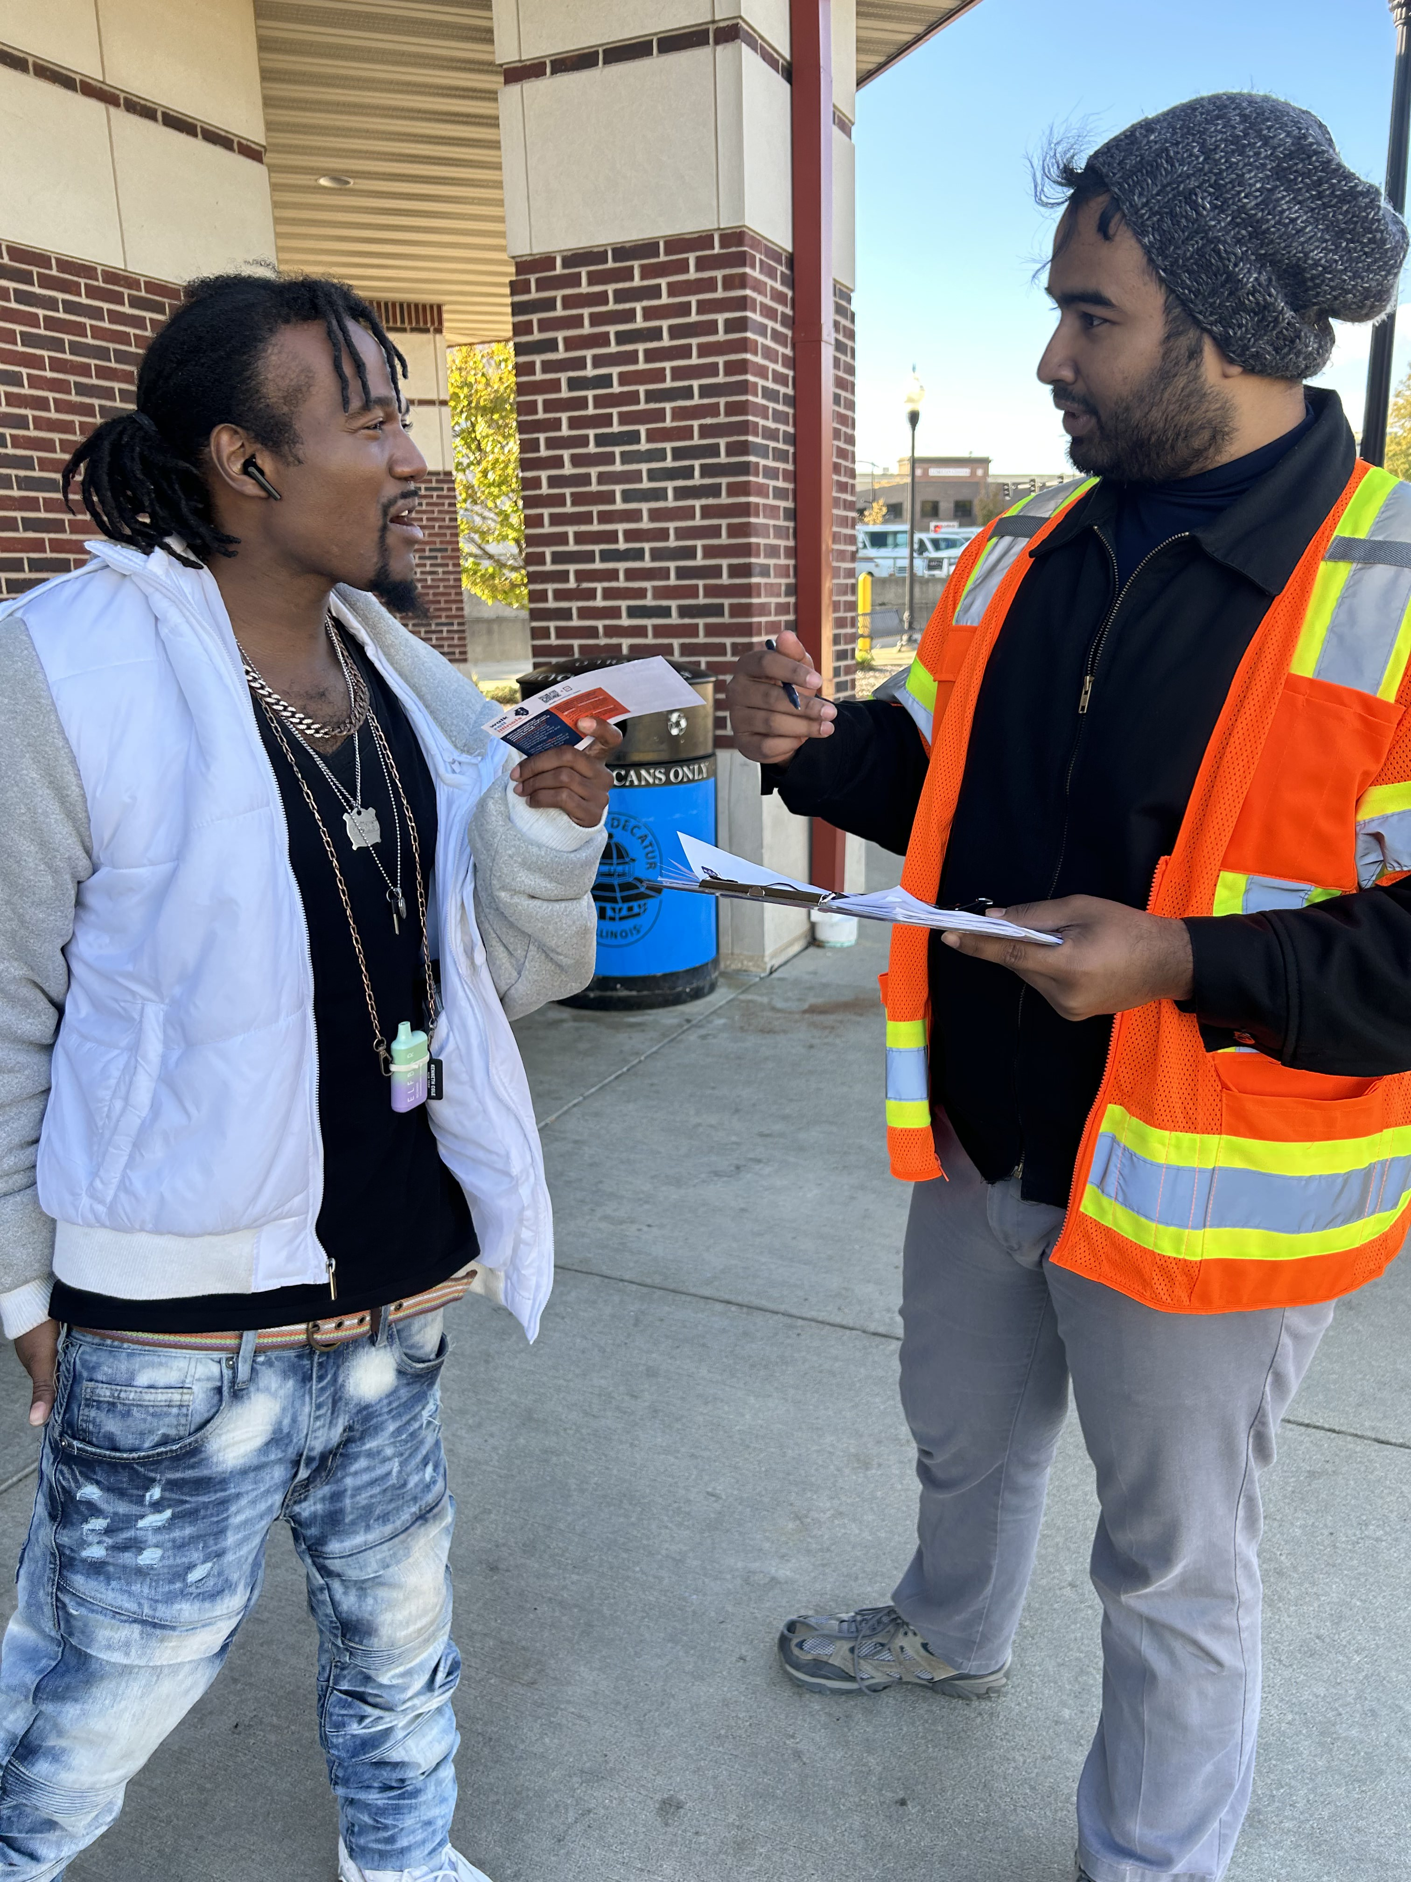
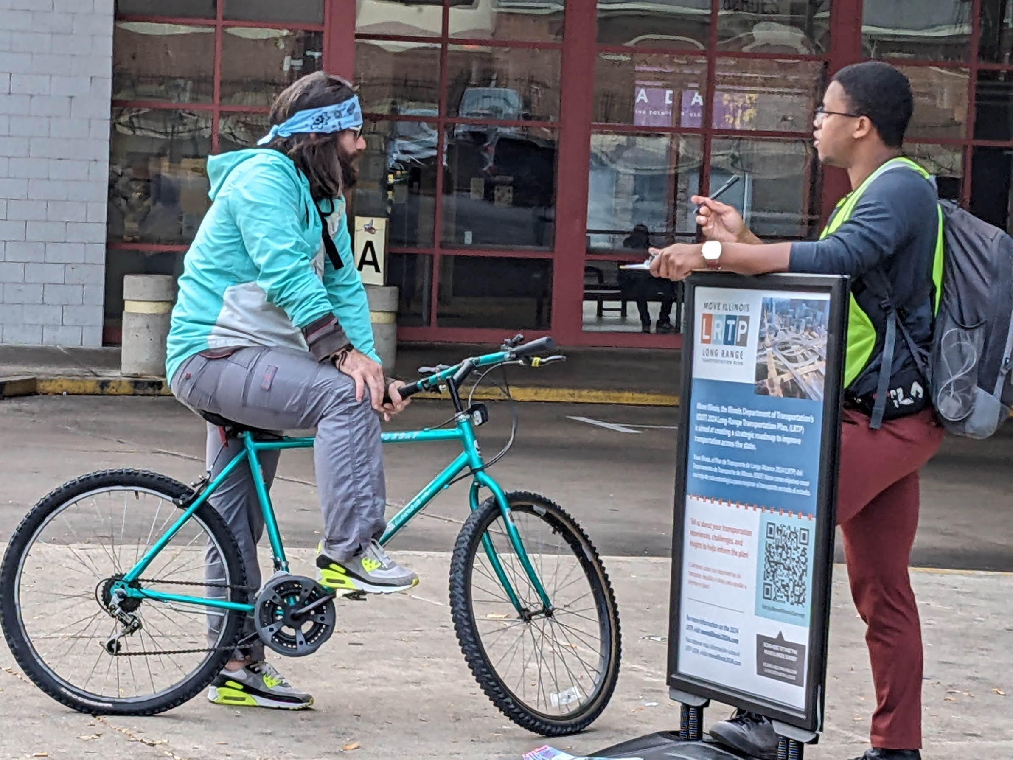
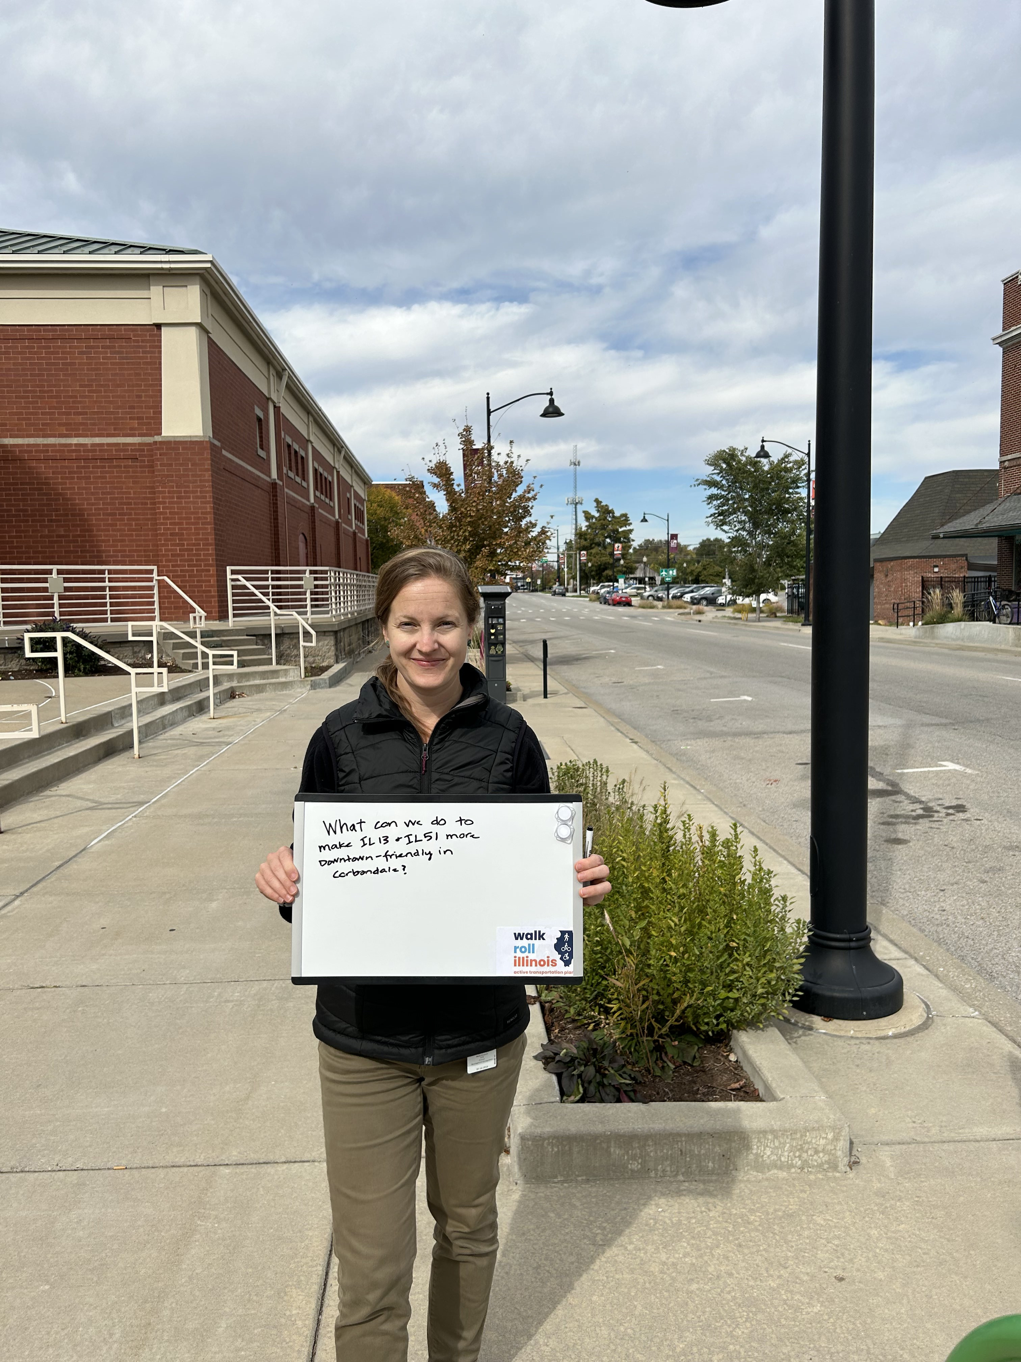
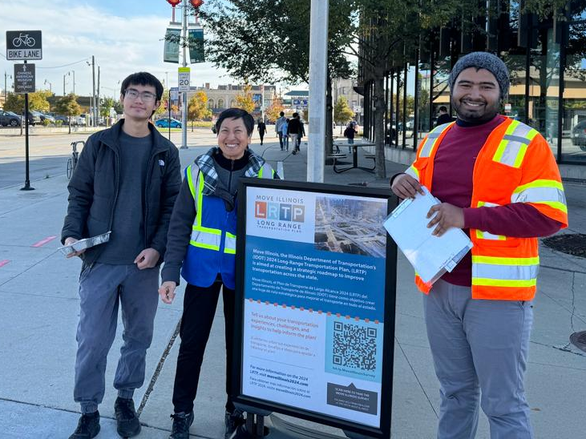
Targeted Outreach
Highlights:
Chicago: Support from the Coalition for a Better Chinese American Community (CBCAC), who offered their Corridor Ambassadors to support efforts in Chinatown and provide translation service
Peoria: Tri-County RPC offered staffing support to conduct outreach efforts, distributed flyers and collected surveys at their regional active transportation plan meeting
Notes:
Krstina (or Kevin?)

Slide 38
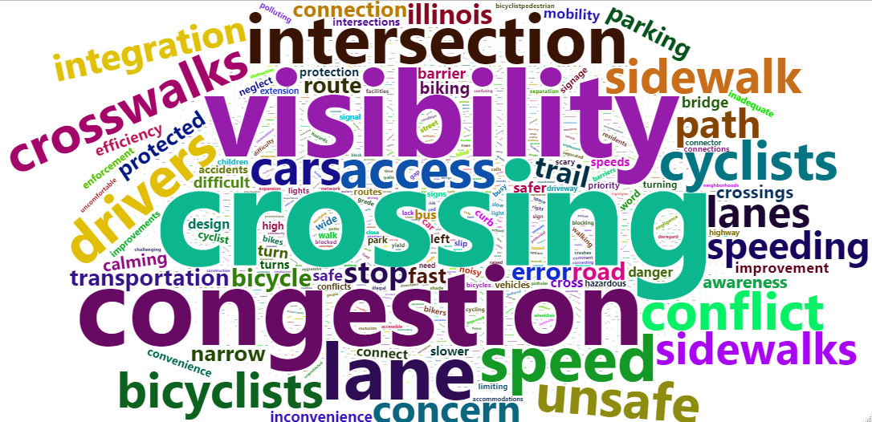
Interactive Map
4,137
Comments
Results are being analyzed
Notes:
Kristina
Overall, most comments were concerned with the safety and accessibility of infrastructure for bicyclists and pedestrians. Respondents pointed out locations that they felt were unsafe or needed improvements to encourage more active transportation.
The top words are to be expected from a survey about infrastructure. When we remove the most common words, we get a better picture of specific topics of concern. People often mentioned visibility, crossings and intersections, and congestion in their responses.

Slide 39
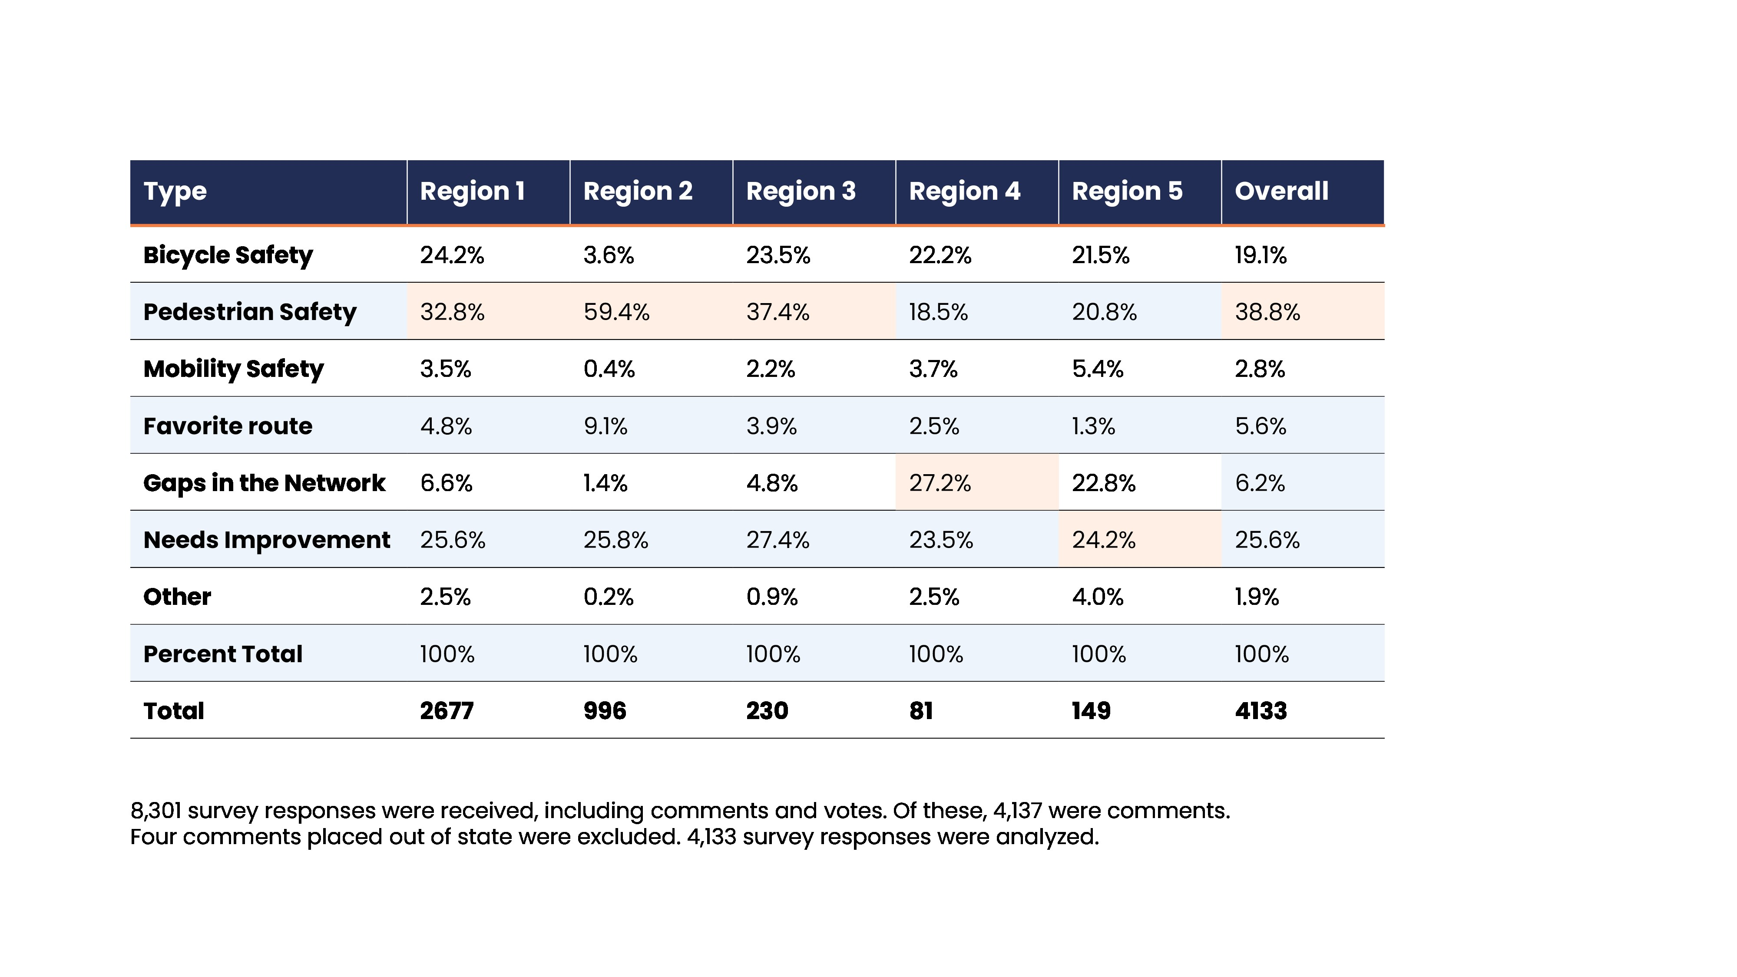
Interactive Map: Comment type by IDOT Region
Notes:
Kristina
Pedestrian safety was a top concern overall, and for Regions 1-3
In region 4, “Gaps in the Network” was the top comment type
“Needs improvement” was a top comment type in Region 5 and the second-highest overall.

Slide 40
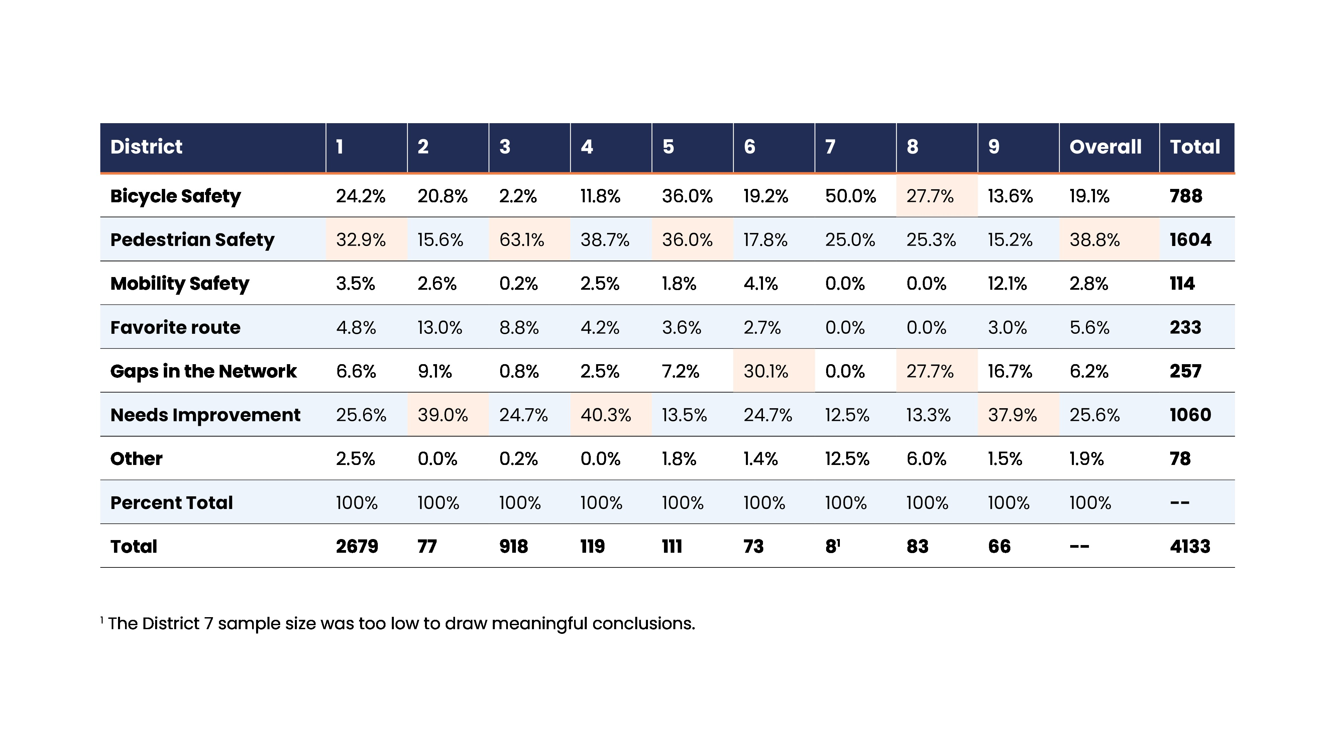
Interactive Map: Comment type by IDOT District
Notes:
Kristina
Pedestrian safety was the most common comment type for Districts 1, 3, and 5
“Needs improvement” was also common
District 8 was the most concerned of all districts about gaps in the network

Slide 41
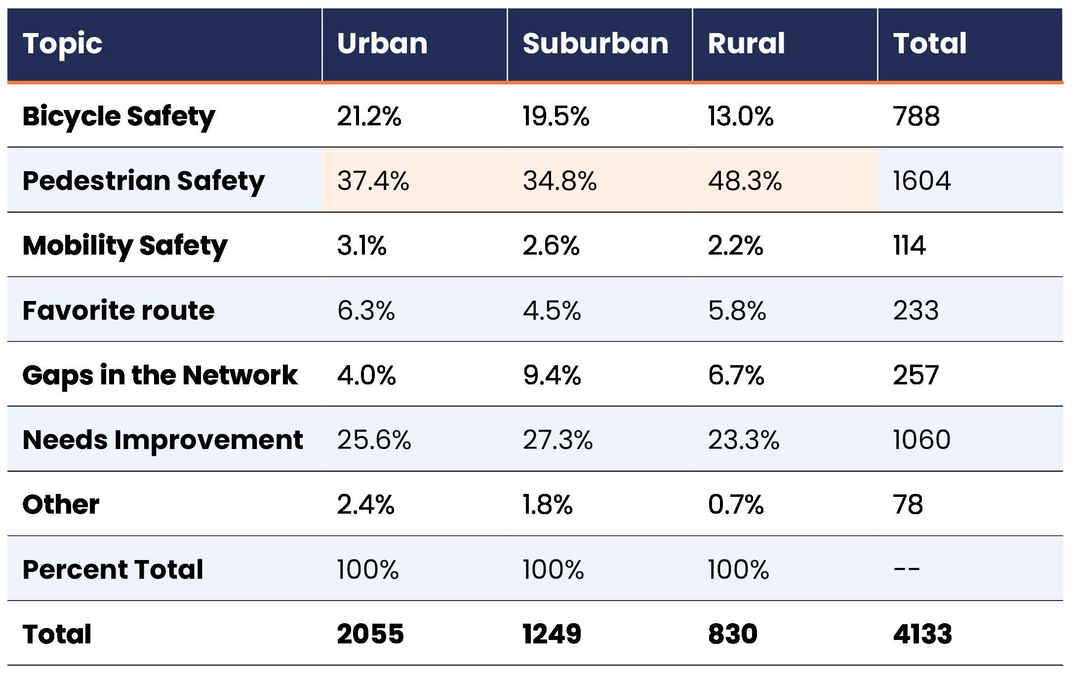
Interactive Map: Comment type by Context
Notes:
Kristina
Pedestrian safety is the top comment type for all contexts, but especially in rural areas.
Bicycle safety is more of a concern in urban and suburban areas than rural ones.
Gaps are slightly more of a concern in suburban areas than urban or rural.

Slide 42
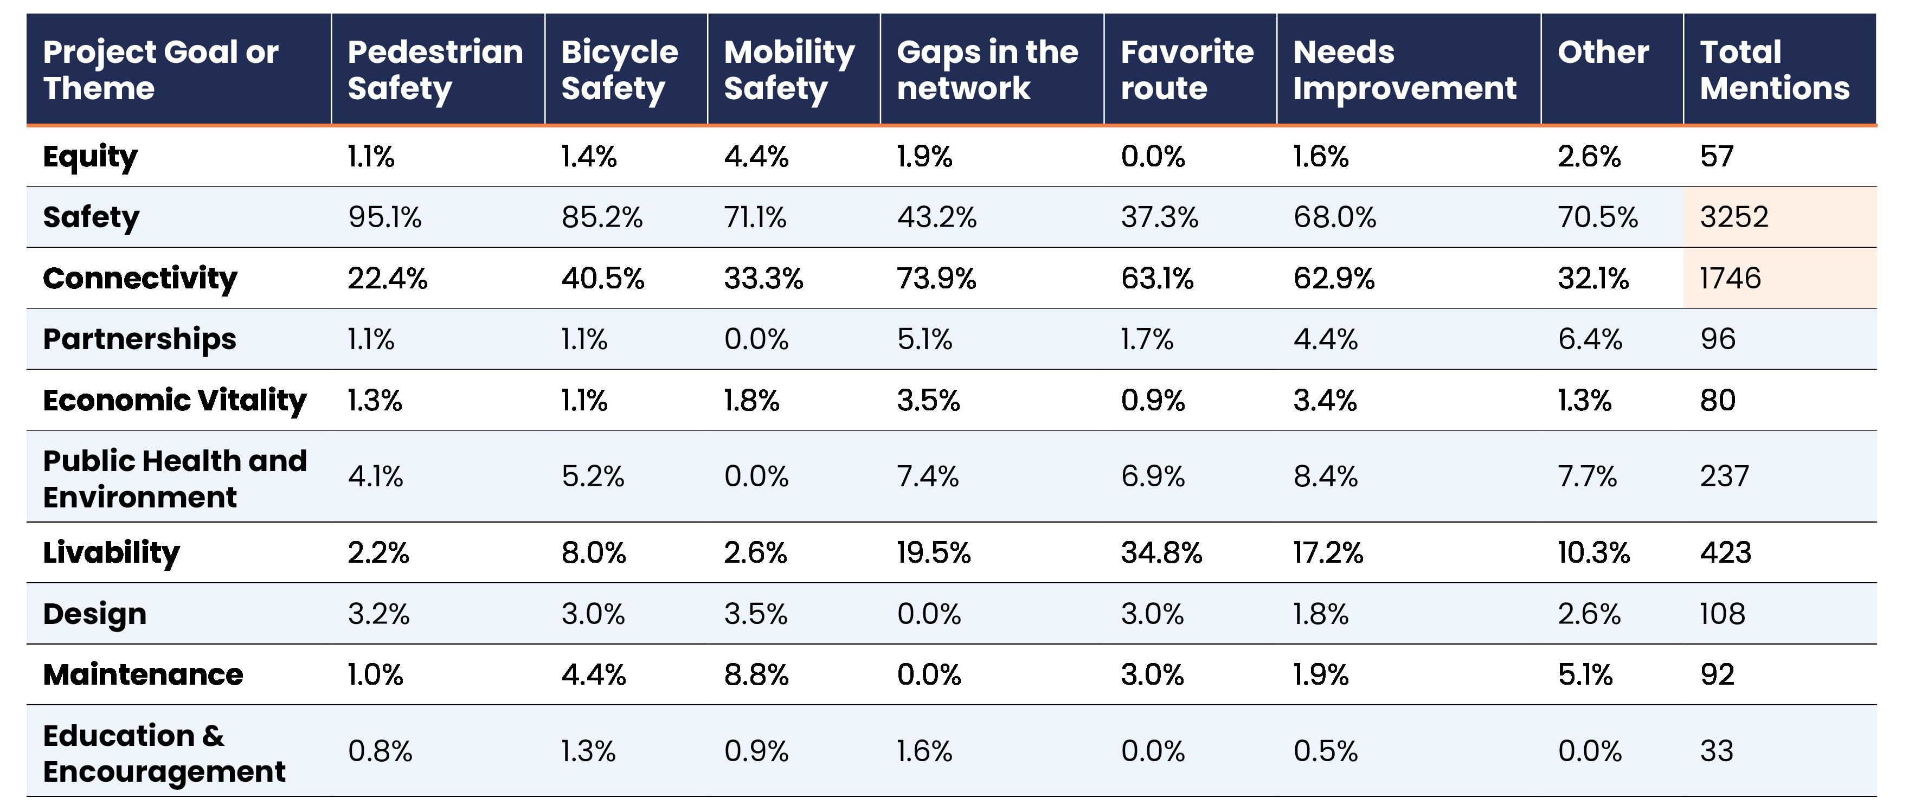
Interactive Map: Mentions of Goals and Themes by Comment Type
Notes:
Kristina
Safety was by far the top theme mentioned in all comments.
Connectivity was the second-most mentioned theme.
Two-thirds of “Needs improvement” comments related to safety.

Slide 43

Online Public Survey Trends
1,323 Urban
2,442
Survey Responses
54.17%
Urban
754 Suburban
271 Small Town
30.87%
Suburban
11.09%
Small Town
96 Rural
3.93%
Rural
Notes:
Kristina
A total of 2,442 survey responses and 8,301 map comments were received by October 31, 2023
Most participants from urban and suburban areas, but also a significant number from small towns.

Slide 44
Online Public Survey Trends
Design with Walkability
in Mind
"Not enough connected paths for walking, riding that connect areas or towns. We don’t build infrastructure or towns with walking, riding a bike or other transportation outside of cars."
Gaps in the Network
"Lack of connections between neighborhoods. For example, there is
an unfinished path between my town (Kingston) and the town I could bike to for errands making the trip unsafe. Similarly,
in the town in which I work, there are some small segments missing, such as finish the path from Route 64 (south side) to
Peace Road (east side). If this were finished
it would be a great bike trip to shopping. "
Safety,
Safety,
Safety
"We need street design that is safe for walkers and bikers and structured to slow down traffic so we can share the road"
Notes:
Kristina

Slide 45
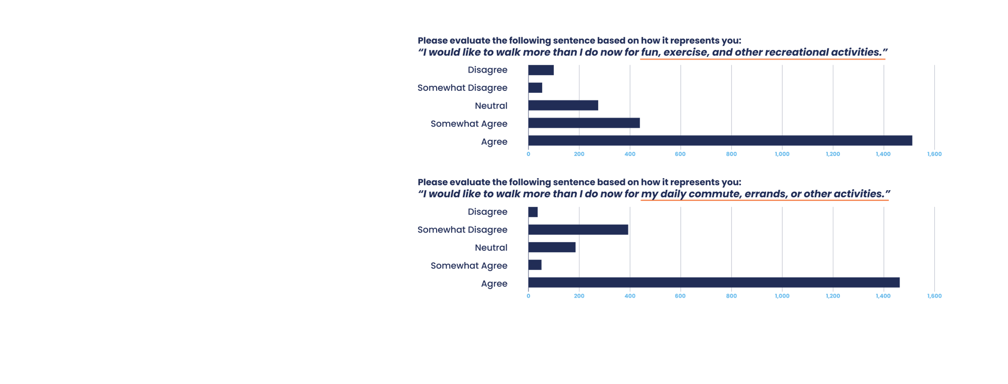
Online Public Survey Trends
Top Barriers:
  I do not feel safe due to traffic
  and speeding vehicles
  Destination too far
  I have to carry things
  Lack of sidewalks, public stairs, bikeways or paths
Respondents want to walk or bike more than they do now for fun and for commuting.
Notes:
Kristina

Slide 46
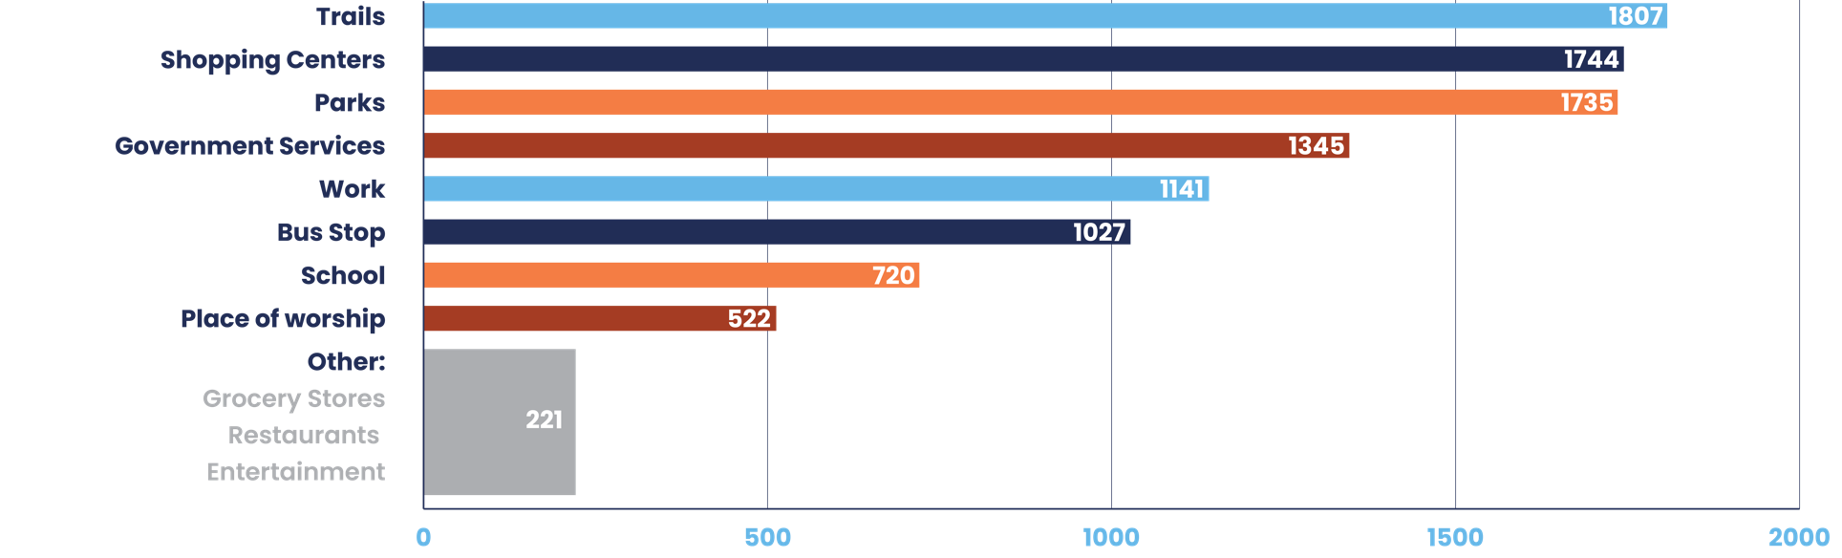
Online Public Survey Trends
People want to walk and bike to:
Notes:
Kristina
Survey results and comments reveal residents' desire to walk (and bike) to destinations they go to often (daily essentials and entertainment) – from parks, to shopping, to library/post office, and restaurants/entertainment.

Slide 47
Online Public Survey Trends: Crashes
While walking In the last year,
69
respondents have been in a crash
while walking in Illinois
1,245
have been involved
in a close call or crash
Similar results for biking
Notes:
Kristina
There is a noteworthy number of close calls for pedestrians walking in Illinois, even if the number of actual crashes is comparatively lower. It's important to note the same question for biking resulted in very similar results, with a slightly higher number of crashes and those who were involved in both a crash and close call.

Slide 48
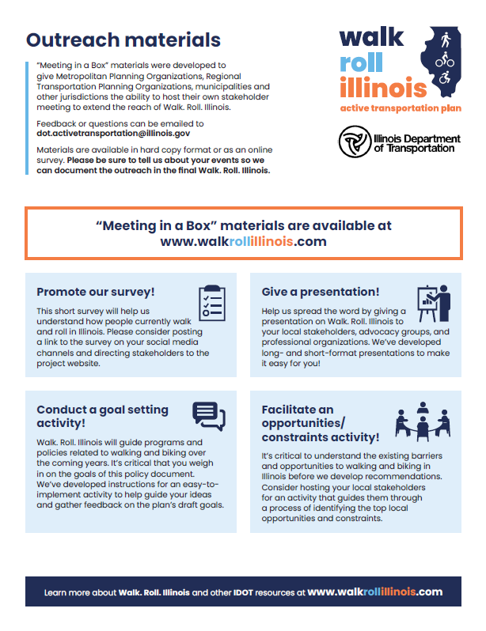
Future Public Engagement
It doesn't end here!
Draft Walk.Roll.Illinois. Active Transportation Plan
Contact info on website
Community resources --> Meeting-in-a-box
DEI Focus Groups (early next year)
Notes:
Kristina
While the survey is closed, we still plan to engage the public throughout the process
The public will have the opportunity to review and comment on the draft ATP plan
People can continue to send in comments and question to the project contact available on the website
Communities will still be encouraged to host and facilitate conversations with residents using our meeting-in-a-box and other project materials

Slide 49
Draft Recommendations Framework
Notes:
Jennifer
Will pull up 2 pager of the Recommendations Framework

Slide 50
Technical Stakeholder Group (TSG) Feedback Round 1
Notes:
Mae

Slide 51
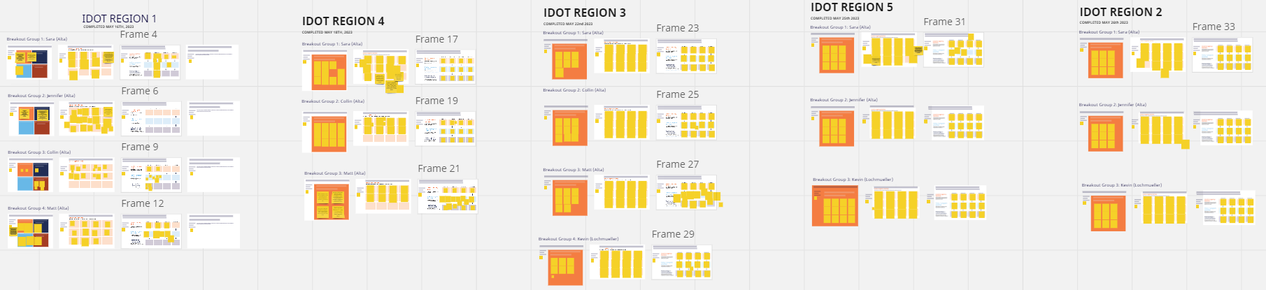
TSG Feedback Round 1
We received A LOT of feedback!
IDOT REGION 1
IDOT REGION 4
IDOT REGION 3
IDOT REGION 5
IDOT REGION 2
42
Participants
14
Participants
27
Participants
30
Participants
15
Participants
Notes:
Mae

Slide 52
Understanding Barriers
Funding
Design Standards
Maintenance
Staff Capacity
Education
For All Users
Connectivity
& Physical
Constraints
Notes:
Mae
https://miro.com/app/board/uXjVNN5wqmI=/?share_link_id=404789982199

Slide 53
Funding
 | Region
Specific barrier | 1 | 2 | 3 | 4 | 5
Inadequate funding. Current demand/cost of AT projects exceeds available funding. | x | x | x | x | x
Design requirements (especially for SRTS grants) that impact funding and schedule. |  | x
Unable to find a local match for funding. |  | x |  |  | x
Complexity of IDOT application process makes it difficult to access state funding. |  |  | x |  | x
IDOT reporting requirements. |  |  | x
Lack of flexibility on the scale of funding for smaller projects; high administrative burden. |  |  | x
Lack of diverse funding sources; difficult to fund projects like safe crossings & spot improvements. |  |  | x |  | x
ITEP specifically is an administrative burden with little flexibility and prohibitive costs. |  |  | x
IDOT doesn’t reimburse for non-infrastructure funding, like SRTS. |  |  | x
Future of funding, specifically funding for non-roadway projects to complete networks. |  |  |  | x
Lack of guidance on how to access federal funds, including SS4A. |  |  |  | x | x
Lack of information on what qualifies for safety funding. |  |  |  | x
County scale funding. |  |  |  |  | x
Project cap. |  |  |  |  | x
Lack of funding for off-street facilities which are popular. |  |  |  | x

Slide 54
Maintenance
 | Region
Specific barrier | 1 | 2 | 3 | 4 | 5
Local agencies are responsible for maintenance—IDOT will install but not maintain new projects. Difficult to maintain Complete Streets projects, on-road facilities, sidewalks; replace facilities. Consequently, bike/ped elements are removed from state route projects. | x | x | x |  | x
Unincorporated area poses problems for maintenance. | x
Policies that require homeowner to maintain sidewalk is a maintenance problem. | x
Clearing debris. |  | x

Slide 55
Education for all users
 | Region
Specific barrier | 1 | 2 | 3 | 4 | 5
Lack of public education and understanding on how facilities work, impact of proven safety countermeasures, and regional trails. | x | x | x | x | x
Lack of school programs to encourage habits and interest at a young age. | x
Enforcement for all users is needed. |  | x |  | x
Users need to use sidewalks and crosswalks instead of streets and mid-corridor crossings. |  | x
Need information for local officials on planning and designing safe facilities. |  | x |  | x
Need more long-term buy-in from city staff and elected officials |  | x | x
Stakeholders are supportive but want lowest cost projects to save funds for other high priority infrastructure. |  | x
There is limited advocacy in some areas, so public engagement could encourage citizens to communicate with local officials. |  |  | x
Officials and small communities don’t want to lose development by enforcing or pressuring bike/ped facility improvements. |  |  |  |  | x

Slide 56
Design Standards
 | Region
Specific barrier | 1 | 2 | 3 | 4 | 5
Standards, design practices, and laws vary between regions; fragmented safety levels. | x
Challenging sharing priorities and next steps between agencies. | x
Gaps along state highways are difficult to manage. | x
Prioritized projects should include perceived safety measurements and consider a Complete Streets approach. | x
Outdated design manuals/policies leads to uncertainty when identifying facilities to improve safety. (e-bike standards, policies on speed and safety) |  |  | x
Need to share local solutions with IDOT. |  |  | x
State standards are focused on designing streets for larger vehicles can result in inadequate improvements for bike/ped users. |  |  | x
Need a toolkit and options to choose from for safe, context-sensitive, and effective measures and solutions. |  |  |  | x
Need clear guidance on what constitutes a safety ATP project. |  |  |  | x
There are gaps in the current network. Users feel unsafe, and safety concerns were a high priority during the bike/ped plan engagement. |  | x |  | x
Rural areas are lacking many bike/ped facilities. |  | x
Enforcement is more difficult with less police staff, necessitating design that addresses speed concerns |  |  | x

Slide 57
Staff Capacity
 | Region
Specific barrier | 1 | 2 | 3 | 4 | 5
Staff capacity is limited with staff turnover and limited resources to implement projects, especially with the number of needs and difficulty of some projects. | x | x | x
Regularity of meetings & coordination between agencies has been a challenge after COVID. Unclear project processes. | x |  |  | x
Difficulty administering or applying for grant |  | x
Smaller towns have limited administrative support/no dedicated staff |  |  | x
Due to limited capacity, training, and difficult application process – not applying to applications. |  |  | x
Current staff capacity can’t get all projects done; there are multiple planning efforts competing for limited attention |  |  | x
Staffing shortages cause difficulty for getting projects designed |  |  |  | x
Environmental permitting and ROW are time consuming. |  |  |  | x
Shifts in scoping add time and effort that is not available. |  |  |  | x
Ride Illinois is often contacted about people having trouble reaching IDOT staff. |  |  |  | x

Slide 58
Connectivity & Physical Constraints
 | Region
Specific barrier | 1 | 2 | 3 | 4 | 5
Physical and infrastructure barriers, such as railroads, waterways, and highways, hinder progress, challenging for bike/ped users to navigate, & gaps in the network. | x |  | x
Speed, crossing distances, and distractions cause issues, often on state roadways. |  |  | x
Unincorporated areas complicate closing gaps of physical barriers. |  |  | x
ROW acquisition conflict with additional infrastructure, especially for railroad ROW. |  |  | x |  | x
Roadway drainage conflict with additional infrastructure. |  |  |  |  | x
L:arge county roads conflict with additional infrastructure. |  |  |  |  | x
On-street parking conflict with additional infrastructure. Facilities are often competing with parking and limited curb-to-curb widths. |  |  | x |  | x
Gaps in the network make users feel unsafe. Infrastructure to connect to key destinations is missing. Missing trails connection between urban and suburban areas |  |  |  | x | x
Connecting to transit is difficult, as the transit agency changes stop locations based on fluctuations in ridership. |  |  |  |  | x
Difficulty connecting existing facilities in many areas because of costs |  |  |  |  | x
Landowners are not always interested in giving land easements, and developers can push back |  |  |  | x

Slide 59
Breakout Groups: Refining the Barriers
Split into three groups
Each group will discuss and refine the proposed barriers
Barriers will inform the development of strategies and action items
Group report outs
Notes:
https://miro.com/app/board/uXjVNN5wqmI=/?share_link_id=404789982199
*If barriers are a struggle, move into strategies
Sara K will set up breakout rooms

Slide 60
Next Steps
Technical Memos
DEI Focus Groups
LRTP Coordination
Stakeholder Round 2 Meetings (Feb)
Notes:
Jennifer

Slide 61
Technical Memos
Current State of Biking and Walking in Illinois
Design Guidance
Policy & Programs
New Mobility
Maintenance
Funding
Notes:
Jennifer

Slide 62
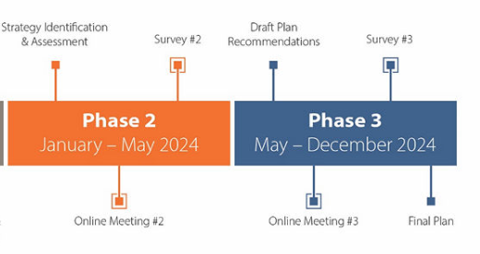
2024 LRTP: Update
Website: www.moveillinois2024.com
Upcoming Advisory Group webinars:
  Monday, 12/11 (12-1). Webex link
  Wednesday, 12/13 (5-6). Webex link
DEI Focus Groups
Schedule
Notes:
Jennifer

Slide 63
Thank you!
Questions?
Jennifer Baldwin
Principal, Alta Planning
jenniferbaldwin@altago.com
Adam Gabany
Intermodal Planning Unit Chief, IDOT
adam.gabany@illinois.gov
Lee Ann Prather
Bicycle and Pedestrian Coordinator
leeann.prather@illinois.gov
IDOT Active Transportation
DOT.ActiveTransportation@illinois.gov
Notes:
Jennifer

