Slide 1
ILLINOIS DEPARTMENT OF TRANSPORTATION
GRANTEE MEETING
Federal Fiscal Year 2023 (FFY23) 10/1/2022 – 9/30/2023

Slide 2
OVERVIEW
Meeting Purpose and General Information
Goals and Objectives
BSPE 205 Data Collection Form
Electronic Submittal of Claims and Financial Information
2832 Periodic Reporting Form
Resources on IDOT’s Website

Slide 3
MEETING PURPOSE
To give grantees the tools they need to be successful in
implementing IDOT/BSPEs safety programs and initiatives.
Ask questions and clarify issues.
Ambassadors for highway safety in Illinois.

Slide 4
BSPE PERSONNEL
Adam Gabany – Safety Programs Implementation Manager Adam.Gabany@Illinois.gov
Carissa Calloway – At-Risk Behavior Manager Carissa.Calloway@Illinois.gov
Shannon Alderman – Impaired Driving Coordinator Shannon.Alderman@Illinois.gov
Rochelle Gillespie - Occupant Protection Coordinator
Rochelle.Gillespie@illinois.gov

Slide 5
BSPE Grant Administrators
Kyle Baker – Kyle.Baker@illinois.gov
Julie Coplea – Julie.Coplea@illinois.gov
Becky Edwards – Becky.Edwards@illinois.gov
Chris Peters – Christopher.Peters@illinois.gov
Brett Reichart – Brett.Reichart@illinois.gov
Location of your assigned GA - Exhibit D Contact Information

Slide 6
CONTACT INFORMATION
Steve Esslinger Safety Projects Manager
Illinois Department of Transportation Bureau of Safety Programs & Engineering 2300 South Dirksen Parkway, Room 007
Springfield, Illinois 62764 Steven.Esslinger@illinois.gov 217/524-1001

Slide 7
IMPAIRED DRIVING
Shannon Alderman

Slide 8
Impaired Driving Program
The un-changing purpose:
Save lives
The mission:
Improve Illinois’ impaired driving fatality rate through the implementation of priority programs
The goal:
Maximize the amount and effectiveness of grant-funded law enforcement hire-back impaired driving, seat belt, and other highway safety efforts within target counties and strongly support that enforcement with aggressive, focused messaging and support of law enforcement training and prosecutorial efforts

Slide 14
LEL Overview
Scott Kristiansen

Slide 15
FFY23 Grantee Orientation Meeting
Goals/Objectives/LEL Overview

Slide 16
IDOT BSPE GRANT TEAM
Grant
Administrators
Program
Coordinators
Law Enforcement Liaisons
GATA Contact Finance Unit

Slide 17
IDOT BSPE GRANT TEAM
Grant
Administrators
Overall Administration of Grants Final Approvals
Administrative Aspects of the Grant
Law Enforcement Liaisons
Work with Grant Administrators Can Do Some Approvals Operational Aspect of the Grant

Slide 18
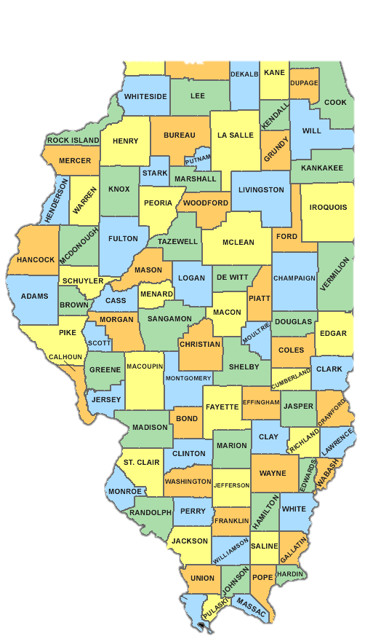
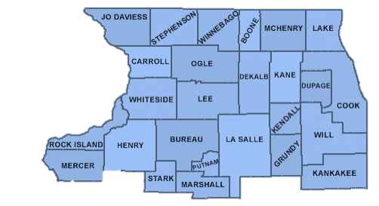
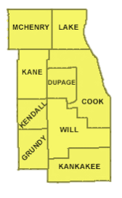
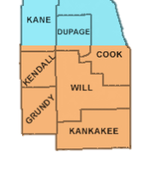
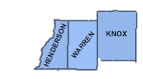
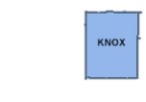
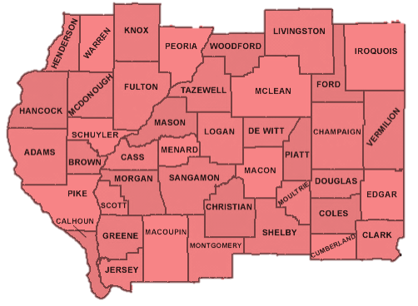
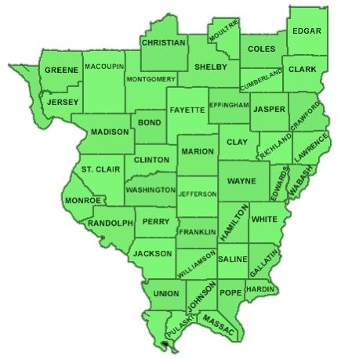
LEL TEAM REGIONS
ALEXANDER

Slide 19
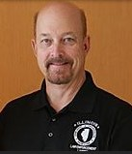
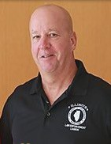
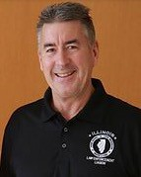
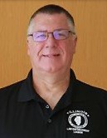
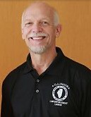
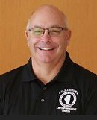
LEL TEAM
LEL Supervisor Scott Kristiansen
Northwest Region Jeff Bain
Northeast Region John Gomoll
Northeast Region Tom Morey
Northeast Region Paul Rizzo
Central/Southern Region
Jim Wolf
www.illinoislel.org

Slide 20

FFY23 STEP GRANT GOALS AND OBJECTIVES
Enforcement Campaigns
Optional
Mandatory
Thanksgiving (Emphasis OP)
Christmas/New Years (Emphasis ID)
St. Patrick’s Day (Emphasis ID)
Memorial Day (Emphasis OP)
Independence Day (Emphasis ID)
Labor Day (Emphasis ID)
Halloween
Super Bowl
Distracted Driving
Child Passenger Safety
(Emphasis based on NHTSA National Campaigns)
Additional Enforcement
Agencies can only conduct additional enforcement outside of the mandatory campaigns. The only exception to this rule is for the month of April. This is due to the Distracted Driving Campaign being the entire month.

Slide 21
FFY23 STEP GRANT GOALS AND OBJECTIVES
Occupant Protection Goals
A minimum of 30 percent of overall patrol hours need to be conducted between 6:00 p.m. and 6:00 a.m.
A minimum of one (1) citation for every 60 minutes of patrol.
Thirty (30) percent of all citations should be for Occupant Protection violations. (Front Seat, Back Seat and Child Passenger - CPS)

Slide 22
FFY23 STEP GRANT GOALS AND OBJECTIVES
Impaired Driving Officer Requirements
All officers conducting grant-funded, alcohol-related enforcement must be trained in the Standardized Field Sobriety Test (SFST).
Officers must complete an ILETSB-accredited academy, a 24-hour SFST course or an SFST refresher course every four (4) years from the date of their last completed certified training.
This can be an MTU or in-house refresher course.
IDOT/BSPE Grant Funded Training.

Slide 23
FFY23 STEP GRANT GOALS AND OBJECTIVES
Impaired Driving Enforcement Requirements
Impaired driving must be conducted between 6:00 p.m. and 6:00 a.m.
Impaired driving patrol hours may be extended providing pre-approval is given by the assigned IDOT Safety Grant Administrator (GA).
Additionally, daytime patrol hours can be conducted by ARIDE- TRAINED OFFICERS ONLY between the hours of 6:00 a.m. and 6:00 p.m.
DRE Callout

Slide 24
FFY23 STEP GRANT GOALS AND OBJECTIVES
Impaired Driving Goals
A minimum of one (1) traffic citation for every 60 minutes of patrol.
A minimum of one (1) DUI arrest for every 15 hours of patrol.
Distracted Driving Goals
A minimum of one (1) traffic citation for every 60 minutes of patrol.
Thirty (30) percent of all citations should be for electronic use violations.

Slide 25
FFY23 STEP GRANT GOALS AND OBJECTIVES
Additional Enforcement
Agencies can only conduct additional enforcement outside of the mandatory campaigns. The only exception to this rule is for the month of April. This is due to the Distracted Driving Campaign being the entire month.
Additional Enforcement has been condensed into one generalized “Traffic Safety Enforcement” effort giving agencies the flexibility to focus their enforcement on the issues in their community at the times they need them.
Additional OP, speed or distracted driving enforcement can be conducted at any time during the day or night. All impaired driving enforcement restrictions apply to any additional ID enforcement.

Slide 26
FFY23 STEP GRANT GOALS AND OBJECTIVES
Additional Enforcement Focus
Agencies shall conduct additional enforcement focusing on contributory causes of crashes, i.e., speeding, impaired driving, electronic devise use, failure to yield, disobeyed traffic control signal/device, as well as occupant protection restraint violations.
Additional Enforcement Goals
A minimum of two (2) traffic stops every 60 minutes of patrol.
A minimum of one (1) traffic citations for every 60 minutes of patrol

Slide 27
FFY23 STEP GRANT GOALS AND OBJECTIVES
LEL Site Visit Meetings
Minimum of four (4) meetings per grant year.
(Three (3) in person and one (1) phone or Virtual call.
Additional meetings can be scheduled as needed.
Initial meeting October/November for the BSPE26 Checklist.
LEL Goal and Objective Reviews
Grant goals and objectives reviewed by campaign and year to date.

Slide 28
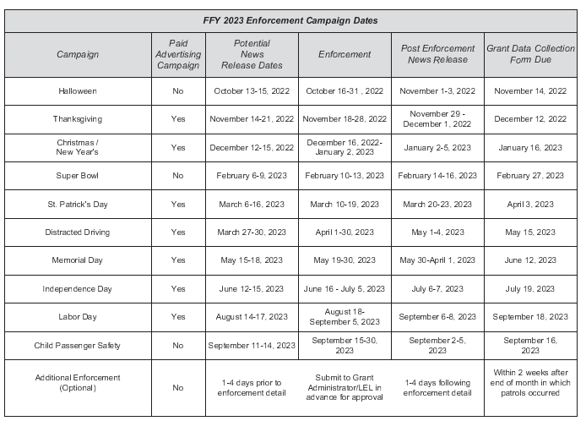
FFY23 STEP GRANT GOALS AND OBJECTIVES
BSPE 411 Campaign Schedule
Lists Campaign, Pre-Press Release Dates, Enforcement Dates, Post Press Release Dates, BSPE205 Data Form Due Date.

Slide 29

FFY23 STEP GRANT GOALS AND OBJECTIVES
LEL & Traffic Challenge Websites
LEL & BSPE Program information.
Training Opportunities, Traffic Law Updates, Training Videos, Case Law Updates, Webinars.
Illinois Traffic Safety Challenge Information.
www.illinoislel.org www.iltrafficchallenge.org Twitter@iltschallenge
Facebook at:
Illinois Law Enforcement Liaison

Slide 30
FFY23 STEP GRANT GOALS AND OBJECTIVES
Questions?
Refer to your Uniform Inter-Governmental Grant Agreement.
Your grant agreement has these goals and objective listed in the deliverables and milestone section. They are also listed in Exhibit E – Performance Measures.
If you have additional questions email or call your grant administrator or law enforcement liaison.

Slide 31
BSPE 205 Form
Brian Arnold

Slide 32
Agenda
What is the 205?
Why is it important?
Where do I find it?
What does it look like?
When do I send it in?
Where do I send it to?
What does it have to do with my claim?

Slide 33
What is the 205?
Data Collection Form
Tracker and Evaluation Tool of Grant Enforcement Activity
Record of Enforcement Hours Worked
Record of Citations Written
Record of Media Efforts
Record of “Other” Important Enforcement Information

Slide 34
Why is the 205 Important?
Ensures Objectives and Goals are being met
Used as a Quality Check for BSPE 500 Claim form
Used to calculate statistics such as
  Cost per Citation
  Cost per Hour
  Seat Belt Citations written for every Hour of Patrol
  Impaired Driving Citations written for every Hour of Patrol
  Percentage of Child Safety Seat Citations written of Total Citations
  Statewide Total of News Stories
  Minutes per Citation Written

Slide 35
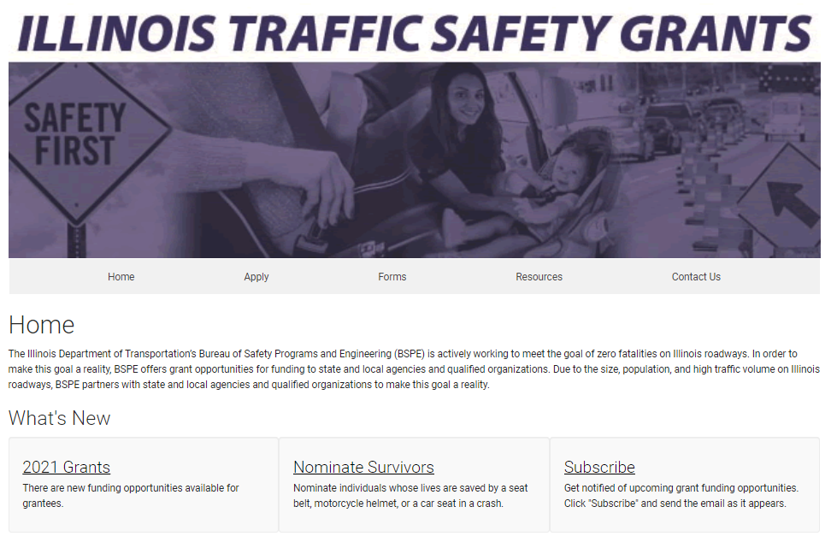
Where do I find the 205?
trafficsafetygrantsillinois.org

Slide 36
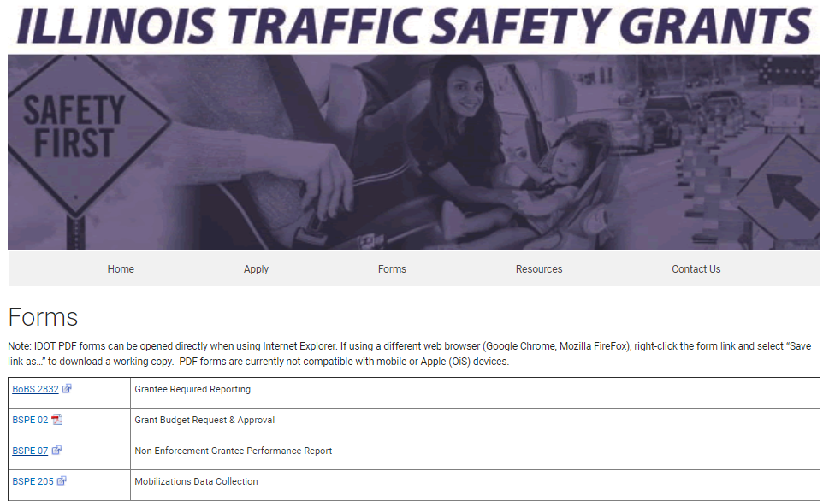
Where do I find the 205?
trafficsafetygrantsillinois.org

Slide 37
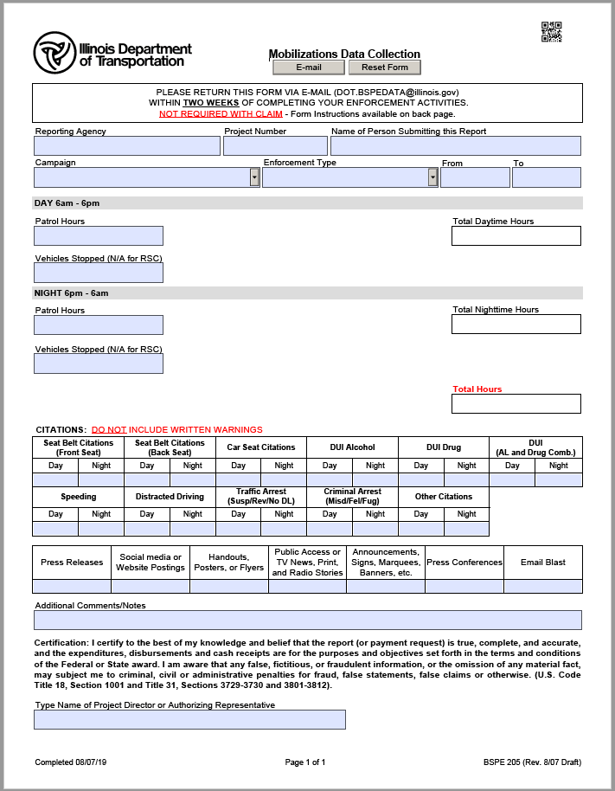
What does the 205 Look Like?
Non-Alcohol is blank in the middle
Agency and Campaign Information
Hours and Vehicles Stopped
Citation and Arrest Information
Media
Additional Comments
Name of Project Director

Slide 38
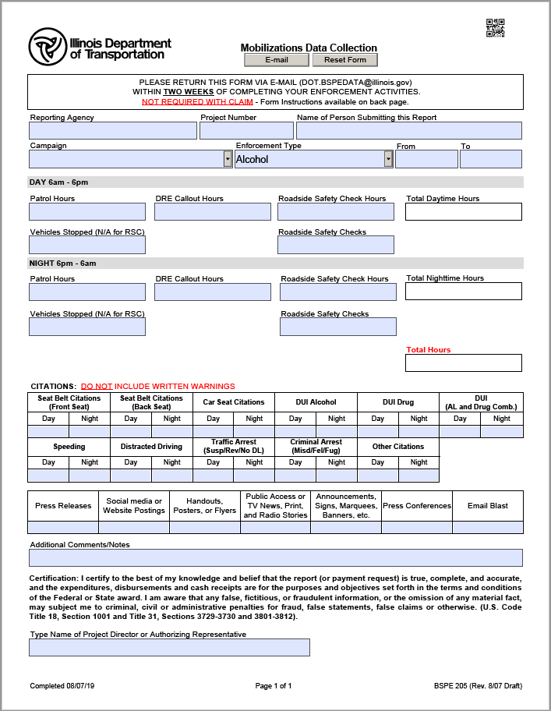
What does the 205 Look Like?
When Impaired Driving and Additional is selected, additional fields appear.

Slide 39
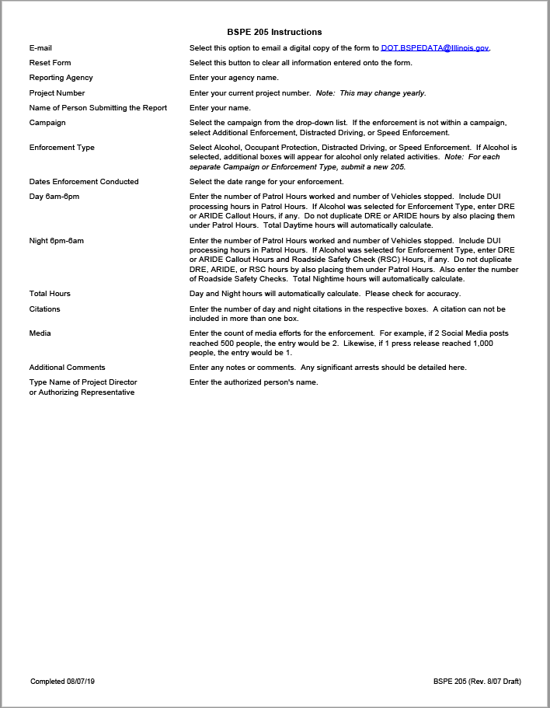
What does the 205 Look Like?
Instructions are on the 2nd page

Slide 40

Specific Sections of 205
Agency Information (Project # Changes Yearly)
Campaign Information
Additional Enforcement
Child Passenger Safety
Distracted Driving
Halloween
Holiday (Christmas and New Year)
Independence Day
Labor Day
Memorial Day
St Patrick’s Day
Super Bowl
Thanksgiving

Slide 41


Specific Sections of 205
Enforcement Type
For Additional Campaigns – Beginning 10/1/2022
Dates: Enter Campaign Dates (if Additional)
Alcohol (“Alcohol will be replaced with “Impaired Driving” beginning 10/1/2022)
Occupant Protection
Speed Enforcement
Additional

Slide 42
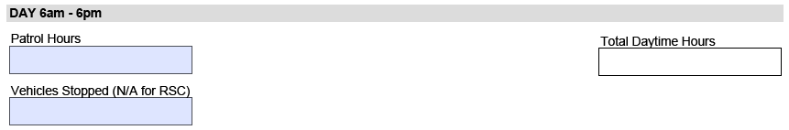
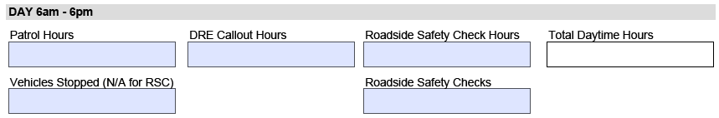
Specific Sections of 205
Day 6am-6pm No Alcohol
Day 6am-6pm Alcohol

Slide 43
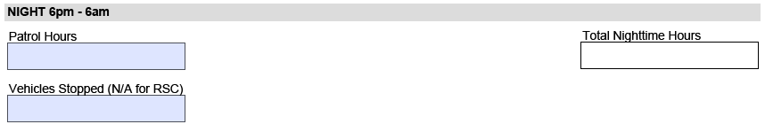
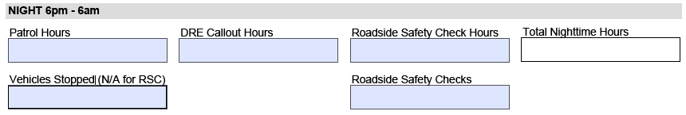
Specific Sections of 205
Night 6pm-6am No Alcohol
Night 6pm-6am Alcohol

Slide 44
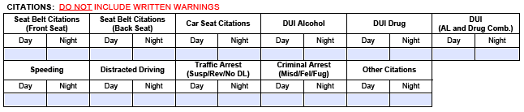

Specific Sections of 205
Citations-Each Citation or Arrest for only 1 box
Media
1 Email Blast sent to 500 people = 1 Email Blast
2 Social Media Postings that reached 1,500 people = 2 Social Media Postings

Slide 45
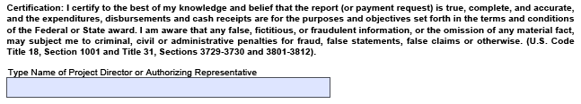
Specific Sections of 205
Additional Comments
detail inclement weather, significant arrests
Authorizing Person

Slide 46



Automation
Day Hours add to Total Daytime Hours automatically
Night Hours add to Total Nighttime Hours automatically
Total Daytime Hours
+ Total Nighttime Hours
=Total Hours automatically
Check for Accuracy!!

Slide 47
When do I send it in?
Within
2 Weeks
After Enforcement

Slide 48

Where do I send it to?
Press “Email” at the top of the 205
The form will be sent to DOT.BSPEDATA@illinois.gov digitally
  cc your Law Enforcement Liaison (LEL)
The form should be sent in digitally
  No need to print and email a scanned copy
New Campaign/Enforcement Type? New 205
Mistake? Resend to same email
  cc your LEL again

Slide 49
What does the 205 have to do with the Claim?
Hours on the Claim
must match Hours on the 205

Slide 50
Questions?
Please contact:
Brian Arnold
Mathematical Evaluation Manager
Bureau of Safety Programs and Engineering
Illinois Department of Transportation
Brian.Arnold@Illinois.gov
217-785-5678

Slide 51
Submitting the BSPE 500
Clint Kassube

Slide 52
How to Complete and digitally submit your BSPE 500
Updated October 1, 2021

Slide 53

Locate the BSPE 500 form on the website
Go to the website at https://idot.illinois.gov/transportation- system/safety/grants/index
Click on the Forms Tab
https://idot.illinois.gov/transportation- system/safety/grants/forms
Locate BSPE 500 and click to open the form
  You MUST use Internet Explorer to access the forms!

Slide 54
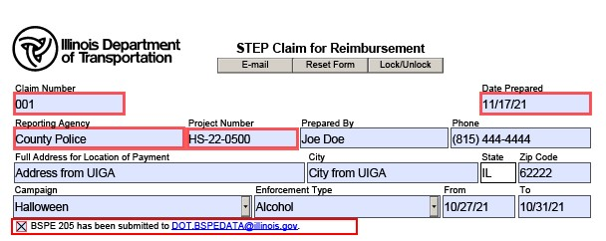
Complete ALL boxes at the top of the form

Slide 55
Agency Information
Claim Number – Enter the claim number in order of completion.
Date Prepared - Use drop down calendar to select date claim was prepared.
Reporting Agency – Enter the agency name. Note: agency name may need to be abbreviated.
Project Number – Enter project number, ex. HS-23-1234.
Prepared By – Enter the name of the person who prepared the claim.
Phone Number – Enter phone number of person who prepared the claim.
Full Address – Enter address listed on page 1 of the signed UIGA.
City – Enter city listed on page 1 of the signed UIGA.
State – Pre-populated with IL.
Zip code - Enter the zip code as listed on page 1 of the signed UIGA.

Slide 56
Campaign Information
Campaign – Use drop-down arrow and select the enforcement campaign.
Enforcement type – Use the drop- down arrow to select one of the following: occupant protection, alcohol, speed enforcement, distracted driving.
  Type cannot be established until campaign is chosen.
From – Use the drop-down calendar to select the start date of the enforcement campaign.
To – Use the drop-down calendar to select the end date for the enforcement campaign.

Slide 57
Project Costs by Budget Category
Approved Budget:
  Enter the approved campaign or additional enforcement amount as listed in BSPE 411.
  Please reference the BSPE 411that was approved with your grant agreement.
The expended this period:
  This will auto fill from page two.
  Please make sure the amount has rounded correctly. This form has a glitch that cannot be fixed.
    If there is an error in the rounding, please note it body of the email and we will make note and fix it.
    Examples of correct rounding.
      $400.455 = $400.46
      $100.1245 =$ 100.12
  NOTE: The Total Amount of the Claim auto fills and cannot be changed.
If the total claim amount listed at the bottom of column B is more than the approved amount and the agency only wants to claim the approved amount, they should make note of that in the body of the email when sending to IDOT for payment.
  They should explain the Total amount claim number and write the budgeted amount request, and date.

Slide 58
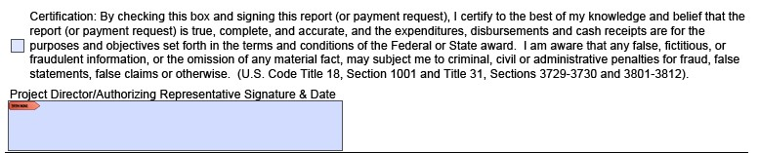
Certification and Digital Signature
SKIP THIS SECTION UNTIL YOU ARE READY TO FINALIZE AND SEND THE CLAIM.
Once you are ready to sign, the Certification box must be clicked
Digital Signature must be used in the Project Director/Authorizing Rep box
  Please see the “Digital Signature Creation.pdf” on how to create this.

Slide 59
Personnel and Indirect Costs - Page 2
Claim Number – Will auto-fill from page 1.
Project Number – Will auto-fill from page 1.
Period Covered From/To – Will auto-fill from page 1.
Budget Category (line item) – will auto-fill Personnel.
If you have Indirect Costs – click the “check to enter indirect costs” box and it will appear.
No equipment or supplies.
Full Address – Enter address listed on page 1 of the signed UIGA.
City – Enter city listed on page 1 of the signed UIGA.
State – Pre-populated with IL.
Zip code - Enter the zip code as listed on page 1 of the signed UIGA.

Slide 60
Personnel - Page 2 Continued
Employee Name column – Enter name of officer/deputy working the grant enforcement. If officer/deputy was receiving compensation time, please denote with (COMP) after their name.
Dates Worked From column – Use drop down calendar to select the first date the officer/deputy worked enforcement for the campaign.
Dates Worked To column – Use the drop down to select date officer concluded enforcement detail. (Please note, if an officer worked several days during the campaign list the date they started and the date they concluded. There is no need to list on additional lines all the detail dates they worked. The project director will ensure the officers worked the dates and times for the campaigns.
Example, if Officer John Doe worked the Thanksgiving enforcement campaign on November 22nd, 25th, 27th, and the 29th the date range for Officer John Doe would be Dates Worked From November 22, 2022, to dates Worked To November 29, 2022.
If the officer worked an additional campaign that spanned two pay periods, then we ask the agency to use the second (latest) pay period for the payroll date. The only time a grantee needs to list an officer/deputy twice is when they are paid one rate during the first pay period, and they receive a pay raise/COLA which effects their time and ½ rate for the second pay period.

Slide 61
Personnel - Page 2 Continued
Hireback Hourly Rate – Enter the actual hourly rate of the officer/deputy.
Total Claim Hours – Enter the total number of hours the officer/deputy worked during the campaign.
Federal Amount – Will auto- calculate the amount.
Payroll Date – Use drop down calendar to select date of payroll.
Indirect Cost:
Personnel can be considered for indirect costs. Enter personnel totals in “amount”
For Percentage, enter indirect cost rate.
Total will auto-calculate and move to the front page.

Slide 62
Certification and Signature Process
Now you are ready to use this section.
At this point, the data entry for the claim is complete. Go back and recheck all entries to ensure they are correct, and the totals add up.
Now you are ready to begin the signature process. You can choose from two options.

Slide 63
Signature Process
Choose one
Option One (Wet Signatures and Dates)
Click the certification box on page one of the claim.
“Print” the BSPE 500 as a PDF for traditional wet signatures.
  In Adobe, click file, Print, print to Adobe PDF. It will save a printed version of the claim on your computer
  Print this copy out and manually sign and date the claim document.
Wet sign and date in the authorizing rep/project manager box. SIGNATURE AND DATE is NEEDED.
After signatures, scan and save the entire document as a PDF.
Skip to the “Claim Submission” section of this document.
Option Two (Digital Signatures) PREFERRED METHOD OF SUBMISSION
Click the certification box on page one of the claim.
Use digital signatures to sign the claim.
The following pages will show you how to complete this. Do not complete until reading the instructions.

Slide 64
Digital Signature Process
Option Two
Save a copy of this claim form WITHOUT any digital signatures.
  Once you add digital signatures, save it under a different file name so you can go back and change information of the unsigned version.
  Once a digital signature is on the form, it cannot be removed.

Slide 65
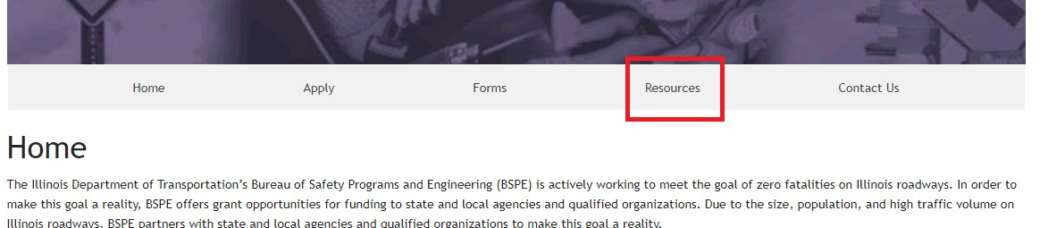
How do to create a digital signature
BSPE created a thorough PDF to walk you through each step.
You can locate the Digital Signature Creation Guidance at https://idot.illinois.gov/transportation- system/safety/grants/resources
  Click on the Resources tab
    Budget and Finance Section
      Digital Signature Creation Guidance
If you are having trouble creating a digital signature, please contact your IT department before requesting help from IDOT. We are unable to answer questions about your IT and software systems.

Slide 66
How do to create a digital signature (continued)
Who needs a digital signature?
  Project Director and/or Authorizing Representative.
Keep your digital signature password somewhere safe or you will need to create a new one as the password will be required each time you need to sign the form.

Slide 67
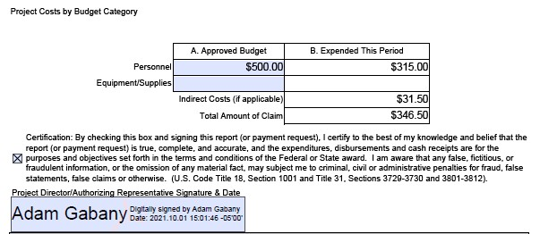
Digital Signature Process (continued)
Now that your digital signatures have been created, you can sign the claim.
The front page of the claim in the only area that requires a digital signature.
Once you are ready to sign, the Certification box must be clicked
Click blue box to place Digital Signature.
Signing is complete
Ready to Submit digital claim.

Slide 68
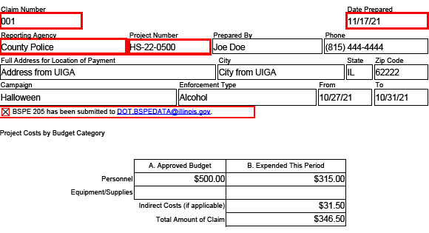
Claim Submission - how do I submit?
This process will be based on your chosen Signature Process
Option One (Wet Signature and Date)
Draft an email to DOT.BSPE.Claims@illinois.gov
  Subject of the email shall be:
    Project Number, agency name, claim number, and dollar amount
    Example: HS-23-0500 County Police 001 $346.50
  Re-Name PDF claim
    Same as email subject line
    Project Number, agency name, claim number, and dollar amount
    Example: HS220500 County Police 001 $346.50
  Attach claim and all supporting documents if you were unable to do so already.
  Click Send, you have submitted your claim to BSPE. Please read last slide for confirmation information.
Option Two (Digital Signature)
See following pages to explain the process.

Slide 69
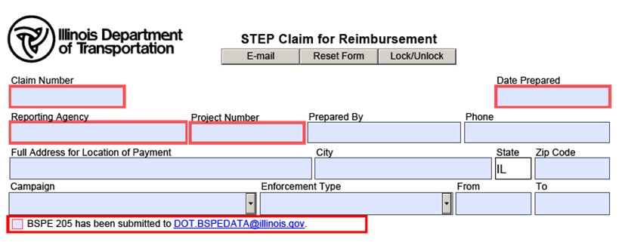
Claim Submission - how do I submit?
Digital Signature
First, save a copy of the form with signatures. Use a different file name than the name you used when saving the form before collecting signatures.
Then, scroll to the top of the form and click the E-mail button
NOTE: Once you click the E-mail button, the form locks. Absolutely nothing can be changed on this form. This is why it is a good idea to save the form before and after obtaining signatures as different versions with different file names so you can easily go back and make edits as needed instead of filling out the form from scratch.

Slide 70
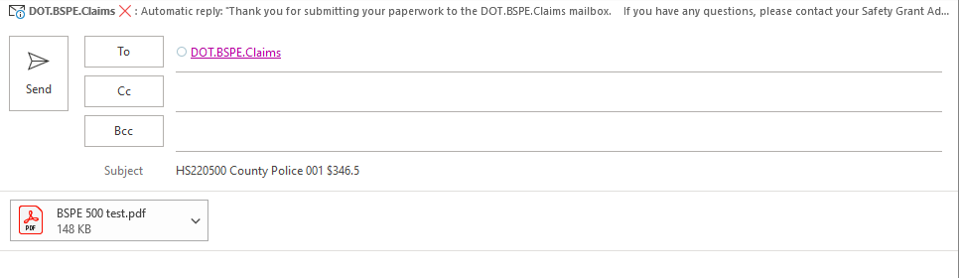
Emailing the form
Digital Signature Process
After the form locks, an email box will auto-generate.
The email will be sent to DOT.BSPE.Claims@illinois.gov.
The subject line will auto-populate information filled out in the claim.
The form itself will automatically attach to the email.
At this time if there are any issue you can state them in the body of the claim but if not…
Click Send

Slide 71
Congratulations! You have
successfully submitted your BSPE claim form with digital signature!
You will receive an automatically-generated response from DOT.BSPE.Claims@illinois.gov in your email inbox. If you do not receive this response, contact your Grant Administrator.
BSPE will now begin processing your claim and may reach our if there are any issues.
If your agency hasn’t received payment within 60 days, contact your Grant Administrator.

Slide 72
Completing the BoBS 2832
Julie Coplea

Slide 73
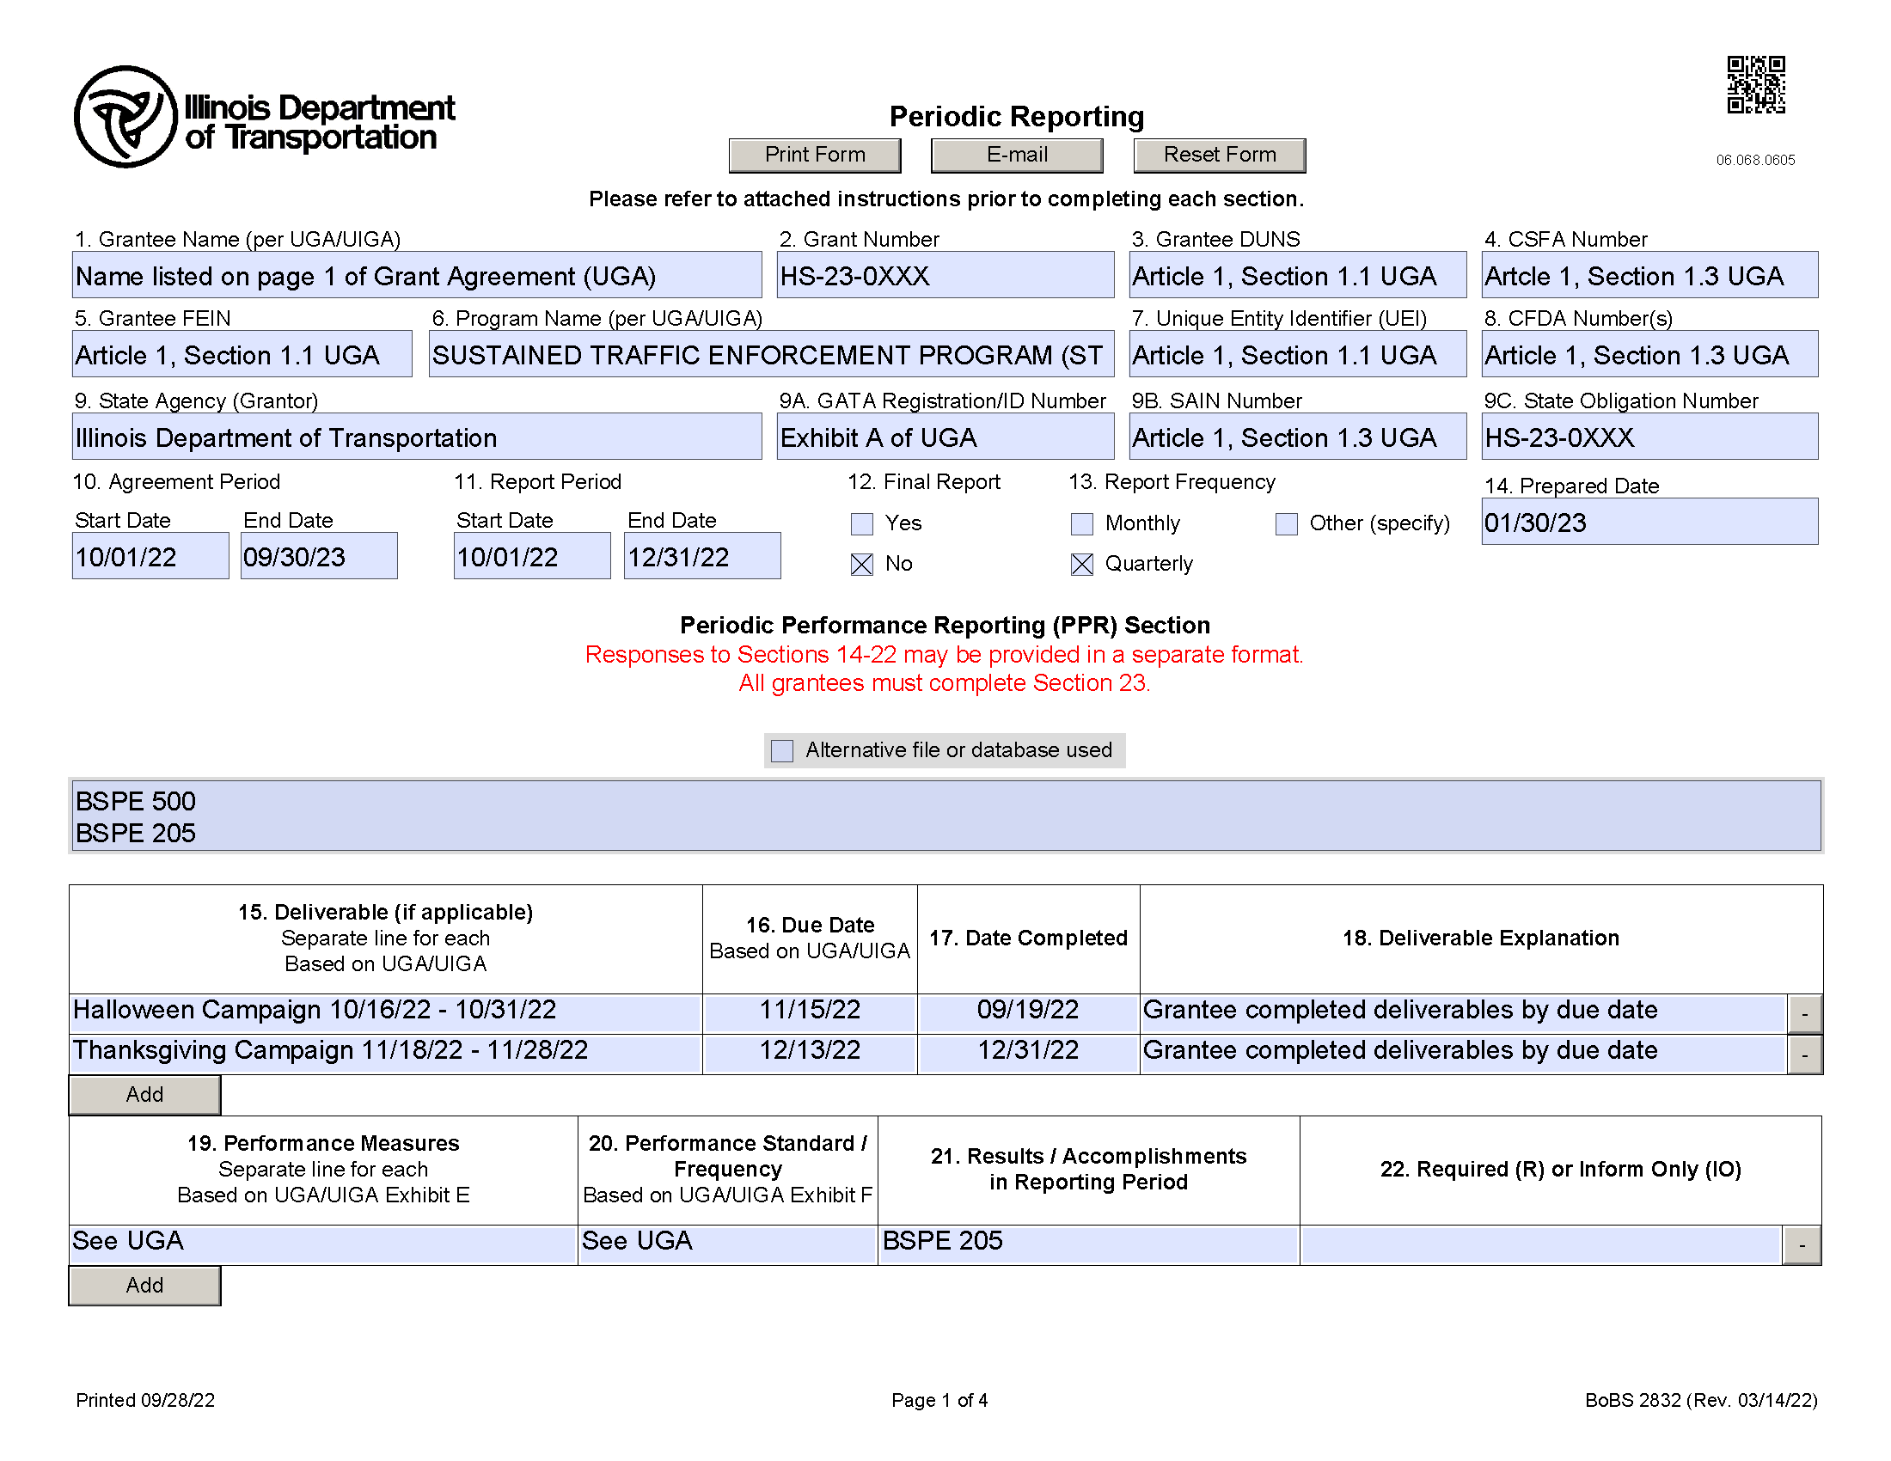

Slide 74
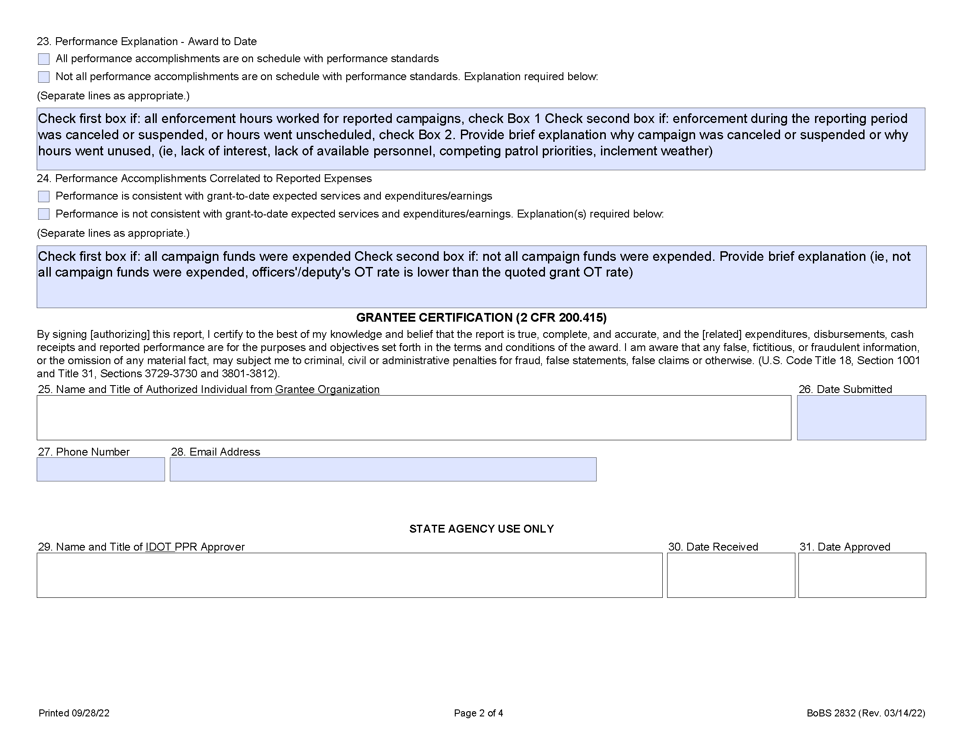

Slide 75
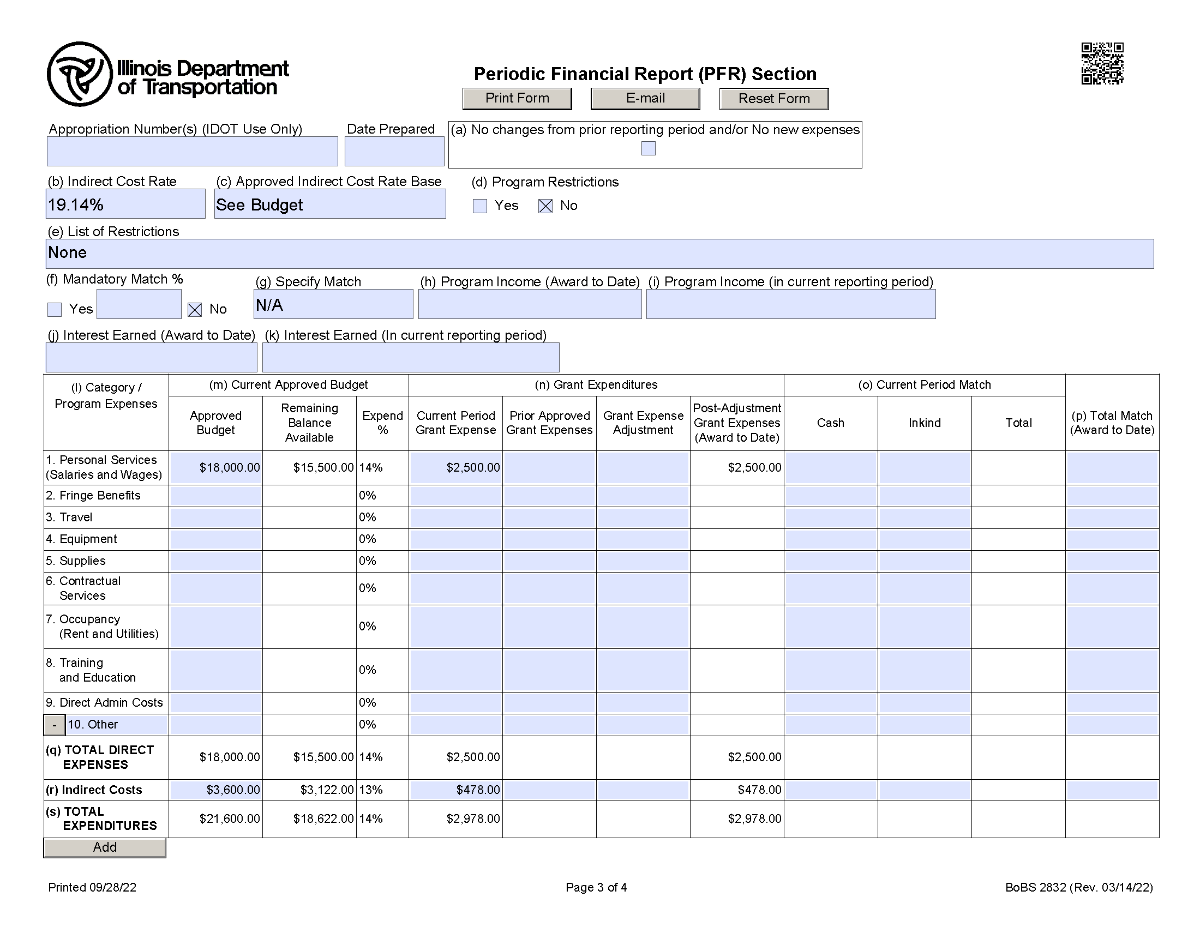

Slide 76
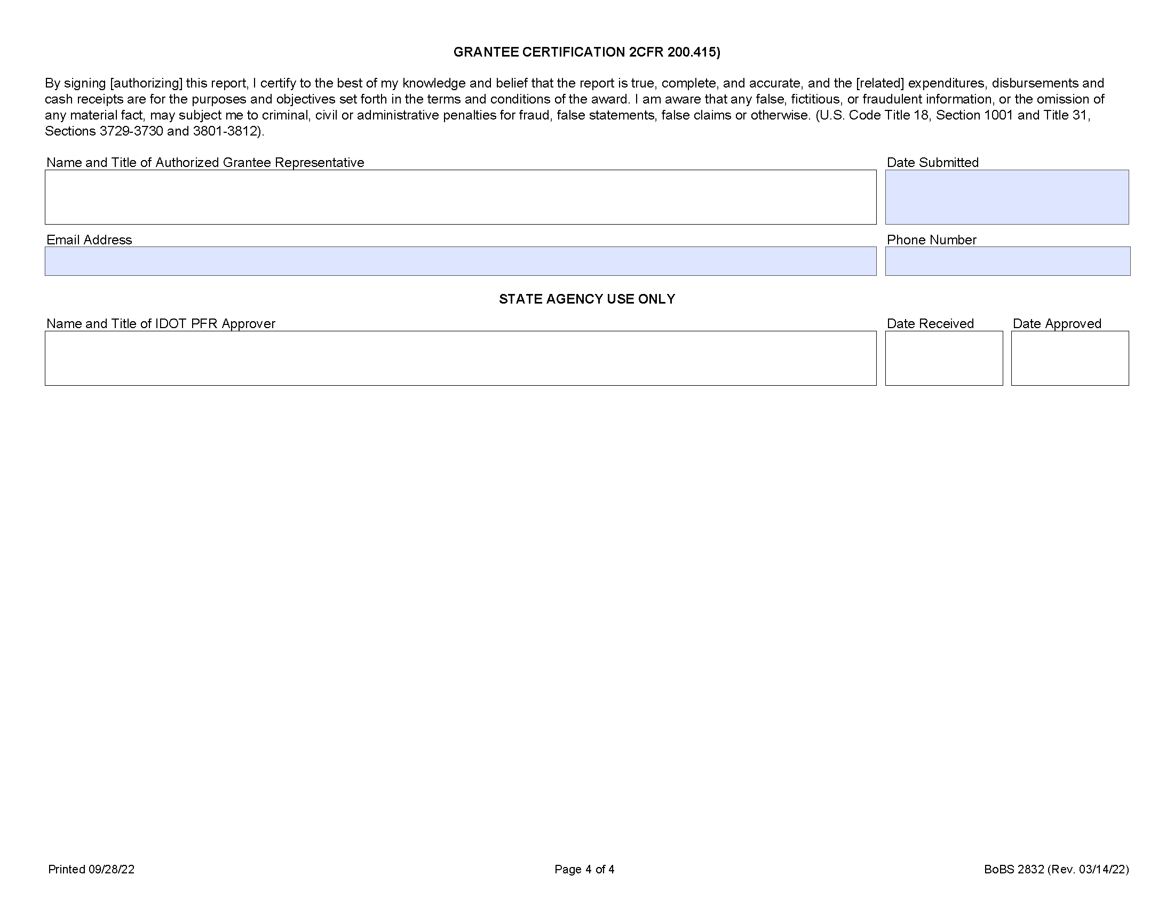

Slide 77
Form Submittals and Resources
Steve Esslinger

Slide 78
Form Submittals
Claims (BSPE 500) DOT.BSPE.Claims@illinois.gov
Mobilization Data Collection Form (BSPE 205) DOT.BSPEDATA@illinois.gov
Periodic Reporting (BoBS 2832) and media releases email to your assigned Grant Administrator (Exhibit D Contact Information)

Slide 79
BSPE Website and Resources
http://www.idot.Illinois.gov/transportation-system/safety/grants/resources

Slide 80
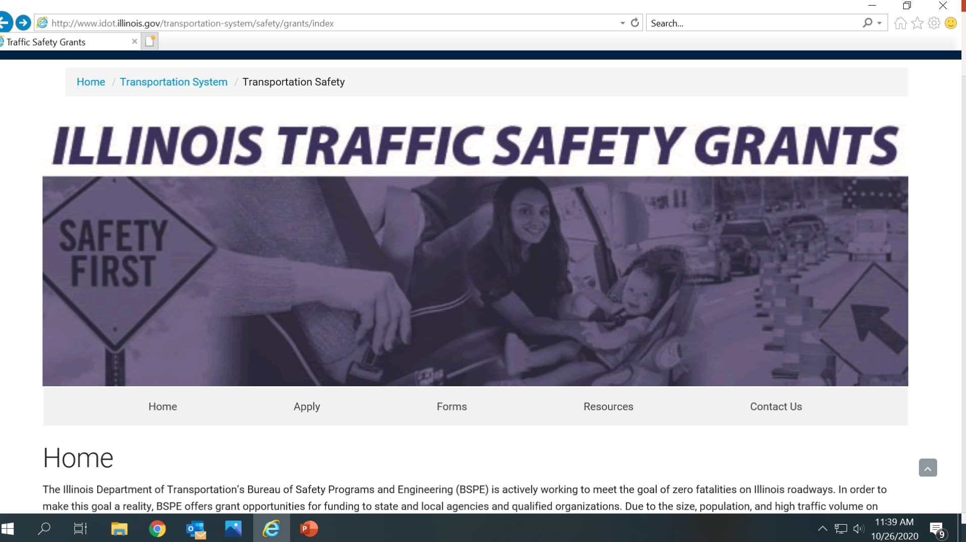
BSPE Website and Resources

Slide 81
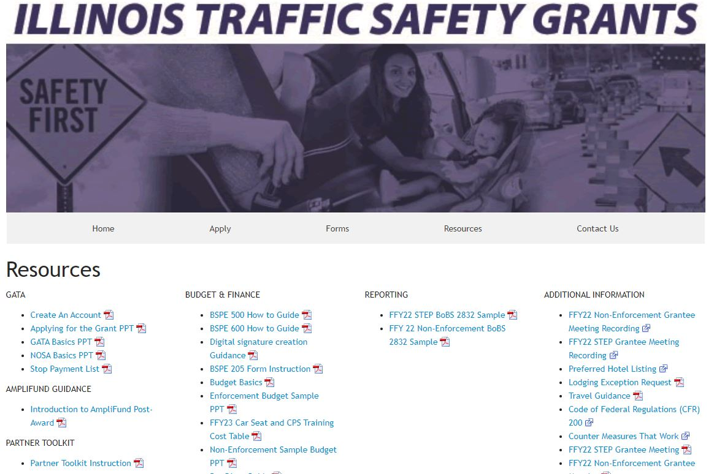
BSPE Website and Resources

Slide 82
BSPE Website and Resources

Slide 83
Amplifund
Steve Esslinger

Slide 84
AMPLIFUND
Q. What is Amplifund?
A. Amplifund is a Grant Management Software Package.
Q. What does that mean for you as a STEP Grantee?
A. All FFY24 STEP applications and documents will be submitted electronically through the Amplifund system.
BSPE & the LEL’s will provide training and procedural documents to assist agencies with the FFY24 application process.

Slide 85
QUESTIONS?

