Slide 1
How to create a login so you can apply for grants through Amplifund

Slide 2
Before you do anything, make sure you have your organization’s name or UEI (Unique Entity Identifier) number that directly correlates with the GATA Portal Account that your login will be tied to. If you are UNSURE of the correct UEI, please contact DOT.TSgrants@illinois.gov before proceeding. You will be provided with the correct UEI number.

Slide 3
Once you have the UEI, go to the website grants.Illinois.gov/portal/ to begin the login process.
http://grants.illinois.gov/portal/

Slide 4
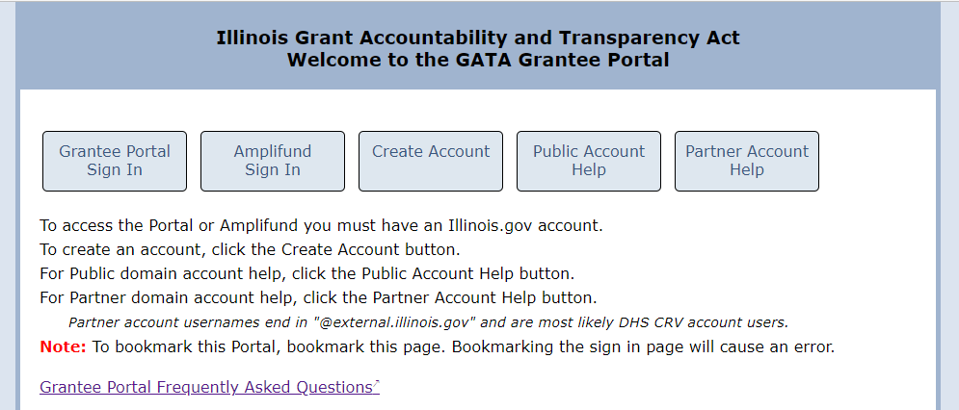
Click on Create Account

Slide 5
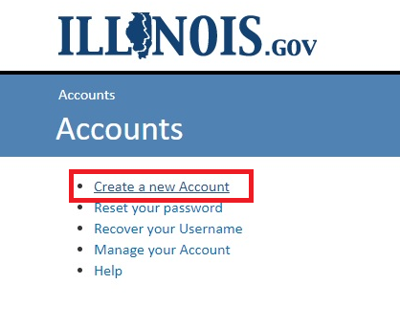
Then, click on Create New Account link

Slide 6
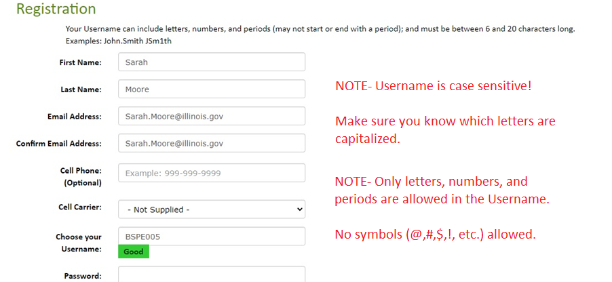
Fill out the information for name, email, and username
See next slide for Password requirements…

Slide 7
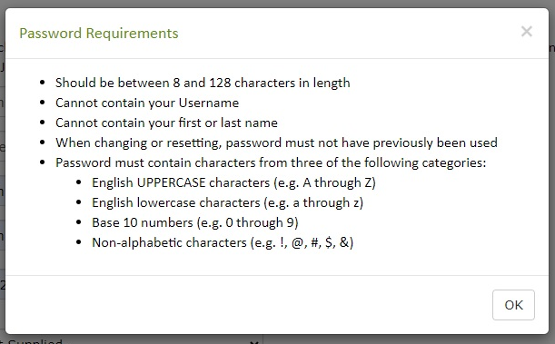
Use the following rules when selecting a password

Slide 8
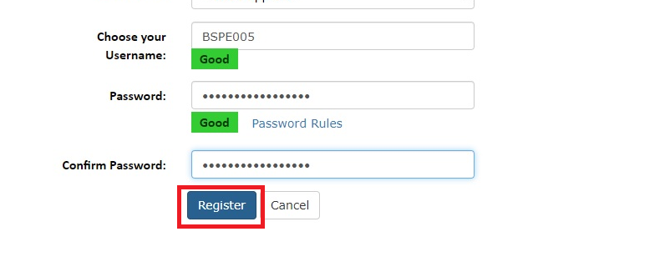
Fill out your password twice and then click the Register button

Slide 9
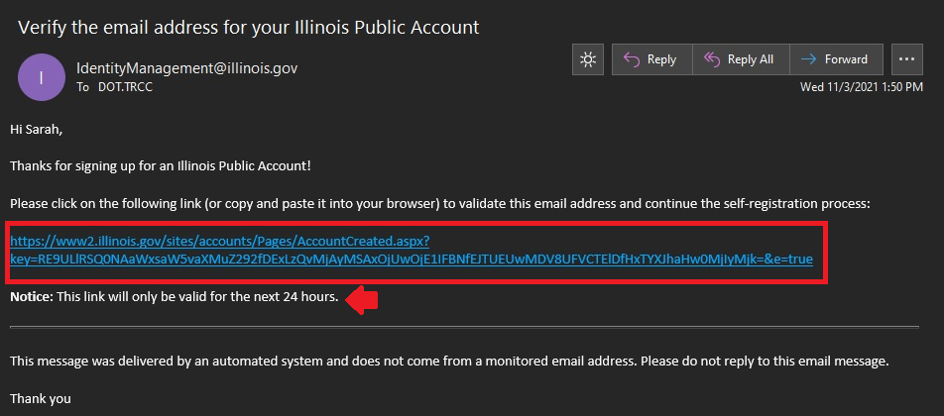
Check your inbox for a verification email- this email contains a link that is only good for 24 hours. Click on this link.

Slide 10
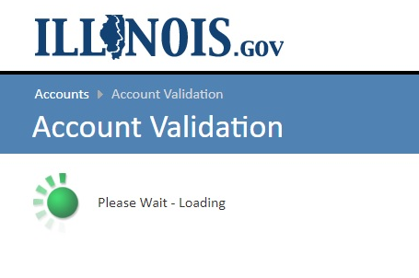
Note- it may take a bit for the link to load

Slide 11
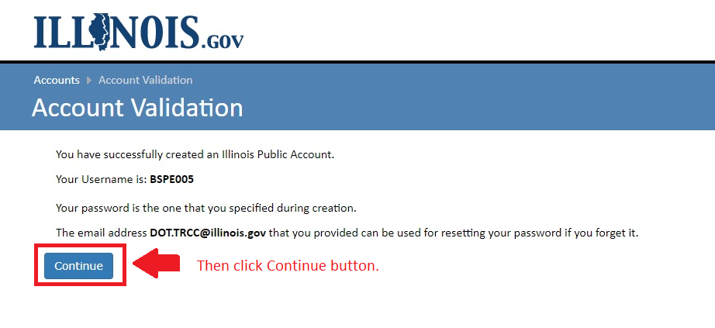
Once loaded, it will provide the following verification information:

Slide 12
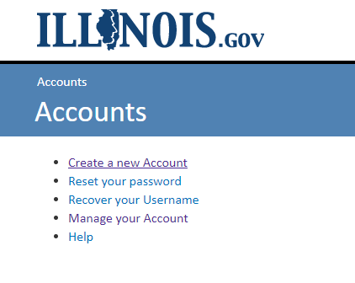
Clicking the Continue button will take you back to this screen
In the meantime, you will be sent a verification email (see next slide)…
And you can go ahead and close out of this website.

Slide 13
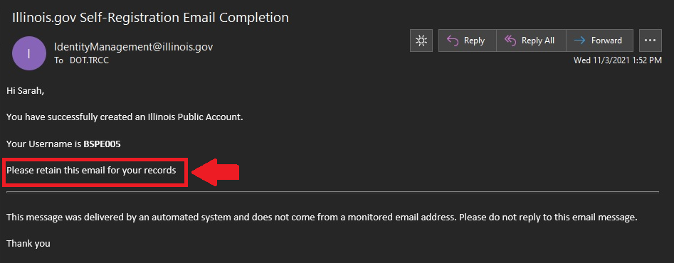
Side Note- you will receive a verification email in your inbox about your login being successfully created.

Slide 14
So now that my account is created, how do I log in?

Slide 15
Well, you go back to grants.Illinois.gov/portal/
http://grants.illinois.gov/portal/

Slide 16
And this time, click on Grantee Portal Sign In

Slide 17
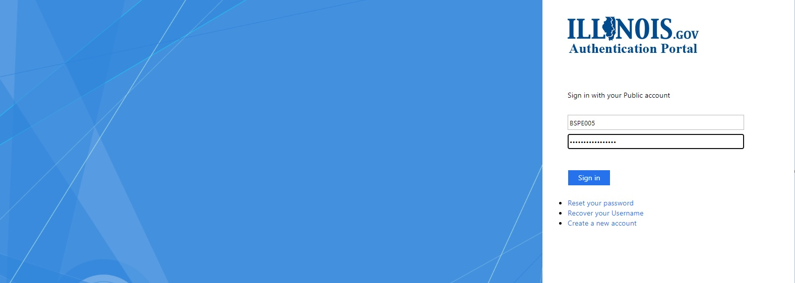
This will take you to a different looking website

Slide 18
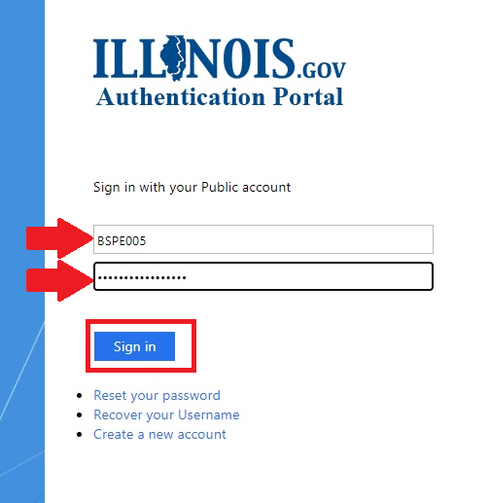
Just enter your login information on the right-hand side and then click Sign In

Slide 19
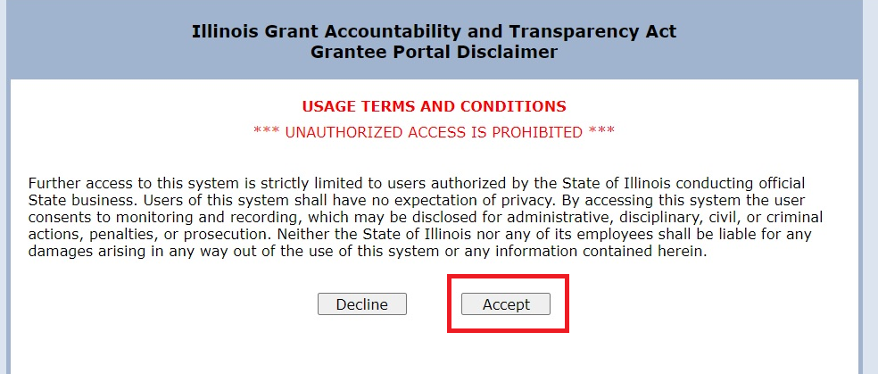
A disclaimer will appear. Click the Accept button.

Slide 20
Enter the UEI associated with the GATA Grantee Portal account with which your login will be associated and then click Submit.

Slide 21
You should have already obtained your UEI number by now. However, if you are unsure of your UEI number, you may email DOT.TSgrants@illinois.gov to make sure you have the correct UEI number to enter.

Slide 22
When the Disclaimer pops up at the bottom, verify the agency organization information and then click the YES button.

Slide 23
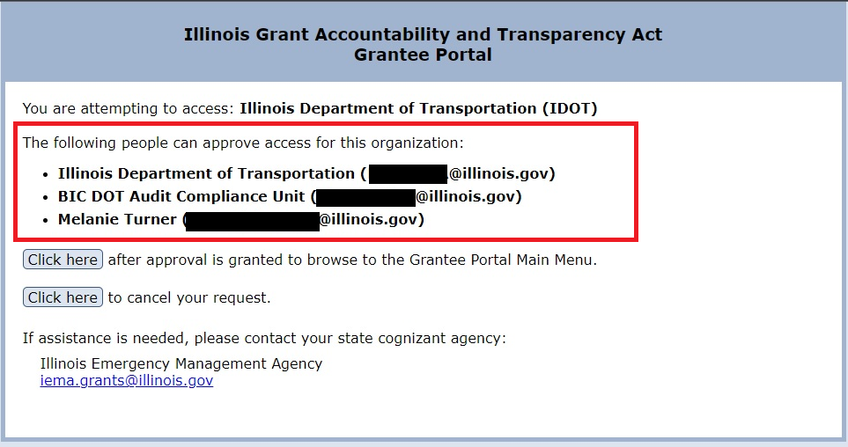
Now that you have entered the UEI number, verified the agency organization, etc., the list of the agency employees who have access to the GATA Grantee Portal account will be listed on this page.

Slide 24
Do NOT click any buttons on this page until someone in your agency has approved your access.
IMPORTANT!

Slide 25
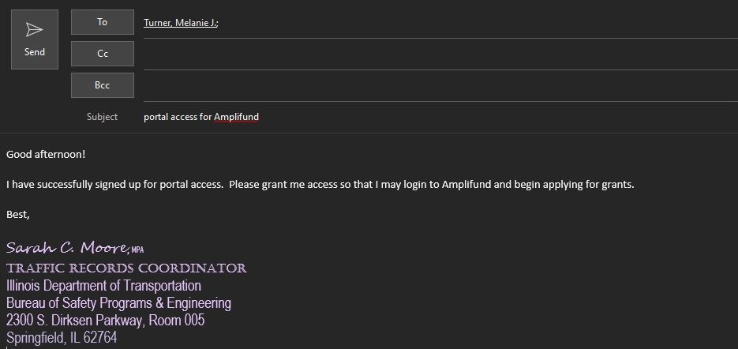
Send the email and sit tight.

Slide 26
Now you just need to wait until someone in the GATA Grantee Portal approves your access. They should respond to your email to let you know it was approved.

Slide 27
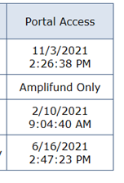
To apply for grants, you only need access to Amplifund, not the GATA Grantee Portal. They will determine whether you need access to the Portal, Amplifund, or both.

Slide 28
So how do I access Amplifund?
Great!

Slide 29
Well first you need to go back to grants.Illinois.gov/portal/
http://grants.illinois.gov/portal/

Slide 30
Then click on Granted Portal Sign In

Slide 31
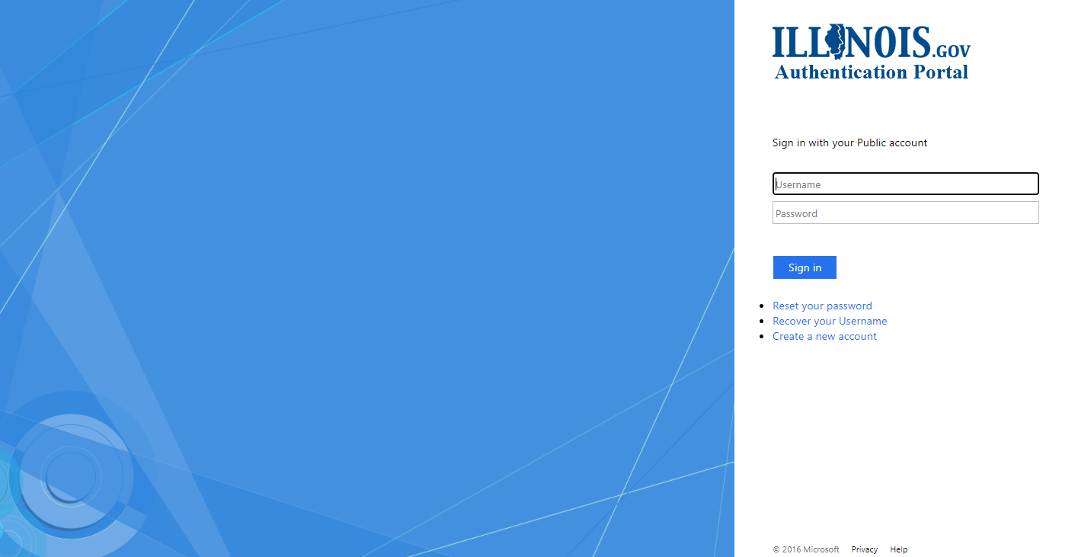
It will bring you back to this page

Slide 32
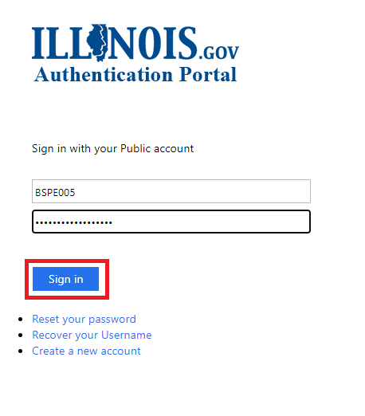
Enter your login information and click Sign In

Slide 33
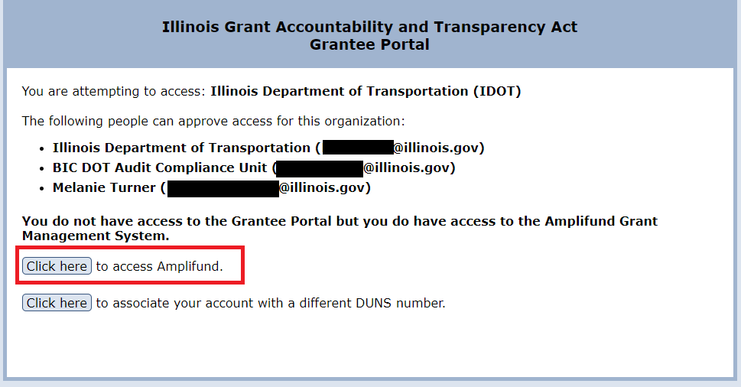
This is what you will see when you login. Click on the Click here button to access Amplifund.

Slide 34
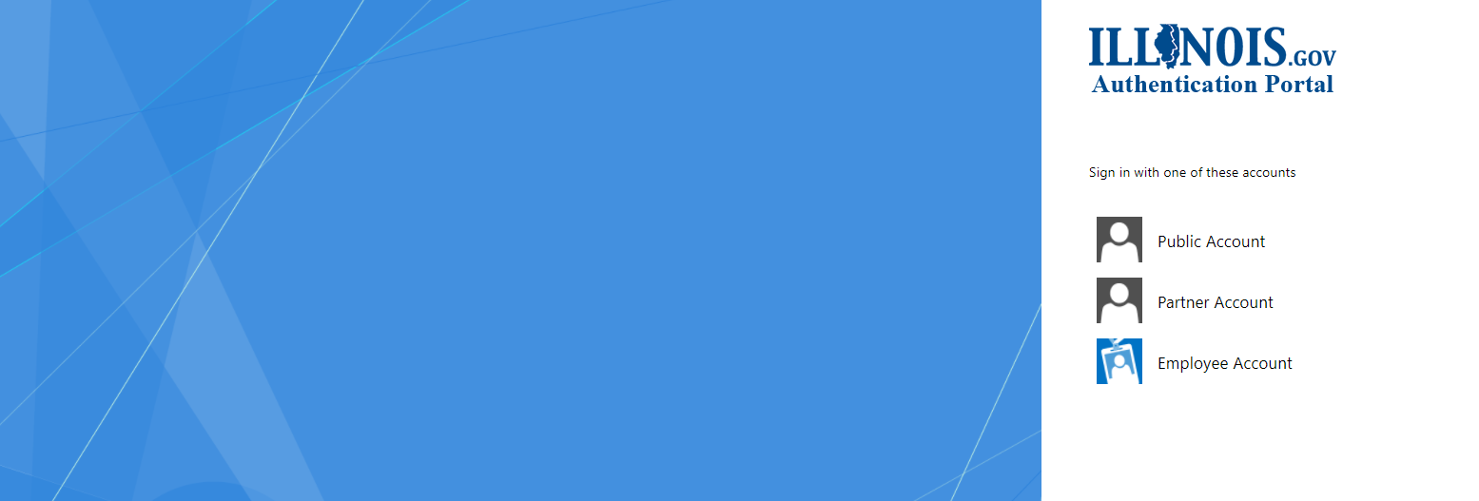
This is what you will see appear

Slide 35
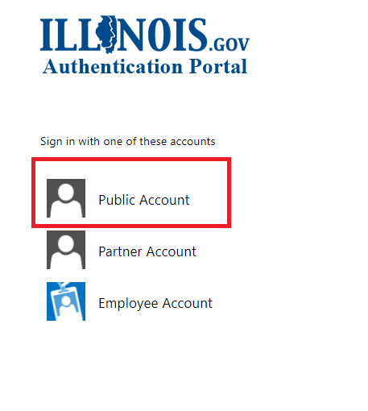
Select the Public Account option

Slide 36
Enter your login information again and click Sign In

Slide 37
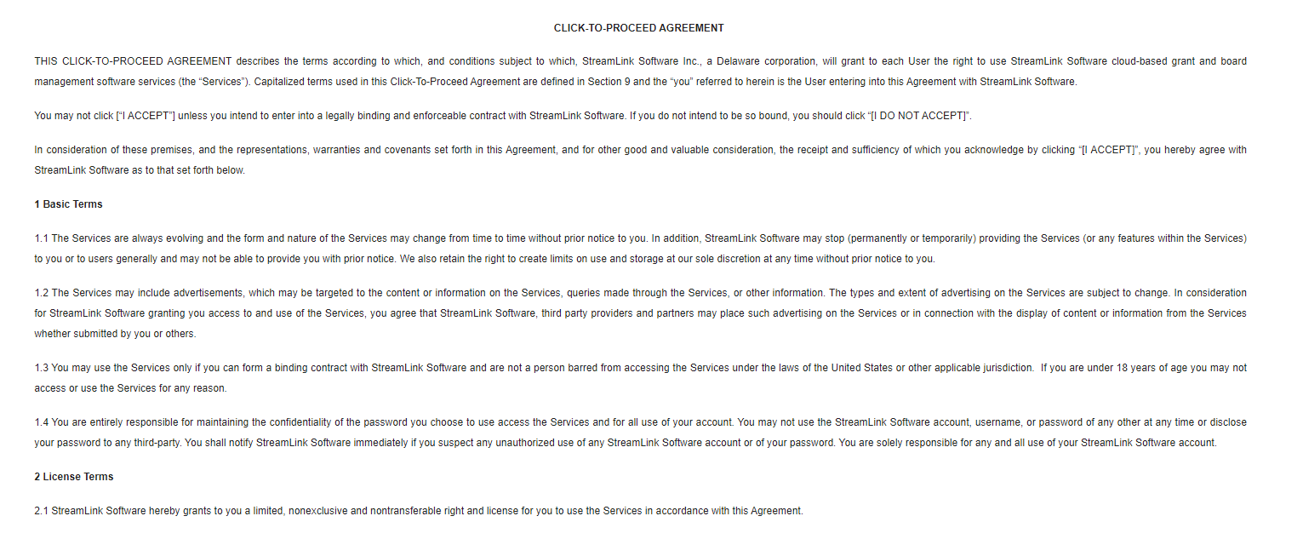
An Agreement will appear. Read through it.

Slide 38
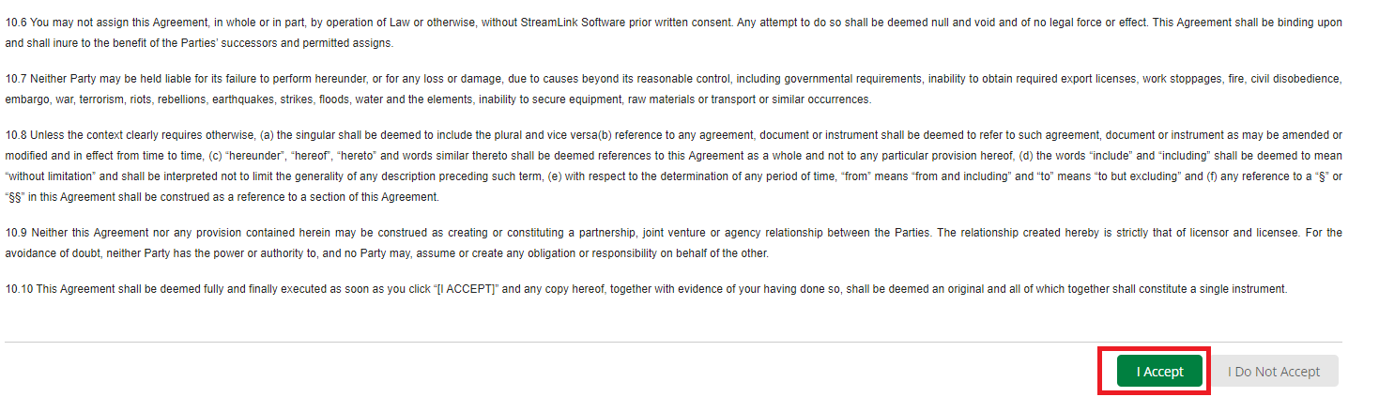
At the end of the Agreement, click on the I Accept button

Slide 39
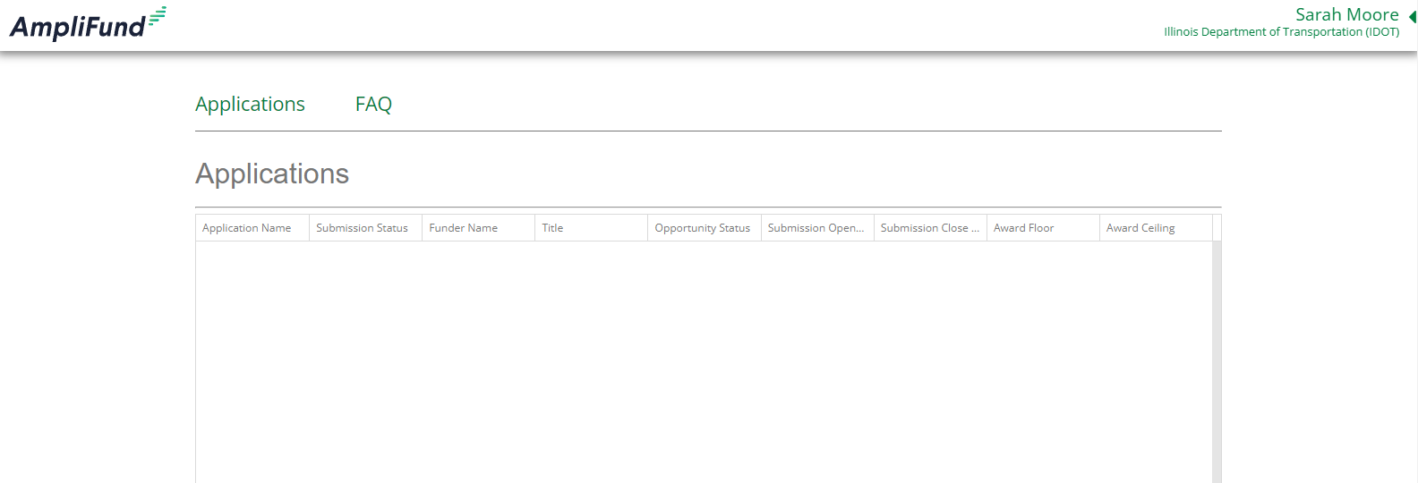
You are now in Amplifund.

Slide 40
Great! I’m in Amplifund! But how do I actually find grant opportunities?
See the Locating Notice of Funding Opportunities (NOFO) in Amplifund for more information.

